Slide 1
2021 National Jamboree
3/1/2020
Mikel White, mikeljwhite@gmail.com 469-865-9410
Character is created when you achieve more than you thought possible

Slide 2
So what happens at the Jamboree
Zip lines
Canopy tours
Challenge courses
Mountain biking
13 acres of shooting sports ranges, including The Barrels (shotguns, rifles, and pistols) and The Bows (archery)
Bouldering and rock climbing in the largest man-made climbing area in the world
Kayaking
Skateboarding
BMX
ATVs
STEM activities
Camping
Patch trading (which gets kinda crazy)
Leadership Heights program (new for 2021)

Slide 3
Promotional Video

Slide 4
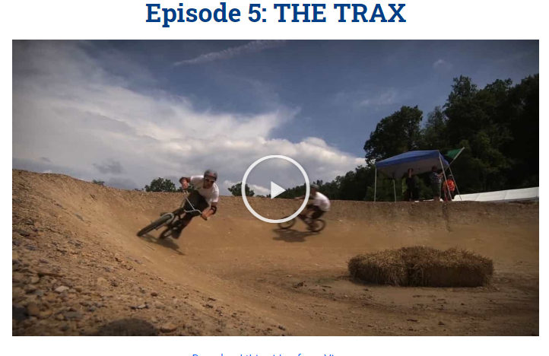
Jamboree venues

Slide 5
Circle Ten Trip
Jamboree admission and perks
Duffle bag, day pack, neckerchief, patch
Airfare and one checked bag
All meals
All lodging
Private uniformed security personal on duty all night in hotels – each floor
Bus transportation including DC tours
One day of touring will be via DC Metro
Adult leaders in each troop
Council leaders traveling with contingent
Professional travel service coordinator
Trip insurance
Itinerary
7/17 Air travel to NYC
Touring, spend night near Time Square
7/18, NYC, bus to DC, tour DC
May choose to go through Philidelphia
7/19, tour DC
7/20, tour DC
7/21, leave DC for Jamboree
7/21-7/30, Jamboree
7/30, Depart for DC on bus, tour DC
Possibly post jamboree white-water rafting, tour of Monticello
7/31, Air travel from DC to Dallas
*Short trip has air travel to DC on 7/20 and follows the rest of the itinerary

Slide 6
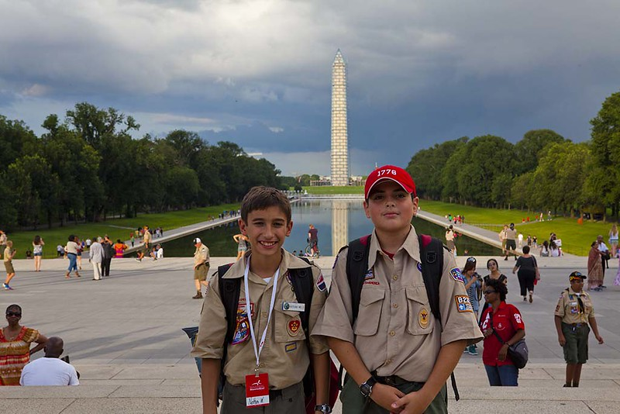
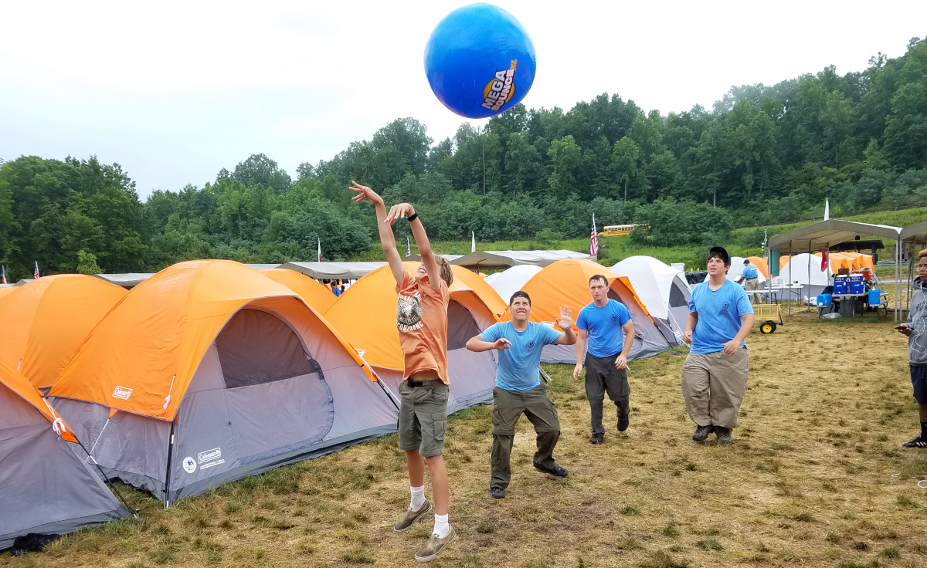
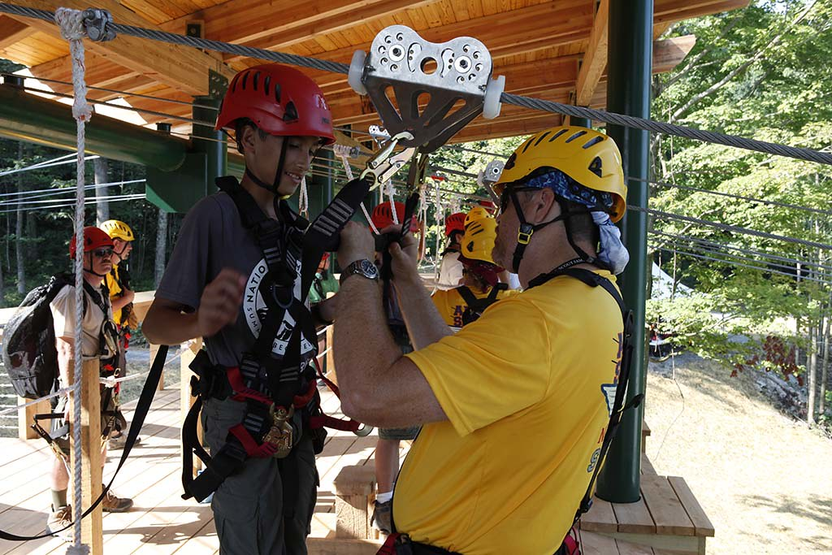
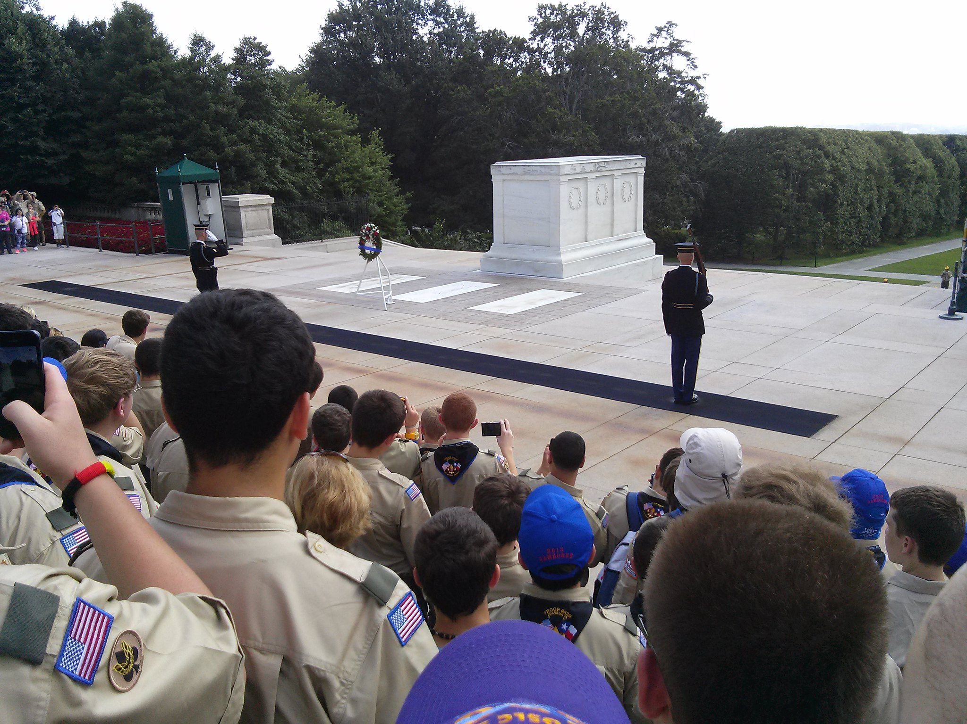
Photo’s – past videos
https://www.youtube.com/watch?v=2w4PRutU-Dw
https://www.youtube.com/watch?v=keU8PM7ZvXk

Slide 7
Things to remember
$300 Deposit, 3/7
$820 ($550) 1st payment, (3/7 - 5/7)
$820 ($550) 2nd payment, 5/7 - 9/7)
$820 ($550) 3rd payment, (9/7 - 1/14/21)
$640 ($550) final payment, (1/14 - 5/14)
Note: Once payment due date is past, previous and current payment must be made
Long trip 7/17/21 – 7/31/21 ($3400)
Short trip 7/20/21 – 7/32/21 ($2500)
Scholarship applications due by April 30th 2020
Must sign up through jamboree sight and council sight
Jamboree signup at https://jamboree.scouting.org/
Council signup at https://scoutingevent.com/571-2021jambo
Sign up today for the scouting trip of a lifetime

