Slide 1
Black pug to Scoutbook import process
Not as easy as it looks
Jeremiah Bybee
Camp Alpine Camp Commissioner

Slide 2
This show is intended to give a BASIC outline to the process of importing Camp Alpine 2019 Summer Camp Data from Blackpug, to Scoutbook
This process may be similar for other 3rd Party software platforms, but as it is not “officially supported” no promises or guarantees as to this process are made, no tutorial for third party softwares will be made by Camp Staff
The process is not automatic, or nearly as streamlined as originally thought
This process will not update Base Camp activities, except the First Aid and Fire Safety Merit Badges, all base camp activities will need to be manually entered one the spreadsheet is received from Camp Staff.
Whoever imports the data into Scoutbook will show as the merit badge counselor that signed off the activities
We suggest putting a “note” into the merit badges areas in Scoutbook that reads something like “Imported on 7/14/2019, Camp Alpine 2019” for each imported badge or set of requirements

Slide 3
LOG IN TO https://scoutingevent.com/802-CampAlpine2019 Click on “View Activity”

Slide 4
Select the camp alpine week you attended/need to import data from

Slide 5
Click on “More” drop Down Select “REPORTS”

Slide 6
Scroll down approximately 2/3 of the way to the bottom – find the “Scoutbook Export” option and click the link to install the feature assistant extension for your browser
***NOTE: ONLY
FIREFOX AND
CHOME ARE
SUPPORTED FOR
THE SCOUTBOOK
FEATURE EXTENSION
TOOLBAR***
CHROME USERS CLICK HERE
FIREFOX USERS CLICK HERE

Slide 7
After you’ve installed the feature extension, navigate back to the reports page Scroll back to “scoutbook export” and download the .csv file
***NOTE: Take notice
of the file name, and
where the file is being
downloaded***
CLICK HERE
***NOTE: Do not alter the file name, nor the contents of the file, as it may effect import status***

Slide 8
After you’ve installed the extension – log into scoutbook
This icon near your
Address bar means
your extension is
installed and
running

Slide 9
Use your “MY UNIT” DASHBOARD OPTION
***NOTE: GOING
THROUGH “MY FAMILY”
INSTEAD OF “MY UNIT”
MAY REDUCE
FUNCTIONALITY OF THE
IMPORT PROCESS***

Slide 10
You now have an option to “import black pug data”…. Click that

Slide 11
Choose the file based of the previously noted file name and location, select “merit badge req’s” and “Complete merit badges” toggles then select “import file”
***NOTE: We suggest letting a second leader go in and “approving” the merit badges, as the badges and requirements will be signed off by whoever is logged into scoutbook during the importing process***

Slide 12
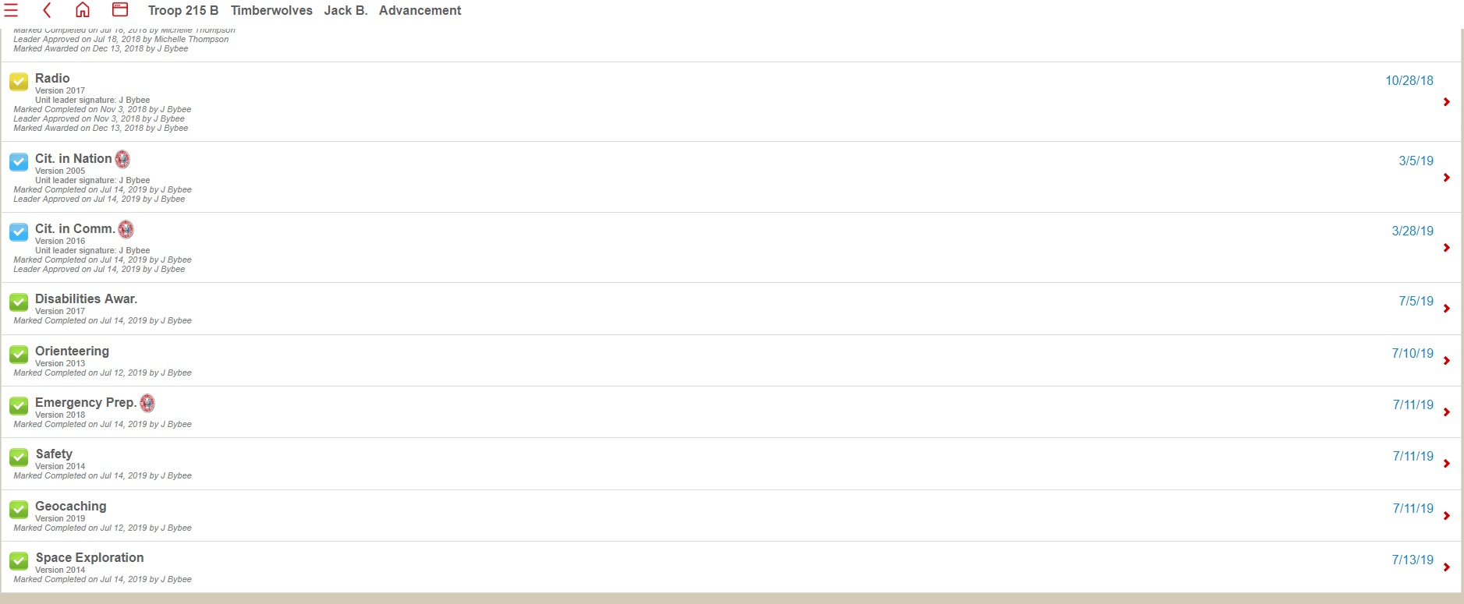
YOUR DONE!
Go in to each scout and verify import completion
This process will not eliminate previous partial data, it will simply write over the top of old data and add to it

Slide 13
Black pug to Scoutbook import process
Not that hard either
Questions?
Contact jeremiah.bybee@gmail.com

