Slide 1
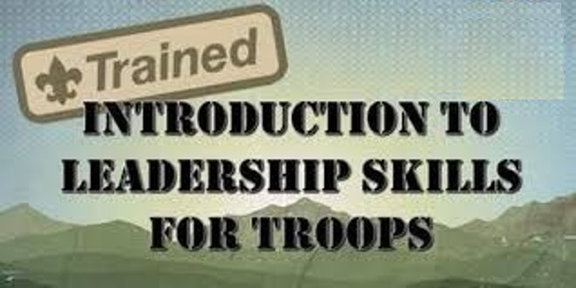
Where: Camp Toyuaha
When: 29-30 March 25
Time 0800 AM
The purpose of the ILST course is to teach Scouts with leadership positions about their new roles and how to most effectively reach success in that role. It is intended to help Scouts in leadership positions within their troop understand their responsibilities and to equip them with organizational and leadership skills to fulfill those responsibilities. ILST is the first course in the series of leadership training offered to Scouts and is a replacement for Troop Leadership Training. Completion of ILST is a prerequisite for Scouts to participate in the more advanced leadership courses National Youth Leadership Training (NYLT) and the National Advanced Youth Leadership Experience (NAYLE).

