Slide 1
HMSR
Second Webinar 2-19-2024

Slide 2
Happy Presidents Day

Slide 3
Merit Badge Schedule
See Attachment in Black Pug or screen share

Slide 4
Merit Badge List
Handicraft Program Area (Hafer Lodge)
Pottery – Working with clay, campers will create using a potter’s wheel and kiln pots, figurines or sculptures. Pre-req’s 7, 8, Basic
Art – Drawing or artistic experience recommended. They will learn how to express their ideas and tell a story using pictures. Pre-req’s 6, Basic
Painting – Learn how to prepare different surfaces, what different paints are available, and which is best for the project you choose to paint. Moderate
Wood carving – This merit badge is not recommended for first year campers due to safety concerns. Moderate, bring Totin’ Chip Card
Open program: pulp and paper, basketry, leatherwork

Slide 5
Merit Badge List
Outdoor Skills/OA Village
Camping – Learn about camping skills and how to prepare for a campout. Requires a lot of written work and previous camping experience. Pre-req’s 4A, 4B, 5E, 8D, 9A, 9B, 9C, Moderate
Wilderness Survival – Build a shelter at camp and sleep in it one night. Bring a backpack and sleeping bag. Recommended for Scouts First Class or above. Pre-req’s #5 prepare and bring a small survival kit. DO NOT INCLUDE any matches or other fire-starting devices/materials. Moderate
Pioneering – Work on a project and splicing. Advanced
Orienteering – Set up and run an orienteering course and utilize your map and compass skills. Recommended to bring an orienteering compass. You will need to teach some basic orienteering skills to your troop. Pre-req’s 1, 2, 4, 6, Advanced
Fishing – Come and learn all about how to fish at our lake. How to make a lure, what’s the best bait and then catch your own fish. We have asked the fish to be cooperative, but this may require you to fish during open program to make your catch, Pre-req’s 7, Basic
Indian Lore – Learn about the early life Native Americans their games, tools, and foods. Pre-req’s 2, 4A, 5A, Basic

Slide 6
Merit Badge List
Ecology/Nature Lodge
Environmental Science – This is a badge that requires several hours of observing, writing, and experimenting. Maturity and a high level of concentration is required. Pre-req’s 1, 3E, 3F, 6, Advanced
Mammal Study – Take the opportunity to learn more about a chosen mammal or mammals and work on a conservation project. Pre-req’s 4, Basic
Geology – Explore and appreciate the Earth’s geological features and processes, by learning all about fossils, different types of rocks, and geologic events in our history. Pre-req’s 4, 5, Moderate
Forestry – Learn to identify trees and plants while exploring the roles they play in a forest’s life cycle. You will discover the resources forests provide to humans and understand why forest sustainability is important. Pre-req’s 5, 8, Moderate
Nature – An excellent introduction badge to nature that includes the study of plants, animals and soil. Basic
Soil & Conservation – Conservation isn’t just the responsibility of soil and plant scientists, hydrologists, wildlife managers, landowners, and the forest or mine owner alone. It is the duty of every person to learn more about the natural resources on which our lives depend so that we can help make sure that these resources are used intelligently and cared for properly. Pre-req’s 2D, 5A,

Slide 7
Merit Badge List
STEM
Space exploration – Learn all about space exploration, and then build and launch your very own model rocket! Moderate.
Astronomy – Take advantage of Hawk Mountain’s open sky and search for stars. This merit badge will hold some extra class sessions in the evening. Pre-req’s 5, 8A, 9, Advanced
Weather – Meteorology is the study of the Earth’s atmosphere and its weather and the ways in which temperature, wind, and moisture act together in the environment. In addition to learning how everyday weather is predicted you will also learn about extreme weather such as thunderstorms, tornadoes, and hurricanes, and how to stay safe. Pre-req’s 10, 11, Moderate
Digital technology – Learn about the history, impact, and applications of digital technology, as well as address safety, security, and ethical considerations in the digital world. Pre-req’s 5B, and 8C, D or E, Moderate
Robotics – This badge is designed to provide you with an understanding of robotics, including safety considerations, programming, designing and building robots, and exploring the ethical aspects of robotics. Pre-req’s 6A, 6B, 7, Moderate
Mining in Society – What is the role of mining in our society, its history, impact on the community, and the various aspects of mineral and mining methods. Moderate
Open Program: radio

Slide 8
Merit Badge List
COPE/Climbing
First Aid – Improve your first aid knowledge. Pre-req’s prepare to demonstrate first aid requirements for Tenderfoot, 2nd Class, and 1st Class, 5A, 5B, Moderate
Climbing – This is a physically challenging badge and requires a strong knowledge of knots, first aid, and safety. Bring clean/dry non-loose-fitting clothing. Recommended for a 3rd year Scout, Advanced
Search & Rescue – Learn how to plan and execute a search and rescue operation before practicing a hasty search scenario. Moderate
Shop
Welding – The requirements of this badge are designed to provide you with an understanding of welding, including safety practices, equipment use, and welding processes. Use what you have learned on your own projects. Pre-req’s 8. Advanced
Metal Work – Will learn about metals and make a project in their preferred technique. Requires physical strength and endurance. Advanced
Plumbing – Want to know how to fix simple plumbing problems. Learn about safety practices, use of tools, and materials while tackling some plumbing projects here at camp. Pre-req’s 8. Moderate

Slide 9
Merit Badge List
Shooting Sports
Rifle – A challenging merit badge. Required to shoot qualifying scores with a .22 caliber single shot, bolt action rifle. Extra time may be needed at the range to achieve the required scores. Moderate
Shotgun – This is a time consuming and challenging badge. You may need time outside of class to qualify. Participation is at the discretion of the range safety officer, as needed. Must be 13 years or older. Advanced
Archery – This is a difficult badge to master. Be prepared to spend a large portion of your open program time at the range to qualify. Requires physical strength and endurance. Pre-req’s N/A, recommended for older campers 13 and up..
Open Program: Cowboy Action, muzzle loaders, Leader vs SPL shoot out

Slide 10
Merit Badge List
Aquatics
Swimming – Pre-req’s 2, Moderate, must complete BSA swimmer test at camp.
Kayaking – Pre-req’s 2, Moderate, recommended for a 2nd year camper, must complete BSA swimmer test at camp.
Lifesaving – With the rest of your class learn and practice the skills and knowledge necessary for lifesaving situations. Pre-req’s 2A,
Canoeing – Recommended for a 2nd year Scout, moderate, must complete BSA swimmer test at camp.
Open Program: Boating all types, stand up paddle board, wagon wheel, swimming

Slide 11
Pathfinder
This is our first-year camper program.
New this year we will focus on advancements and team building.
The program will run just in the morning so they can pick their merit badge to earn Block 4 & 5.
Open Program
Kittatinny Neckerchief

Slide 12
Trading Post
Keep an eye out for our designs for pre-order

Slide 13
CIT Program
This program is focused on preparing the next generation of camp staff.
3-week immersive program designed around targeted skill development and personal growth.
Structured training as a camp counselor
Be 14 at the time the program starts
Be registered in a Scouting program.
CIT’s will check in on Sunday and go home each Saturday morning.
They will be able to take merit badges the first week.
Second week is dedicated to training that will help them become better leaders.
Third week focuses on internships in different program areas of camp.
The last requirement: Be energetic, eager and ready for fun!.

Slide 14
Friday Trips out of Camp
Registration will be Black Pug
Each week will go somewhere different.
Campers must have completed their merit badges to participate.
Hershey Park Week 1, Knoebels Amusement Park Week 2, Lake Tobias Week 3, Hershey Park Week 4, Gettysburg Week 5
Meetings will be set up in May to discuss final locations, transportation and cost.

Slide 15
Adult Training and Fun
New position this summer Adult Program Coordinator
Will be posting closer to camp what training and programs are available.
Sign up on Black Pug.

Slide 16
Meal Service
Upper Crust
Meal Schedule –
Breakfast to go in units
Lunch Grab and Go from the Dining Hall.
Dinner in the Dining Hall
Dietary Form will be a fillable form that can be sent directly to me.
Any questions please feel free to call at 570-754-7552 or email at michele.Bement@scouting.org

Slide 17
Upcoming
February 24th Hiring Fair at HMSR 10-2pm.
March 1st - Initial deposit of $100 per camper and adult due. CIT program open.
March 17th ? Webinar
April 1st - 2nd payment of $150 per camper and $50 per adult due.
April 14th Webinar. See Black Pug Calendar
April 21st – Leaders Meeting at HMSR, 2-5PM Zoom option will be offered
May 1st - completed Campership Applications due
May 15th - balance due payments are due
May 16th - price goes up per person $25
May 19th – final camp webinar

Slide 18
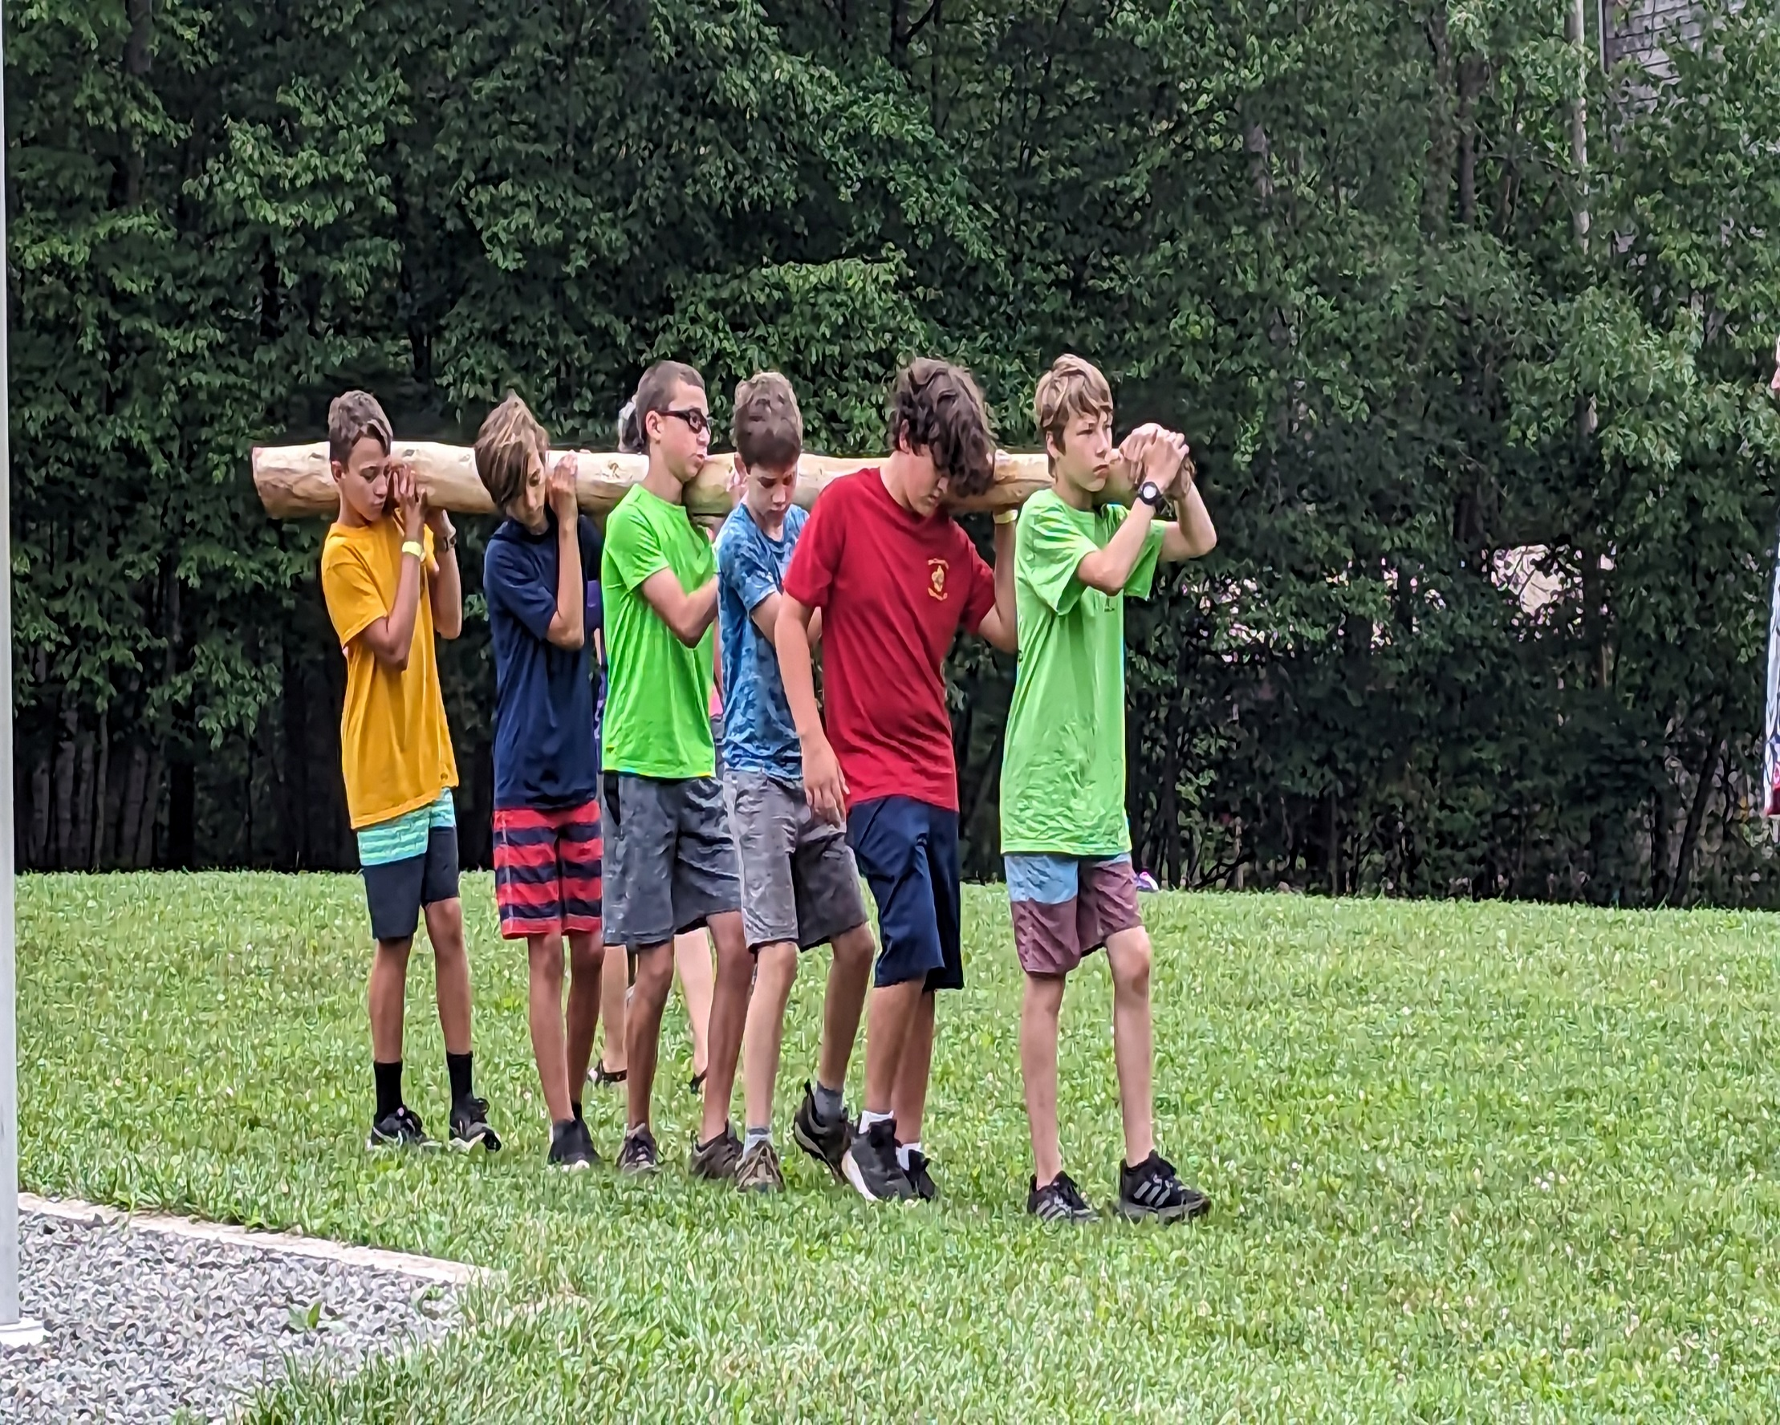
HMSR
Contact:
Michele Bement
Council Program Director
Michele.Bement@scouting.org
570-754-7552

