Slide 1
HMSR
First Webinar 1-29-2024

Slide 2
What parents said
Parents top 10 things in order of importance:
Building self-confidence
Building self-reliance
Gaining new skills
A trusted Adult with my child
Being outdoors
Merit Badges/Advancements
Have something to do
Being with their troop
Attending with friends
Cost of attending
List in order of the best things your Scout got out of the Summer Camp experience?
Self-reliance
Earning merit badges
Outdoor activities
Fun
Self-confidence
New skills
Friends
New Experiences

Slide 3
What kids said.
Kids top 10 things in order of importance
To have fun
Work on merit badges
To be outdoors
To be with my troop
To learn & practice outdoor skills
To build leadership skills
To work on rank advancement
To meet other Scouts not in my troop
To have something to do
Why did you give a camp an A+ or an A
Fun
Great staff
Good camp – general
Good merit badge instructors
Good food
Lots to do
Clean facilities
Very organized camp

Slide 4
So, Now What?

Slide 5
A New Path
We are thrilled to announce that we are starting on a new path!
Our team is looking forward to working collaboratively to achieve success.
Thank you to everyone who has supported us in the past.
Your continued encouragement means a lot, and we are ready for the exciting challenges ahead.
We hope you are also!
If you know of a best practice you think we should try, we’d love to hear it.

Slide 6
Camp Schedule
Tentative Daily Schedule
6AM Reveille
6:15AM Early morning activities i.e. Polar Bear and Grizzly Bear
7:30AM Breakfast with morning flags immediately following
8:30AM-12:20 PM Merit Badge Blocks x4
12:30PM Lunch
1:40PM Merit Badge Block 5
2:40PM Open Program
6:15PM Evening Flag
6:30PM Dinner
7:45PM Evening Program

Slide 7
Evening Program Sample
Older Scout Cracker Barrel
Wood Badge Cracker Barrel
OA Ceremonies
Drive-in Movie
Staff themed activities
All camp activities
Scoutmaster Belly Flop and SPL Cannonball Contest

Slide 8
NEW
Food Vendor
More FUN!!
Camp Games volleyball, gaga, disc golf etc… follow SAFE guidelines
New staff living site
Leaders Lounge
Fees
Possibly IOLS for adults as well as other trainings, still working on this.
Commissioner time with Troops
Day Trips
Revitalized Customer Service

Slide 9
CIT Program
3-week program – pick any 3 weeks during camp.
Campers must be 14 – 15 years old.
2 Merit Badges a week plus a special “outing”
If staff positions are open CIT’s can apply for those positions for Weeks 4 and 5
Cost is $50 per week
Added Perk – In 2025 you can request the program area you want and we will do everything we can to meet that request.

Slide 10
Pathfinder
This is our first-year camper program.
New this year we will focus on advancements and team building.
The program will run just in the morning so they can pick their merit badge to earn Block 5.
Open Program
Kittatinny Neckerchief

Slide 11
Trading Post
Make your own shirt will be back.
Branding –
Tee-shirt pre-orders
HMSR Swag

Slide 12
Staff
International Staff
Other States
Other Councils
Looking for enthusiastic staff in all program areas.
Don’t have the whole summer? That’s ok.
Adults and Leaders do you have skills you want to share?
Whoever is happy will make others happy. --Anne Frank

Slide 14
Registration
Registration is open on Black Pug
February 19th, 7PM Webinar rolling out Merit Badges, how to maneuver in the Black Pug System, and Friday day trips.
Pay prior to merit badge sign up. If you don’t put each Scout in and pay the deposit the system will not let you choose merit badges.

Slide 15
Upcoming
Open House Saturday February 17th, 10-2pm
February 19th Webinar information on Black Pug Calendar.
March 1st - Initial deposit of $100 per camper and adult due. CIT program open.
April 1st - 2nd payment of $150 per camper and $50 per adult due.
April 14th Webinar. See Black Pug Calendar
April 21st – Leaders Meeting at HMSR, 2-5PM Zoom option will be offered
May 1st - completed Campership Applications due
May 15th - balance due payments are due
May 16th - price goes up per person $25
May 19th – final camp webinar

Slide 16
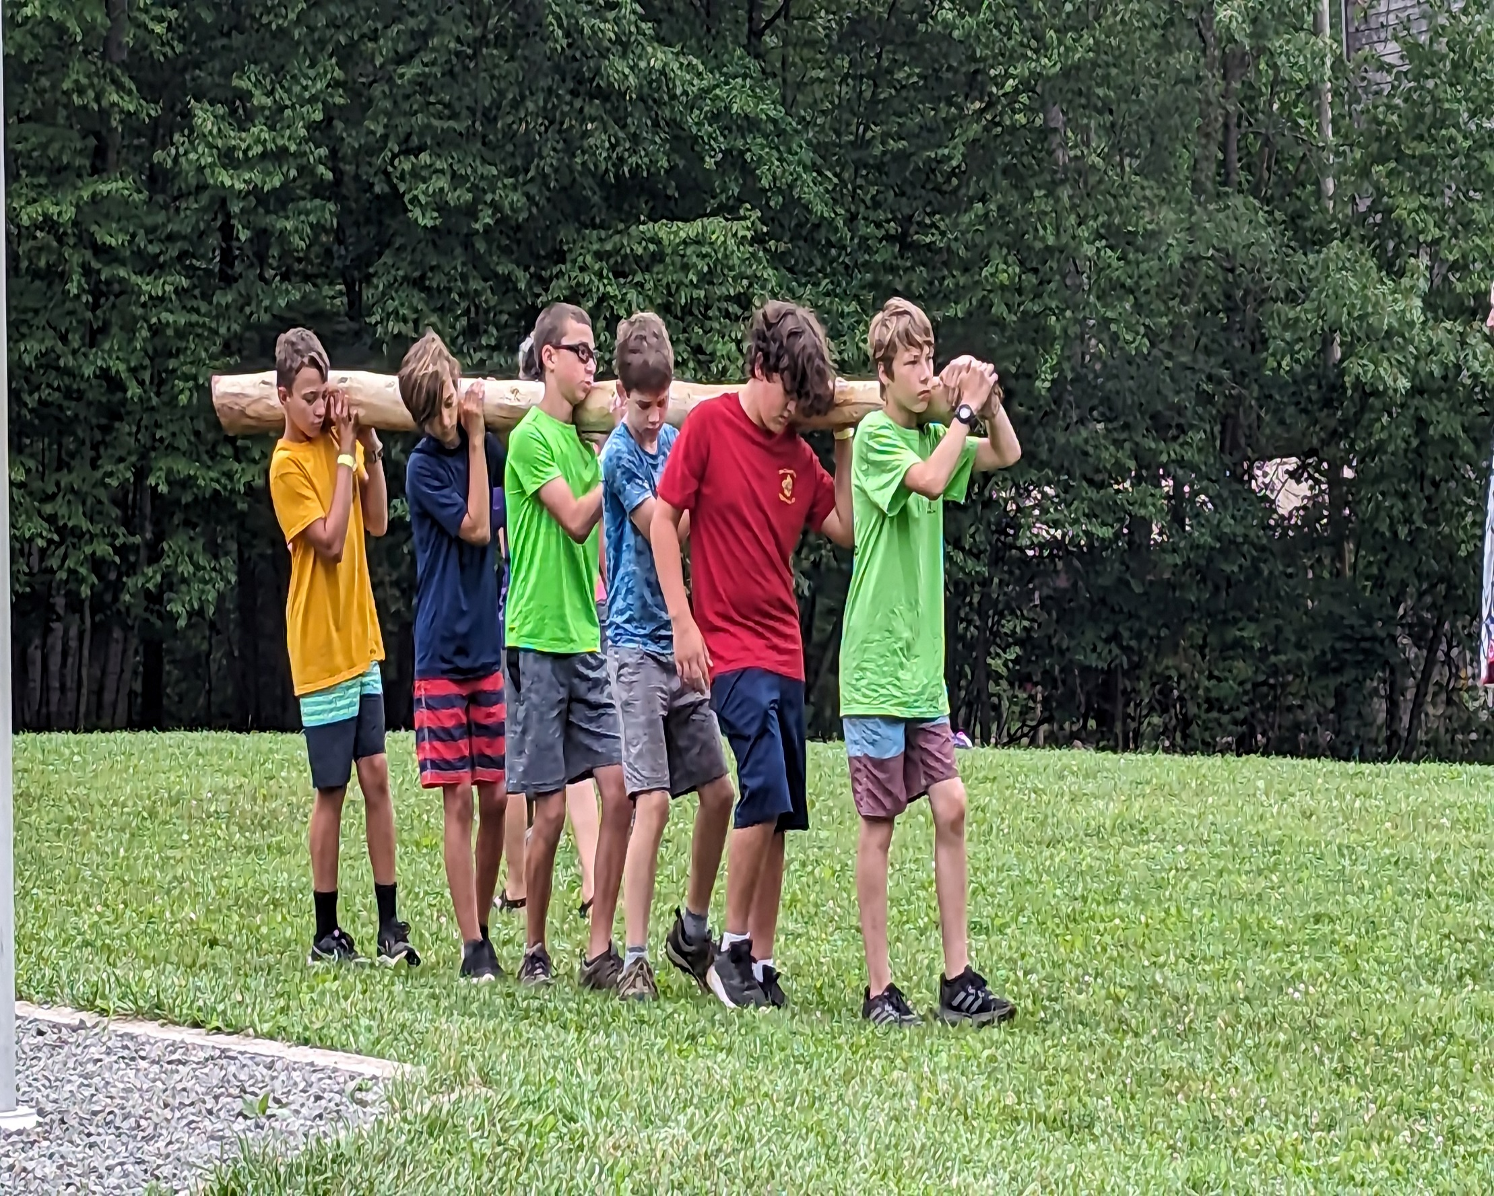
HMSR
Contact:
Michele Bement
Council Program Director
Michele.Bement@scouting.org
570-754-7552

