Slide 1
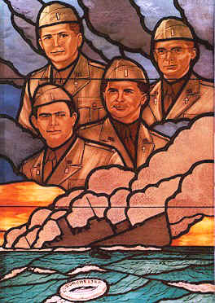
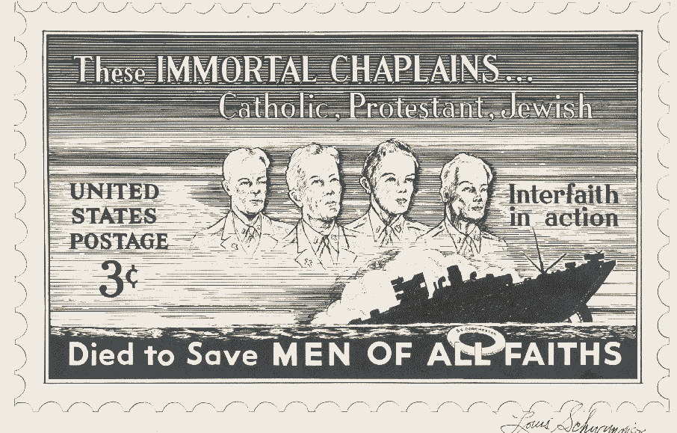
Save The Date
Please plan to join Troop 530 and other local organizations in an interfaith patriotic memorial service honoring the sacrifice of The Four Chaplains. These four Army chaplains of different faiths organized the evacuation of their troop transport when it was struck by a torpedo in the frigid waters of the North Atlantic just after midnight on 3 February, 1943. These brave men of God were then last seen, arms linked, leading those left behind in prayer as they sank beneath the waves.
When: 2PM, Sunday, 2 February 2025
Where: Incarnation Church
Duration: Approximately 25 minutes

