Slide 1
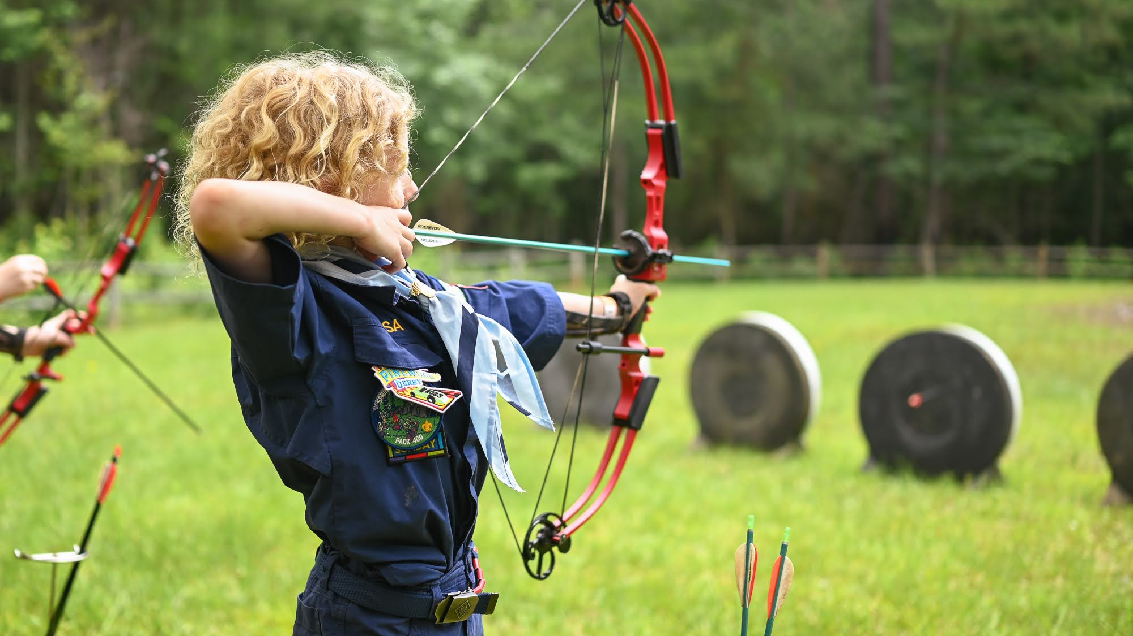
Summer Cub Resident Camp
Summerween
Pre-Camp Presentation

Slide 2
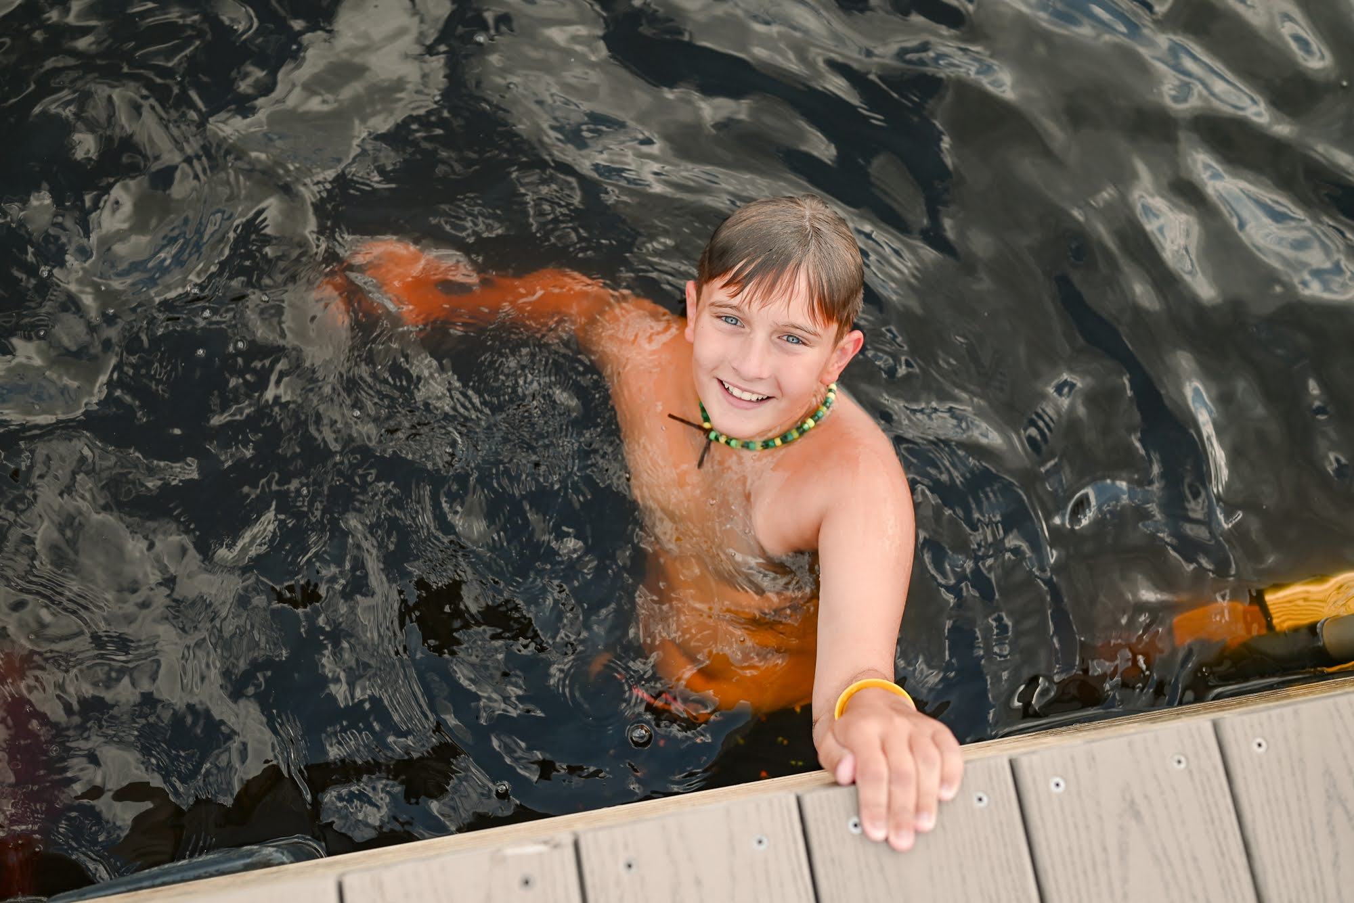
Check-In/Opening Day
Arriving to Camp
  Drive to your Campsite (Maple, Holly, Red Cedar)
  Unpack and set up your home for the short week!
Swim Tests
  2PM – 5PM
  Ability Group
Health Checks – Grand Lodge
Leader's Meeting – 5:30PM
Carnival Night!

Slide 3
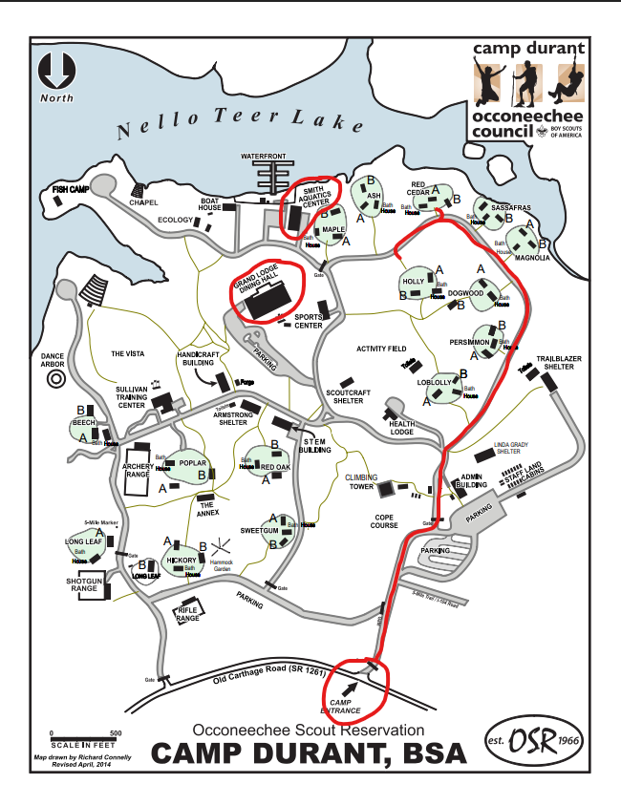

Slide 4
Campsite Assignments
Holly A
Pack 787, 356, 352, 314, 347, 511, 202
10 Adults / 14 Youth
Holly B
Pack 391, 10, 451, 924
8 Adults / 10 Youth
Red Cedar A
Pack 421, 28, 39, 820
6 Adult / 7 Youth
Red Cedar B
Pack 438, 211, 400, 449
10 Adults / 13 Youth

Slide 5
Check-In Times
1:00 PM
Holly A
1:30 PM
Holly B
2:00 PM
Red Cedar A
2:30 PM
Red Cedar B

Slide 6
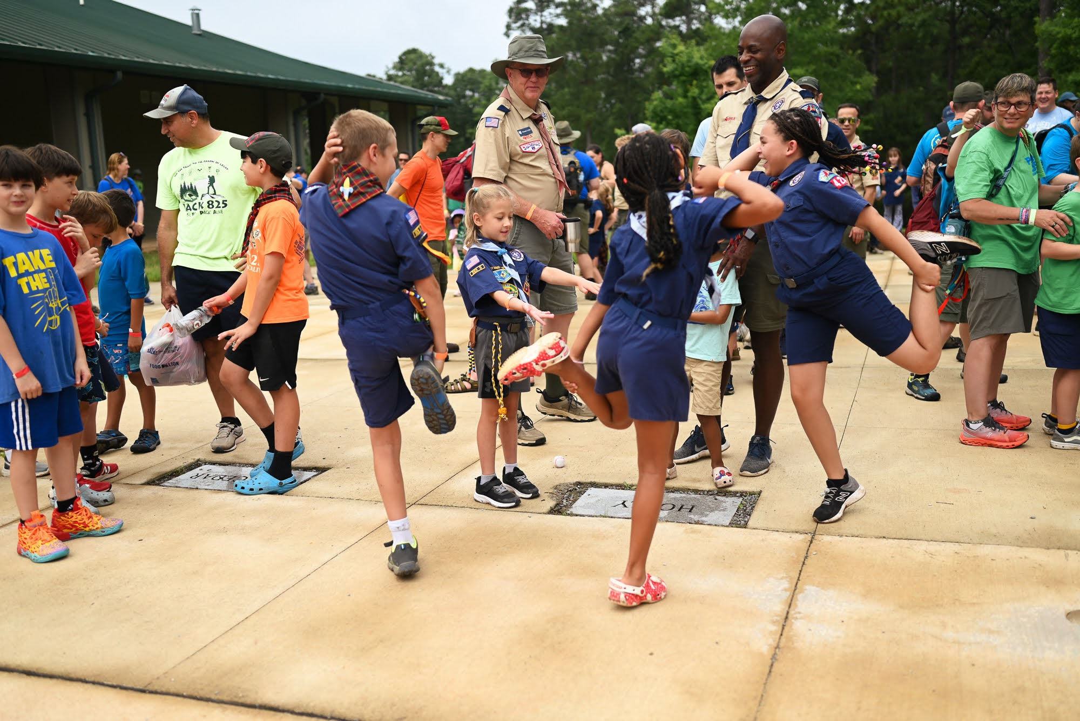
Daily Schedule
8:00 AM – Morning Assembly
8:15 AM – Breakfast
9AM-10:15AM – Session 1
10:30AM-11:45AM – Session 2
12:15PM – Lunch
1PM-1:50PM – Siesta
2-3:15PM – Session 3
3:30PM – 4:45 – Session 4
5:00PM – 5:45PM – Open Program
6:15 PM – Evening Assembly
6:30 PM - Dinner

Slide 7
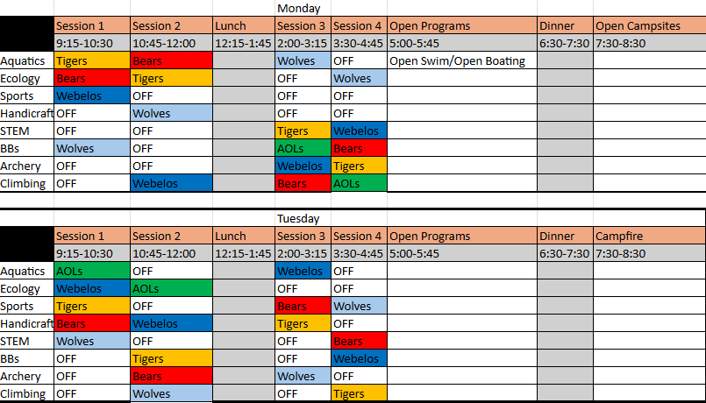

Slide 8

BALOO
Instructor: Cynthia Abel-Brown
Limited Availability: 10 Spots
Sign-up on BlackPug ($10)
Times:
Monday 9:30 AM – 12:00PM; 2:00PM – 5:00PM, 7:00PM-9:00PM
Tuesday 9:30AM – 12:00PM

Slide 9
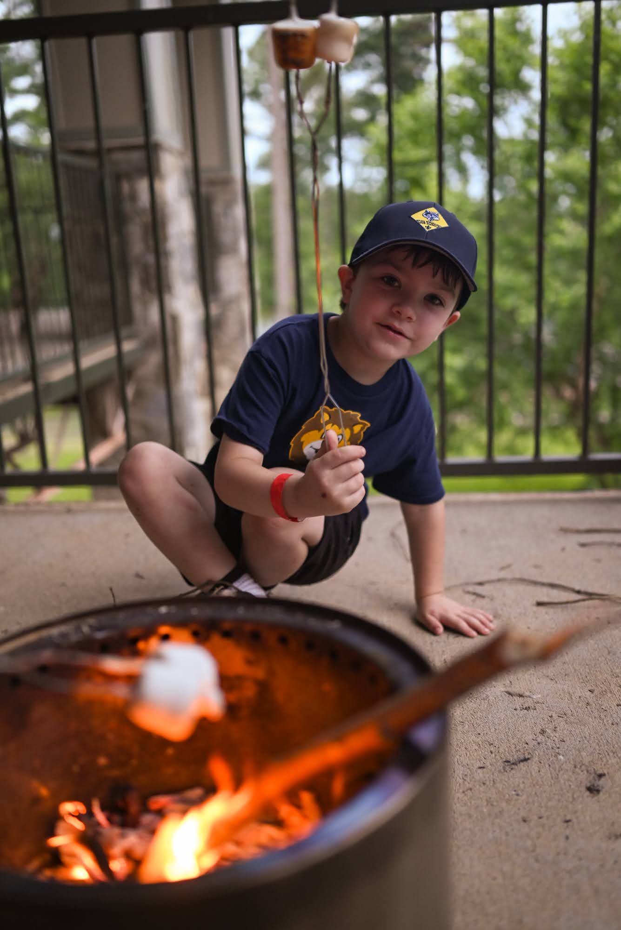
Trading Post & Grill
Hot Food Available
Open during the week
Hours will be posted upon arrival

Slide 10



Theme: Summerween

Slide 11
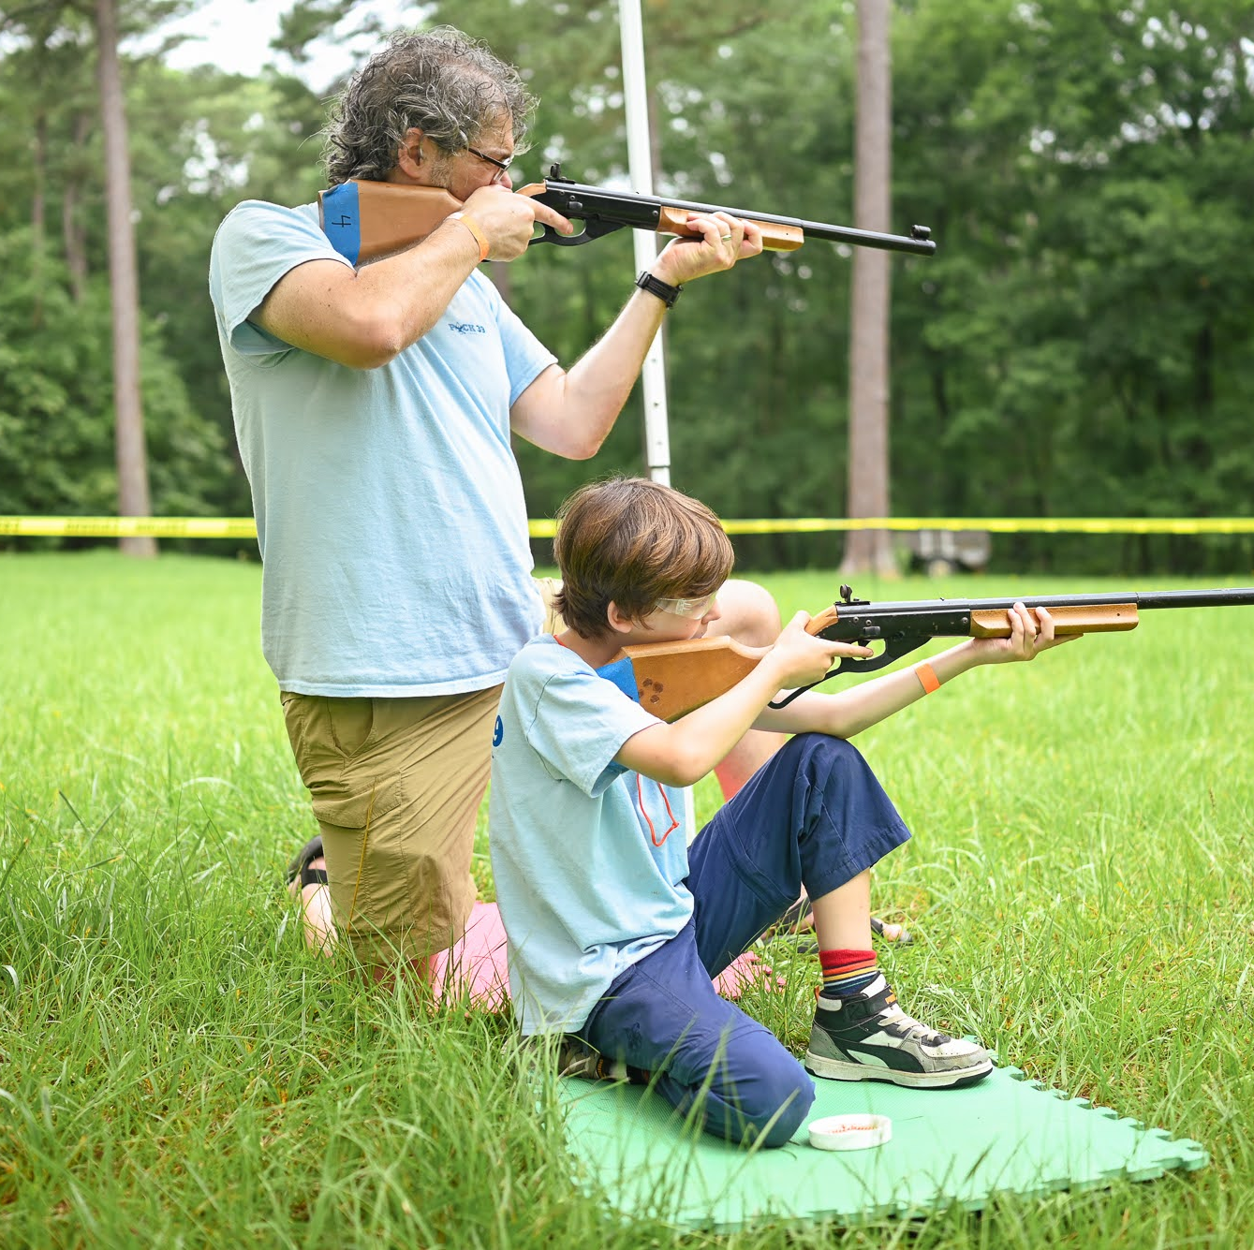
What to Bring
6 Essentials
Uniform
Activity Clothes
Bathing Suits
Towels
Water Shoes & Walking Shoes
Toiletries
Health Form
Etc
  More extensive list on Pg. 22 of Leader's Guide

Slide 12
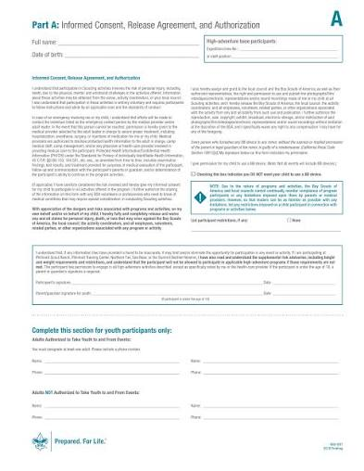
Health Forms & Medicines
A & B Health Form
  Camp is only 68 hours!
https://www.scouting.org/health-and-safety/ahmr/

Slide 13
Questions?
Email: campdurant@gmail.com
Phone: (910)948-2382

