Slide 1
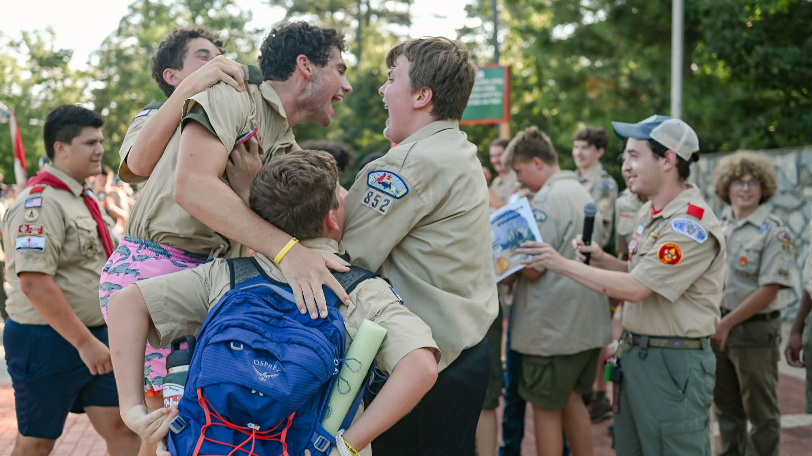
Camp Durant
Final Pre-Camp Leader's Meeting
June 11th, 2026

Slide 2
Key Objectives:
Receive updates on program additions and spaces
Final notes about Black Pug accounts
Final key tips for preparing for your week at Camp Durant
Quick rundown of Sunday Check-In
Updates from YOUR Program team!

Slide 3

Camp Director Updates:
Black Pug Accounts
  Zeroed balance
  Changes to participants can be done through Black Pug pages
  Changes to schedules (MB schedules for scouts and leader's training courses) can be done through your account up to a week before your arrival.
  Refund Policy – Page 8
Dietary Needs/Special Diets
  Found in Black Pug registrations (either through primary login or through parent portal if set up.
Early Arrivals – email: erin.shiflett@scouting.org

Slide 4
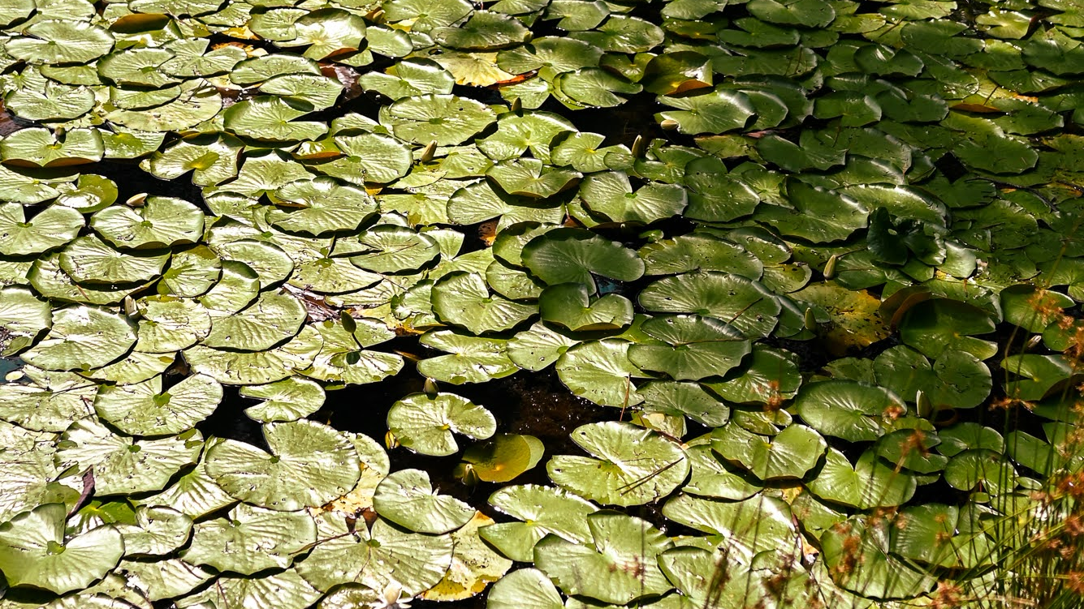
Camp Director Updates:
Program Additions
  Scouting Heritage (Week 1 ONLY) session 4 (2PM)
Permission Forms – Located in BP attachments
  General Permission Form
  Older Youth Programs Form
Health Forms
  ABC & Insurance Card
  Kept in Health Lodge
  Medicines
Unit Swim Checks
  Send to: campdurant@gmail.com

Slide 5
Camp Director Updates:
Week 1 Merit Badge changes will be held on Sunday ONLY (tentatively)
ATV
  Online class must be taken BEFORE coming to camp
  Permission forms
  All found on Black Pug attachments section
Trading Post & Grill
  Open all week
  Hours of operation will be located on camp schedules as well as posted on Trading Post and Grill doors.

Slide 6



2026 Patch Set

Slide 7

60th Anniversary Patch

Slide 8

Older Youth Programs
Spots still open for all weeks
  Week 1: 2
  Week 2: 5
  Week 3: 6
  Week 4: 6
Cost: $50
Must be 14 and older
All week adventures!

Slide 9

FLYER AVAILABLE ONLINE (BP ATTACHMENTS)

Slide 10
Administration Corner
Letters to campers
Packages
Beluga Club
  Set-up for Scoutmaster/Leader use
  Note: Scoutmaster meeting @ 9:30AM, SPL meeting @ 1PM, First Aid/CPR/AED on Thursday 2-4PM, Thursday night advancement report
  Other locations to access Wi-Fi
    Sullivan, Grand Lodge, STEM (PLEASE CHECK WITH AREA DIRECTORS BEFORE WORKING IN A PROGRAM AREA)
    Wi-Fi vouchers for Scoutmasters/Leaders ONLY
Use of your Black Pug account while at camp
  Check in on advancement
  Pay outstanding balances

Slide 11
Commissioner's Corner
Check-In Sunday
  Check for campsite time (Leader's Guide page 15)
  Troop Trailers
  When you arrive...
  Camp Tour
    Immediately following check-in
    Recommended: Scouts pack a day pack with their swimsuit, towel, water, and anything they may need while on tour of camp
Site Guides
Check-Out Saturday

Slide 12
Check-In
1:00 PM
Red Oak, Dogwood, Red Cedar, Holly
1:30 PM
Sweetgum, Poplar, Maple, Sassafrass
2:00 PM
Loblolly, Ash, Magnolia, Persimmon
2:30 PM
Hickory, Beech, Longleaf

Slide 13
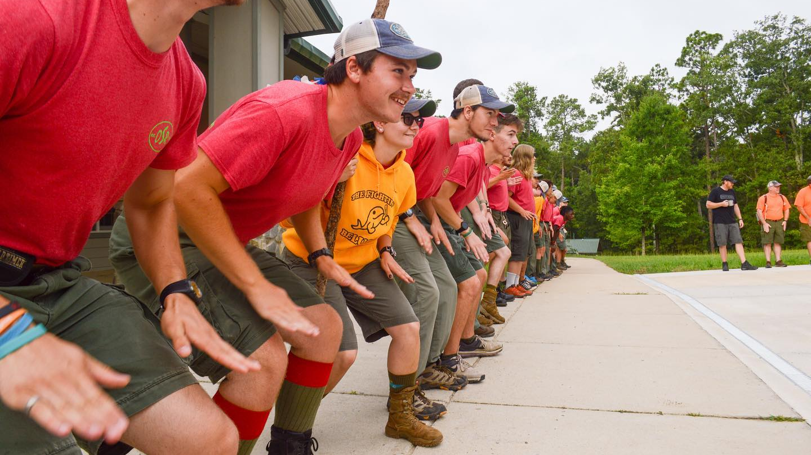
Program Director Updates:

Slide 14
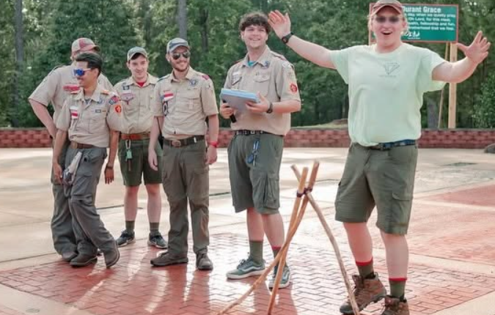
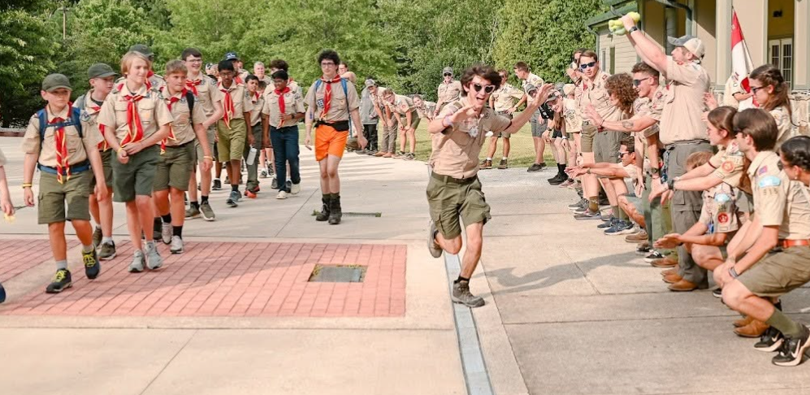
What to Expect
Youth-
Weather
Wildlife
Cheerful Service
Enthusiasm
Early Personal Growth
Trying new things
Meeting new people
HAVING FUN
Adults-
Leader's trainings
Opportunities for Personal Work
Homesick Campers
Working with Young Staff
TROOP THEMES

Slide 15
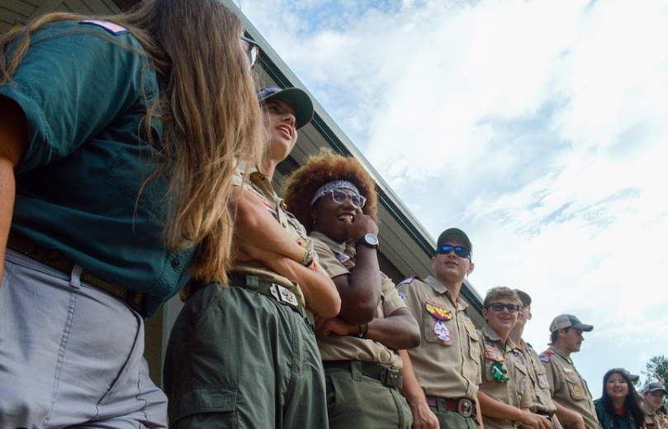
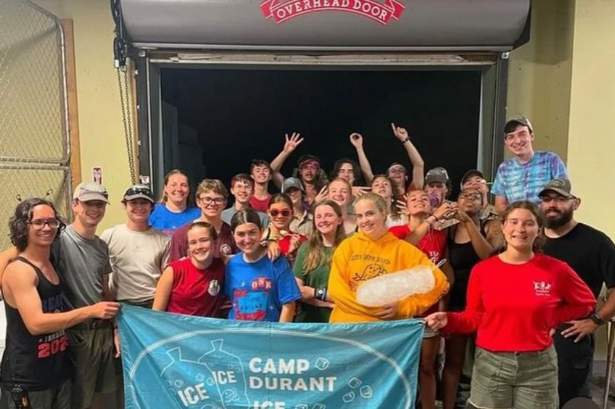
Schedule
8am: Flag Raising and Breakfast
9am-12:15pm: 1st, 2nd, and 3rd Sessions
12:15-12:45pm: Lunch
12:45pm-2pm: Siesta
2pm-4pm: 4th and 5th sessions
4pm-5pm: Open Programs(Swim, Shoot, Fish, ect)
6:15pm: Flag Lowering and Dinner
7:30pm-9:30pm: Twilight Activities(Mario Kart, Movie Knight, Twilight Swim)
11pm: Lights Out

Slide 16
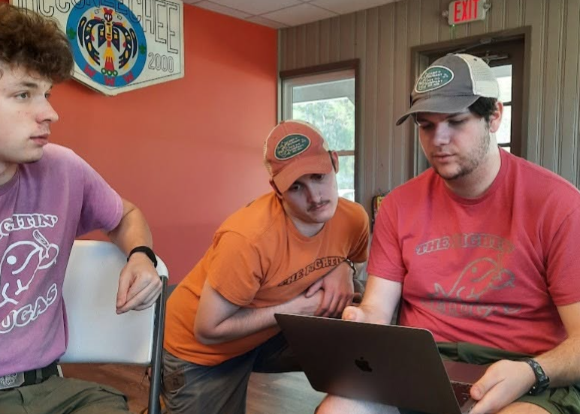
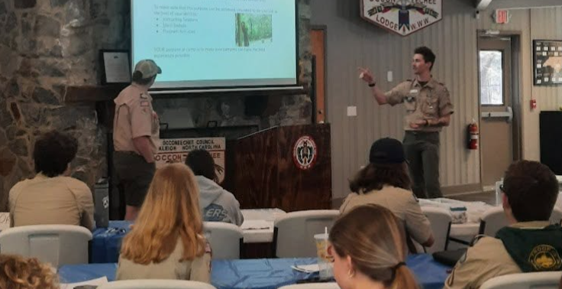
Leader Opportunities
IOLS(Week 2 Only as of right now)
Wilderness First Aid
Softball
Paddle Craft Safety
Water Rescue
L1 Tower Training
Turkey Shoot
Scoutmaster Merit Badge
Services always welcome and appreciated

Slide 17
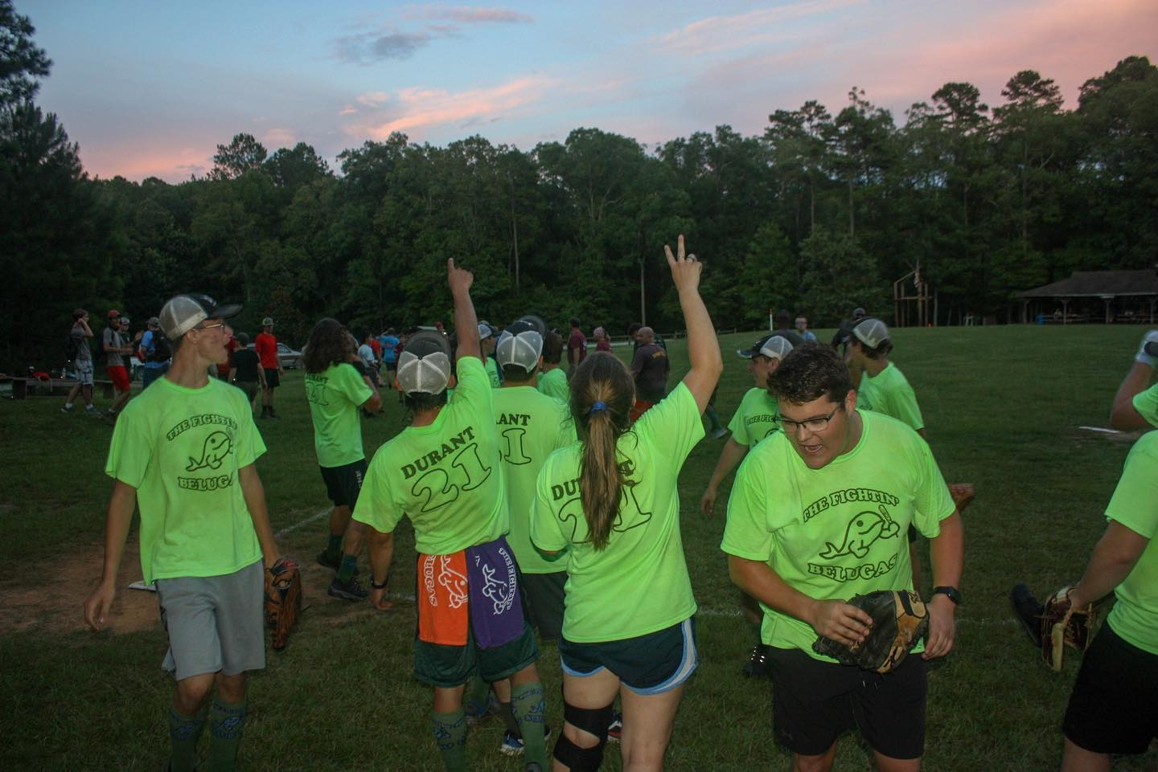
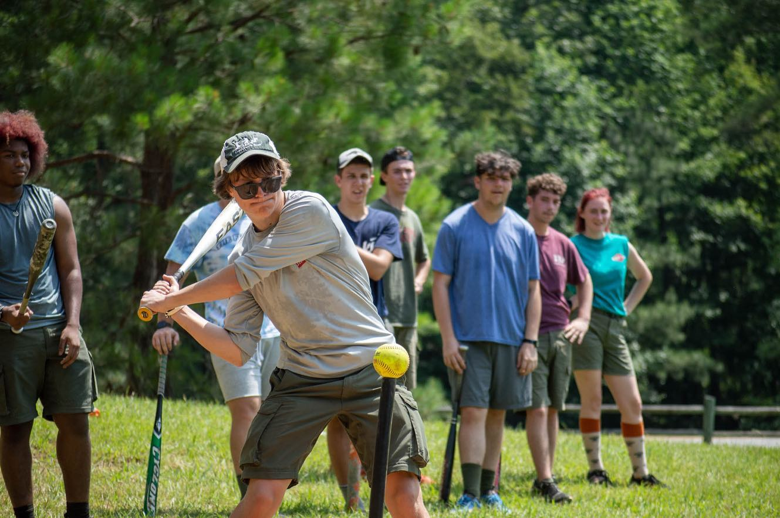
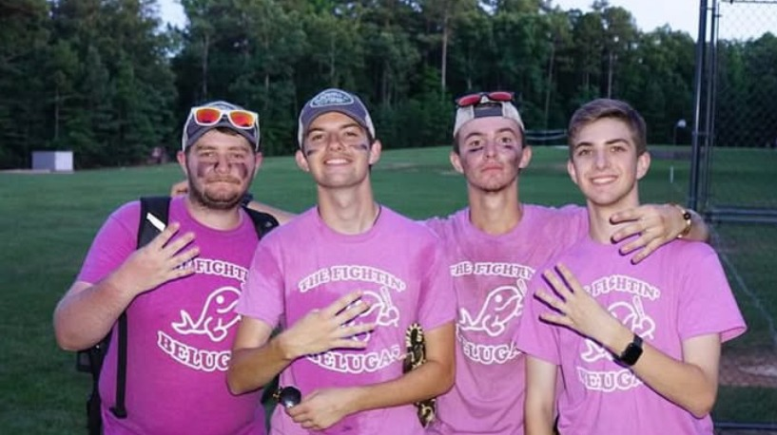
Twilight Activities
The Beluga Softball Experience
Carnival
Float Night
Twilight Swim

Slide 18
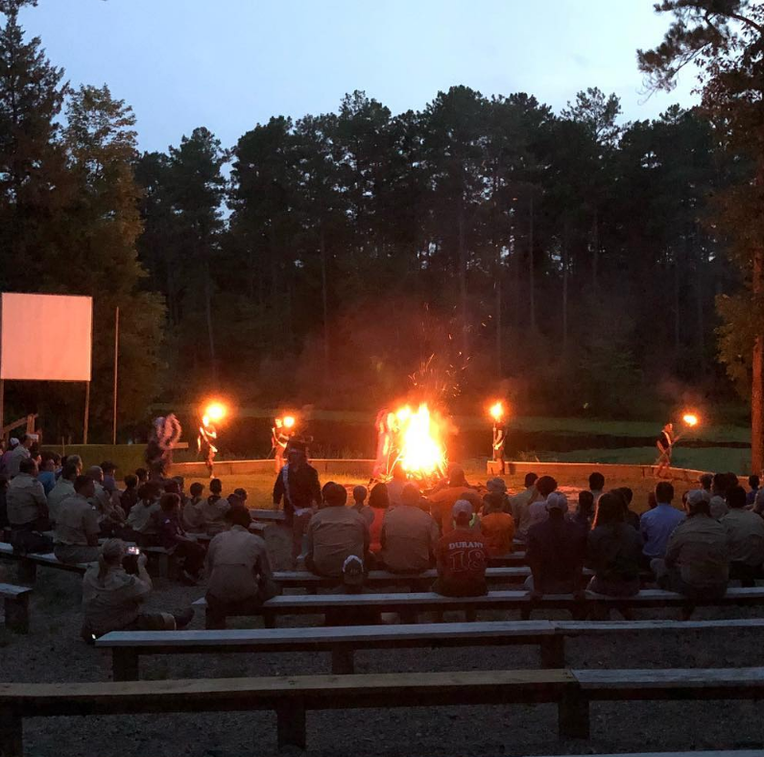
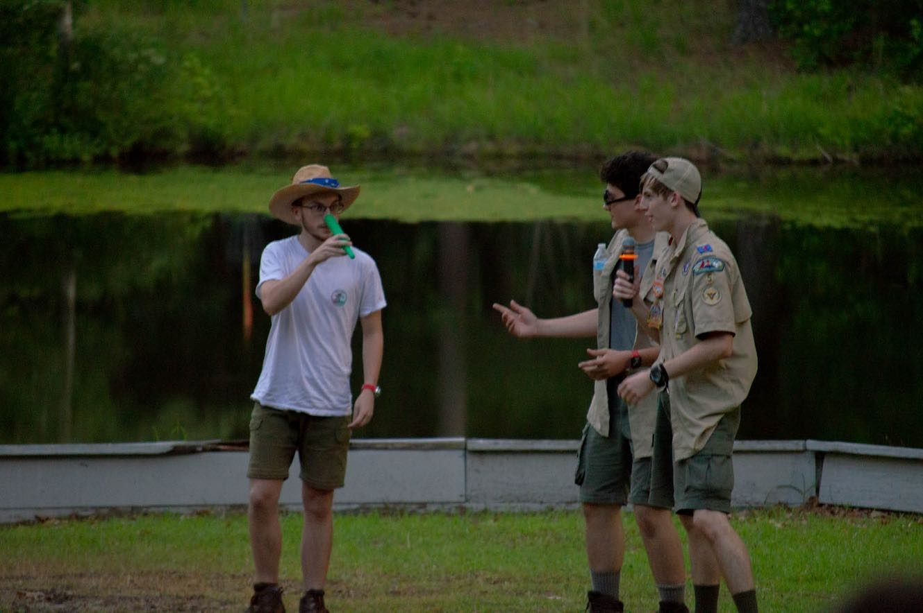
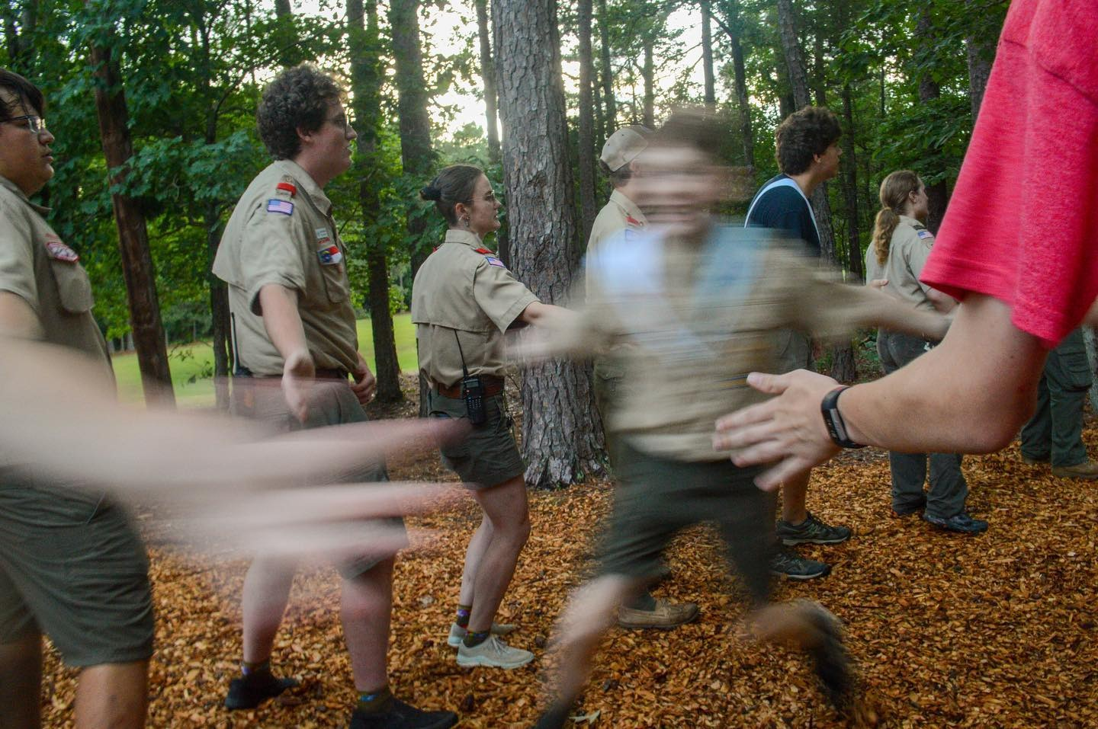
Campfire
HIGH FIVE LINE
SKITS
CAMPER INTERACTION
SPIRIT STICK
OA CEREMONIES

Slide 19
Closing
Questions
Camp Director's Minute
  Extra Shoes
  Check the weather
  Always bring a good attitude

