Slide 1
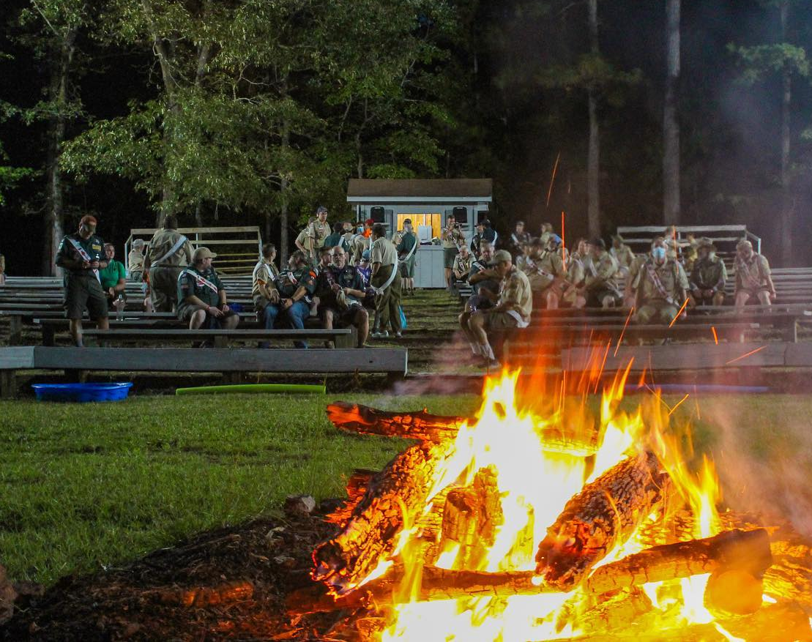
Camp Durant
Summer Camp Leader's Meeting
April 12th, 2026

Slide 2
Introductions
Erin Shiflett – Camp Director (erin.shiflett@scouting.org)
Michael Morrell – Director of Outdoor Programs/Reservation Director (michael.morrell@scouting.org)
Samuel Harrelson – Program Director (samuel@theharrelsons.com)
CJ Matthews – Asst. Program Director (cjmatthews224@gmail.com)

Slide 3
Important Updates - General
MB Registration is OPEN to those who are paid in full
Provisional is open for Weeks 2 – 4!
Personal Fitness
  Requirement updates
Indian Lore --> American Indian Culture Merit Badge
Trailblazers
  First 3 sessions @ Trailblazers shelter
  Great program, focus on fun games and activities to instruct requirements and instill Scouting Spriit
2026 Parent's Guide

Slide 4
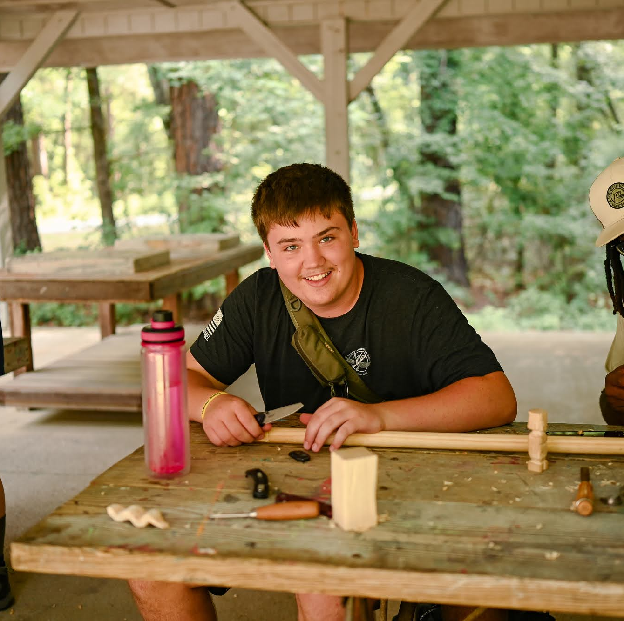
New Older Youth Program Offerings!
Sadie Reese – Older Youth Programs Director
Cost: $475
Participants must be 14 by the start of the program!
5 Day Adventure
  Features Camp Durant activities/program
  Off-site field trips
Focus in:
  Climbing, SUP, Mountain Biking, Hiking & more!
  Rocky Face – Natural rock Climbing
  Whitewater Center

Slide 5
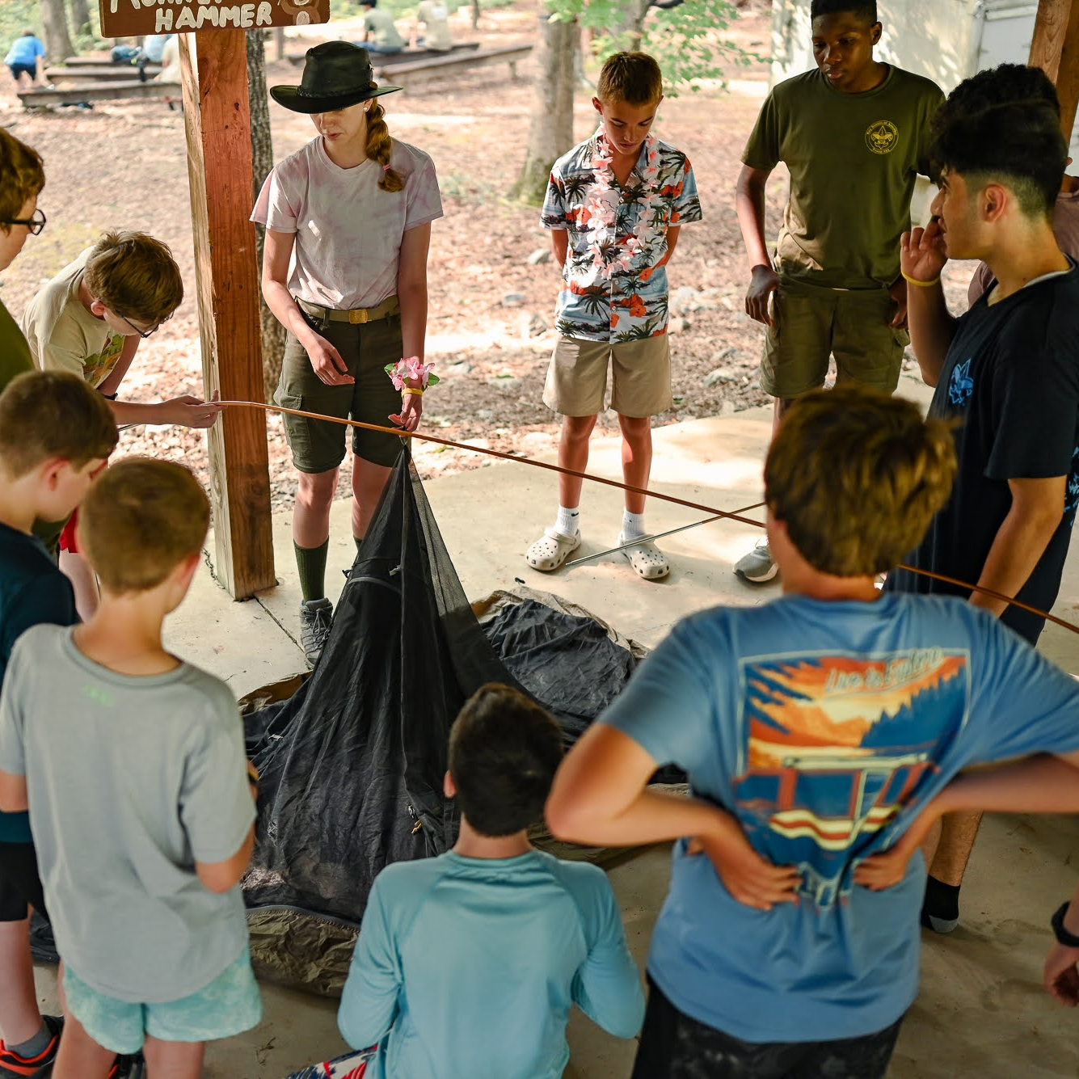
Aux Merit Badge Offerings
Stephen Keith – Week 1 – Communications MB
Jimmy Smedley – Week 1 – Public Speaking
Option available every week depending on Adult volunteers
What I Need:
  Confirmation of MB Counselor training
  MB offering
  Requirements that can be done
  Class size (your comfort)
  Materials needed
  Accommodations (if needed)
  Deadline: May 15th, 2026

Slide 6
Summer Camp – General Schedule
Mon – Thurs:
  9:15 – 12:15 (Sessions 1 – 3)
  2:00 – 4:00 (Session 4 & 5)
  4:00 – 5:00 (6th Session)
Open Area:
  4:00PM – 5:00PM
Twilight Activities:
  7:30PM – 8:30PM
Other Events:
  Sunday Night Campfire
  Staff vs Scoutmaster Softball – Monday Night
  Carnival – Wednesday Night
    Cobbler Cook-Off

Slide 7
Summer Camp – General Schedule
Friday
  Merit Badge Make-Up
  Tomahawk Race
  Flop from the Dock
  Closing campfire

Slide 8
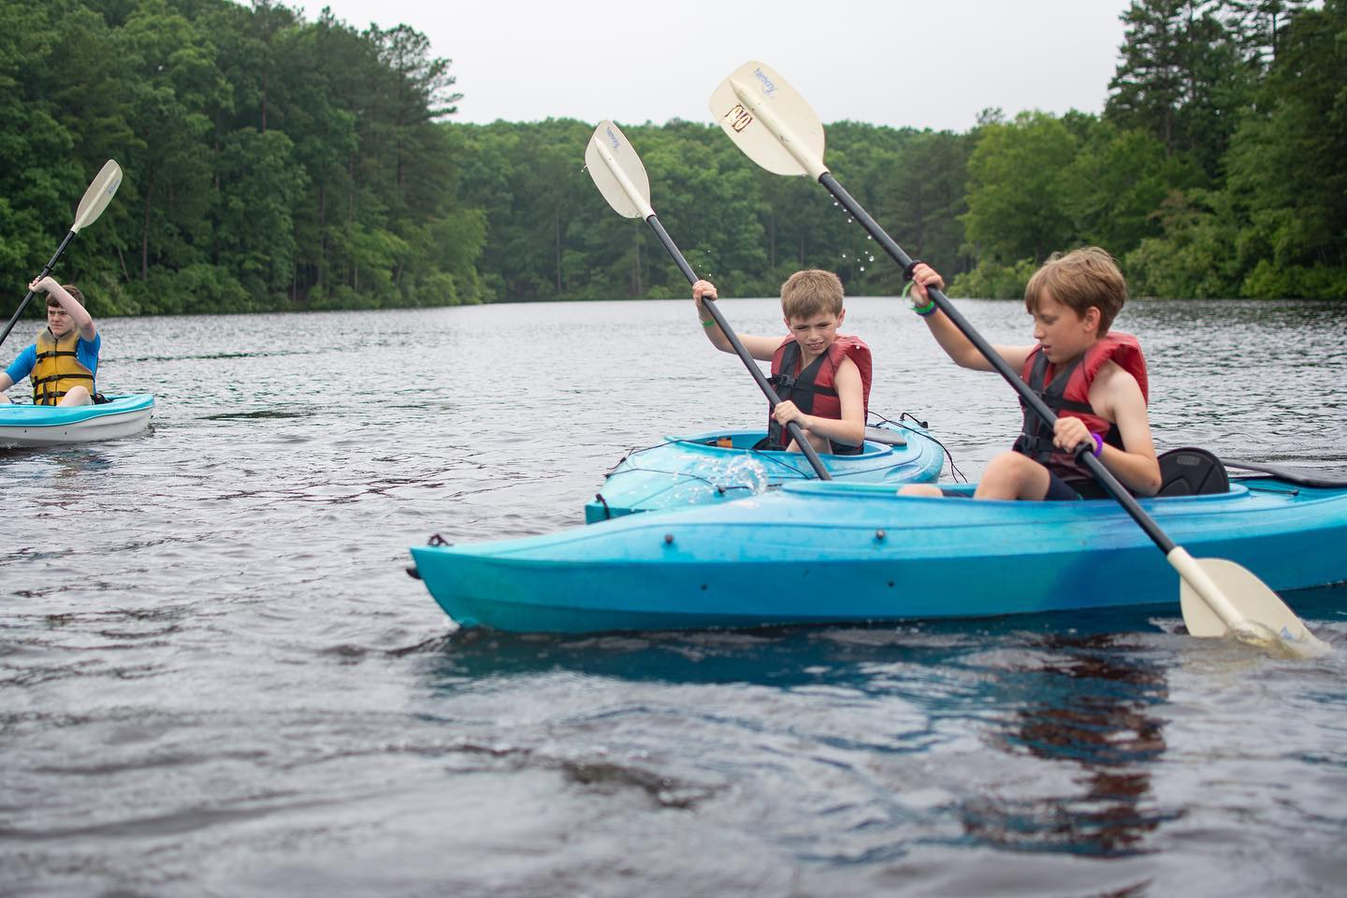
Aquatics Updates

Slide 9
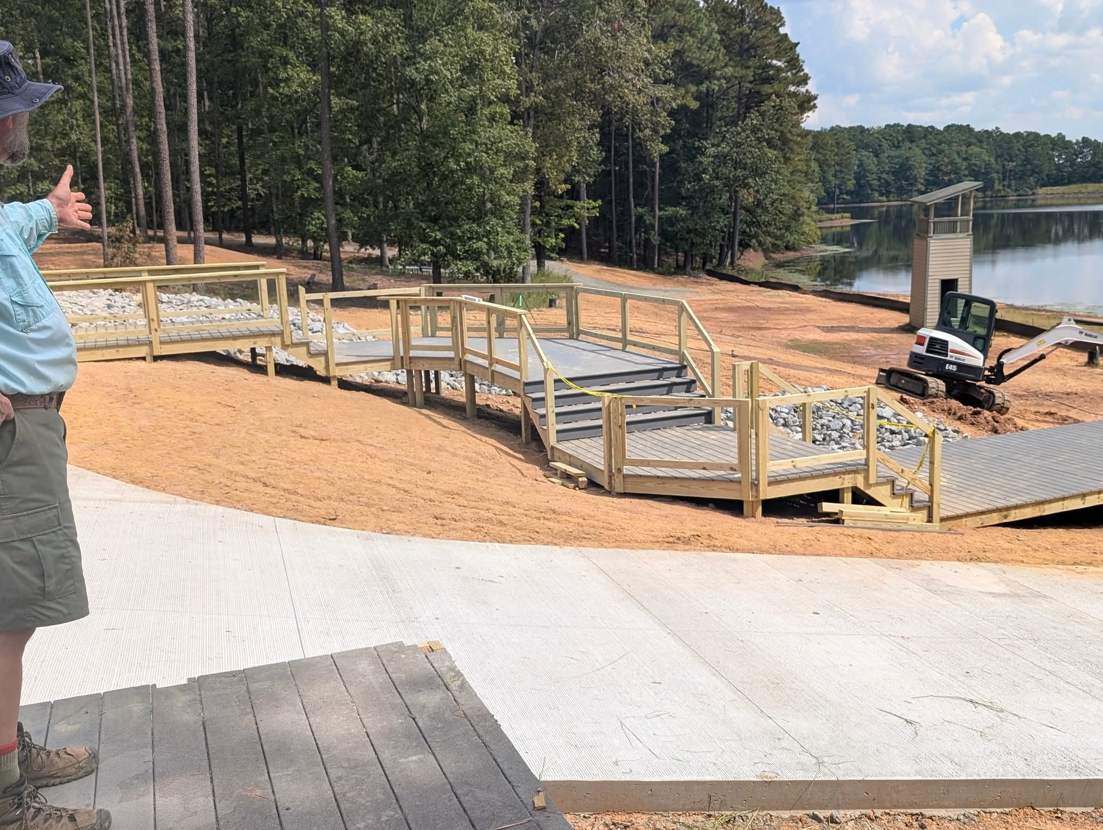
Aquatics Updates:
Jeff Pitts – Aquatics Advisor
Fred Burke – Aquatics Director
New waterfront procedures
ARC Lifeguard
  Cost: $75
Adult Training
  Swim & Water Rescue
  Paddlecraft Safety
Swim Tests – Highly recommended to complete prior to camp
  Swim Tests on Sunday following your tour
  Unit Swim Tests Prior to Camp – Please send to campdurant@gmail.com
  Tests must be signed by a Certified Instructor (ARC Lifeguard or equivalent)
Swimming Merit Badge Program Updates
  2 Hour Sessions
  4 classes being taught

Slide 10
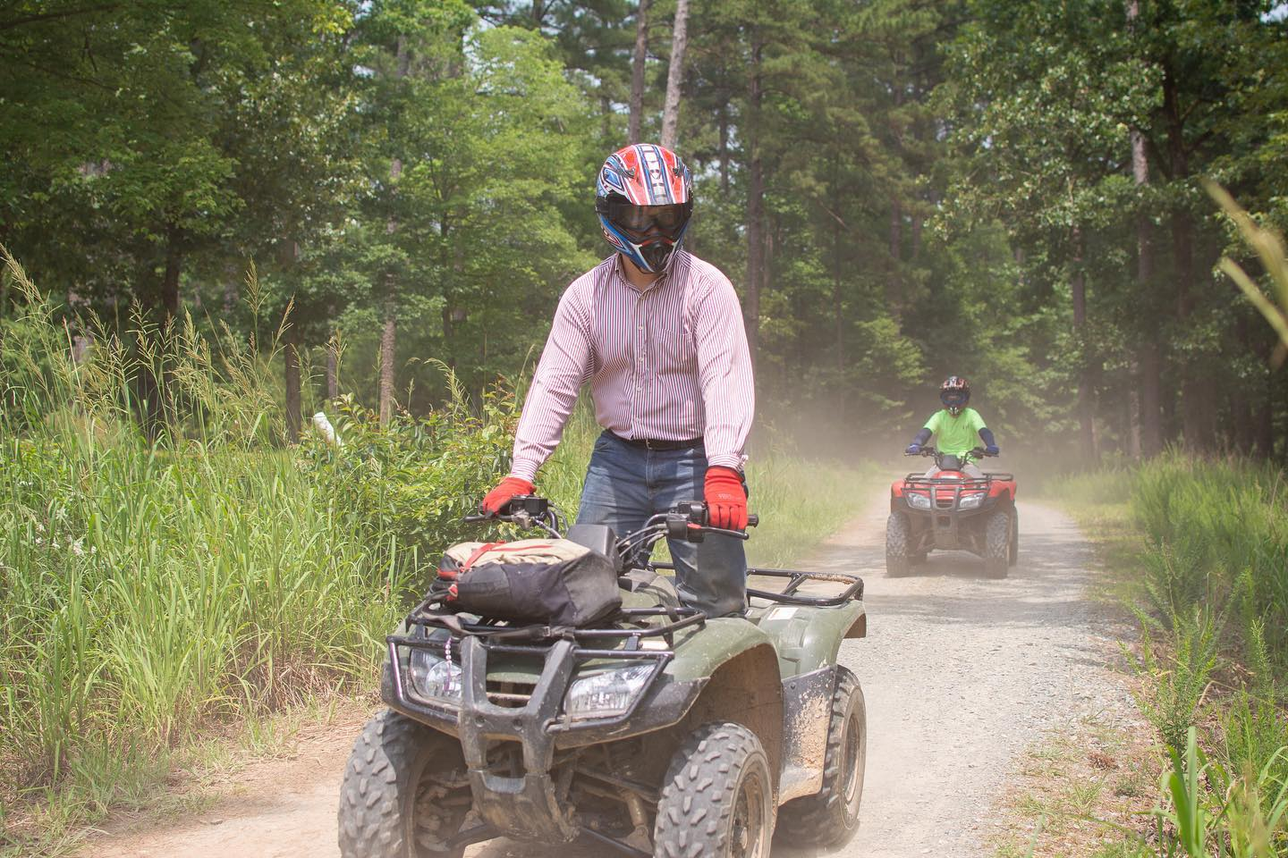
ATV Updates

Slide 11

ATV Updates:
Robin & Carolyn Covert: robincovert@bellsouth.net
ATV Rider Course – 2 parts
Online E-Course (must be completed prior to arrival at camp) - certificates will be accepted at Check-In
Hands on course
Course Fee: $25
Participants must bring:
Long sleeve shirt, long pants, and boots that cover their ankles
Signed waiver
E-Course completed certificate
Required documentation and other resources available on BP site

Slide 12
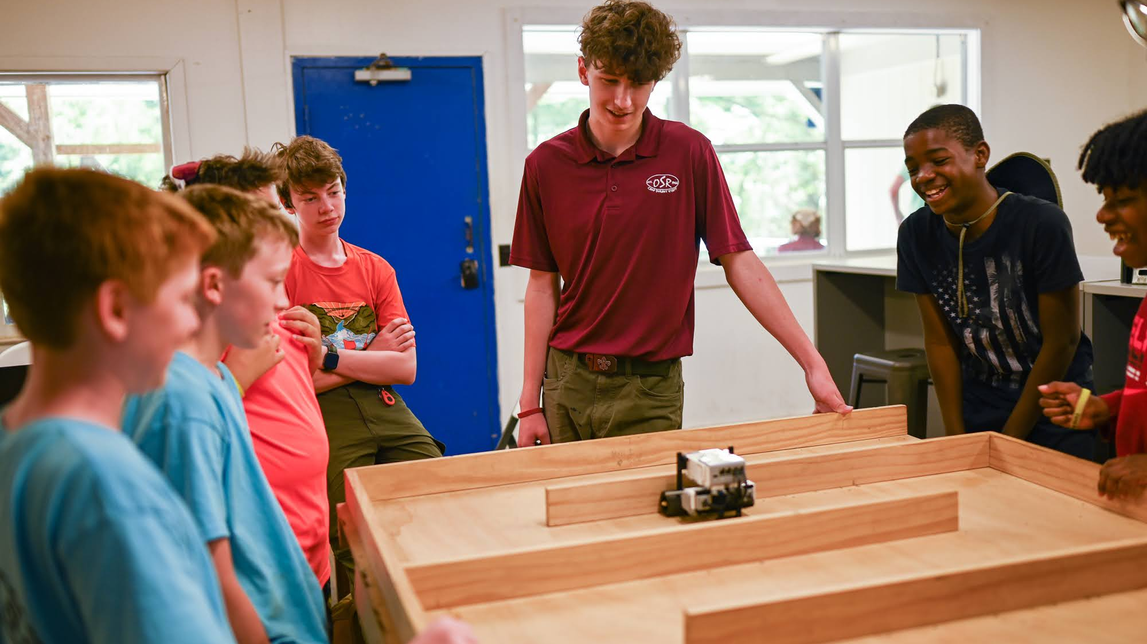
STEM/Ecology Updates

Slide 13
STEM/Ecology Updates
Radio Merit Badge
Aviation Merit Badge

Slide 14
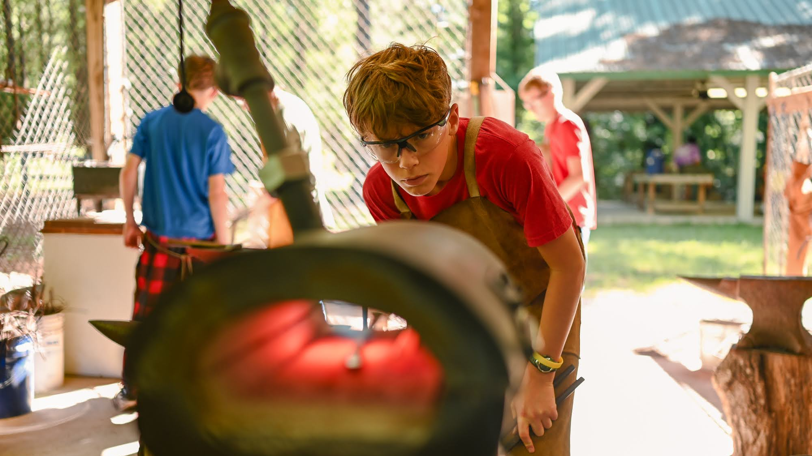
Metalworking Updates

Slide 15
Metalworking Updates:
Scouts must be 14 before the start of camp to be able to be in session

Slide 16
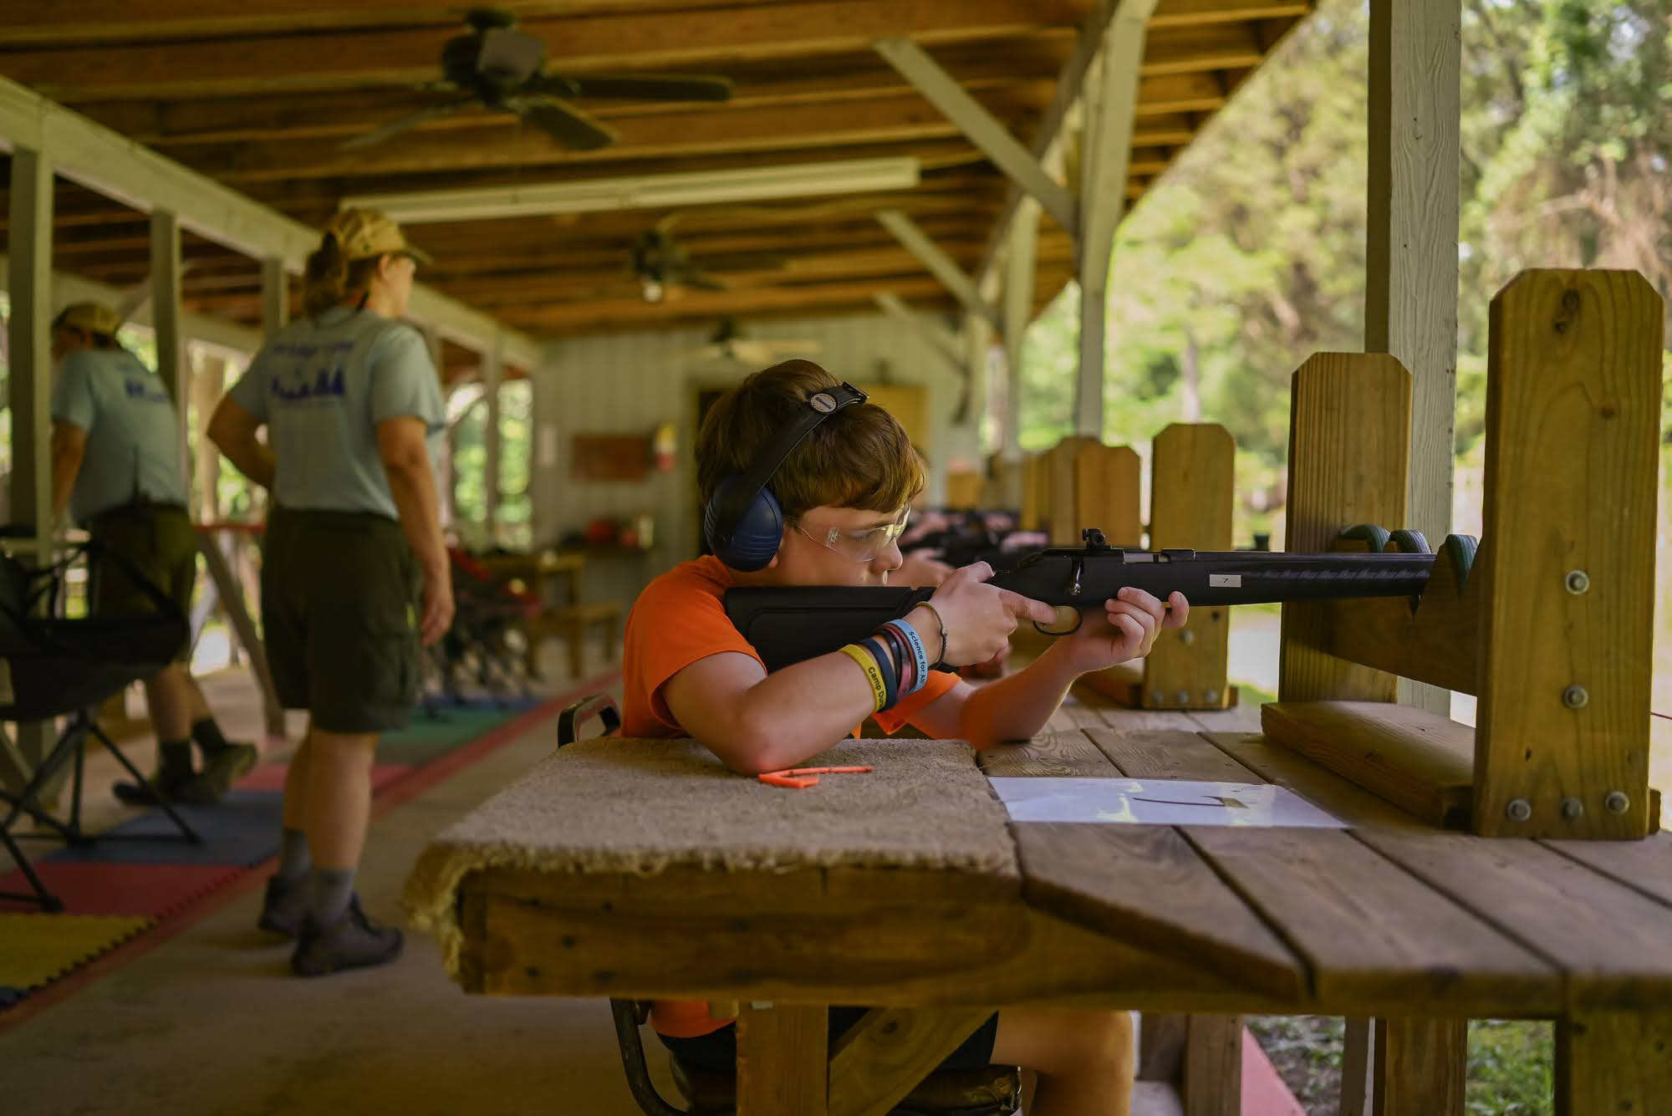
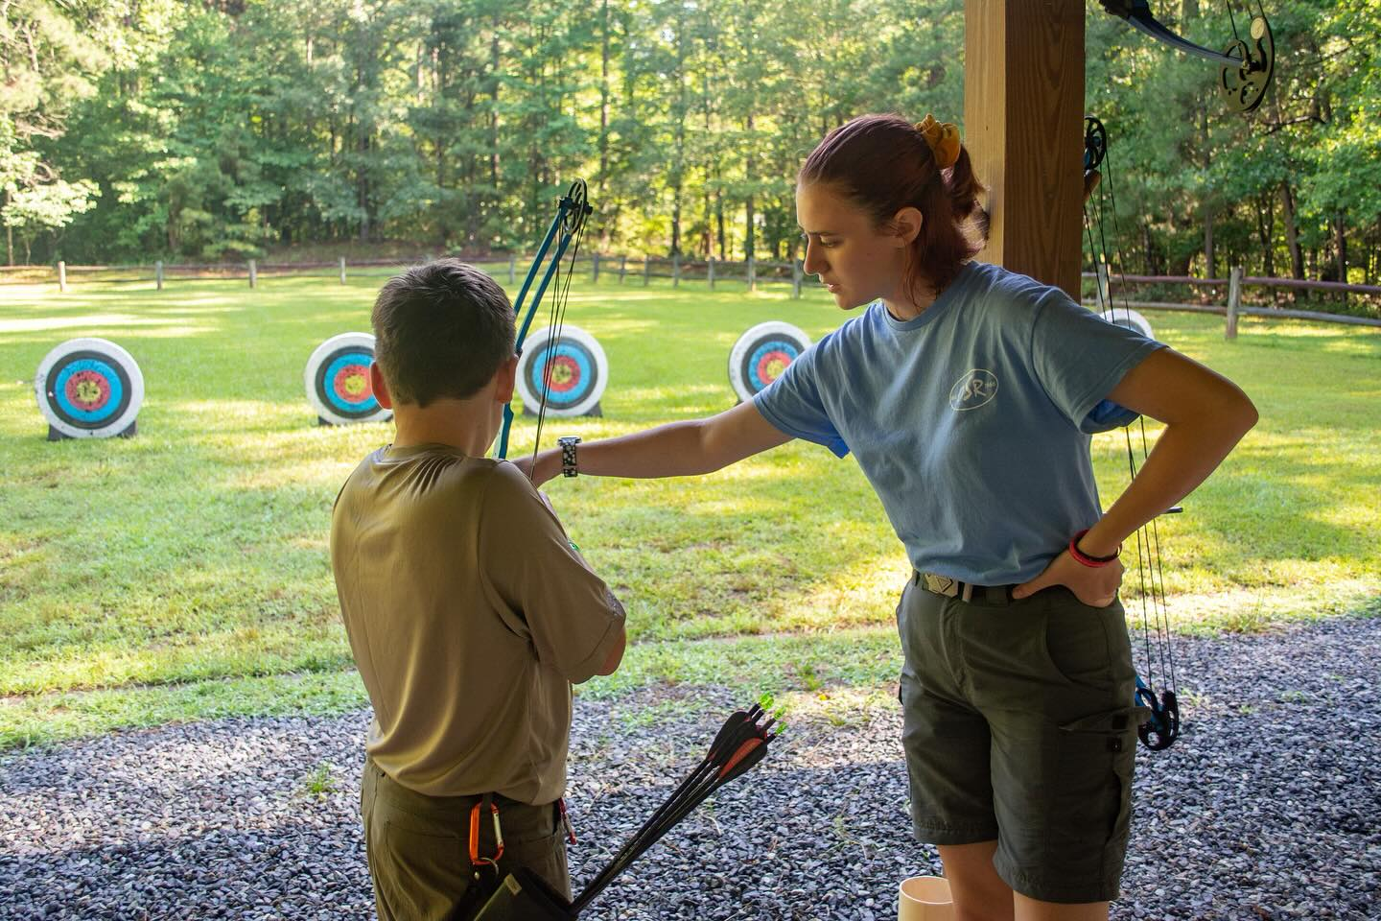
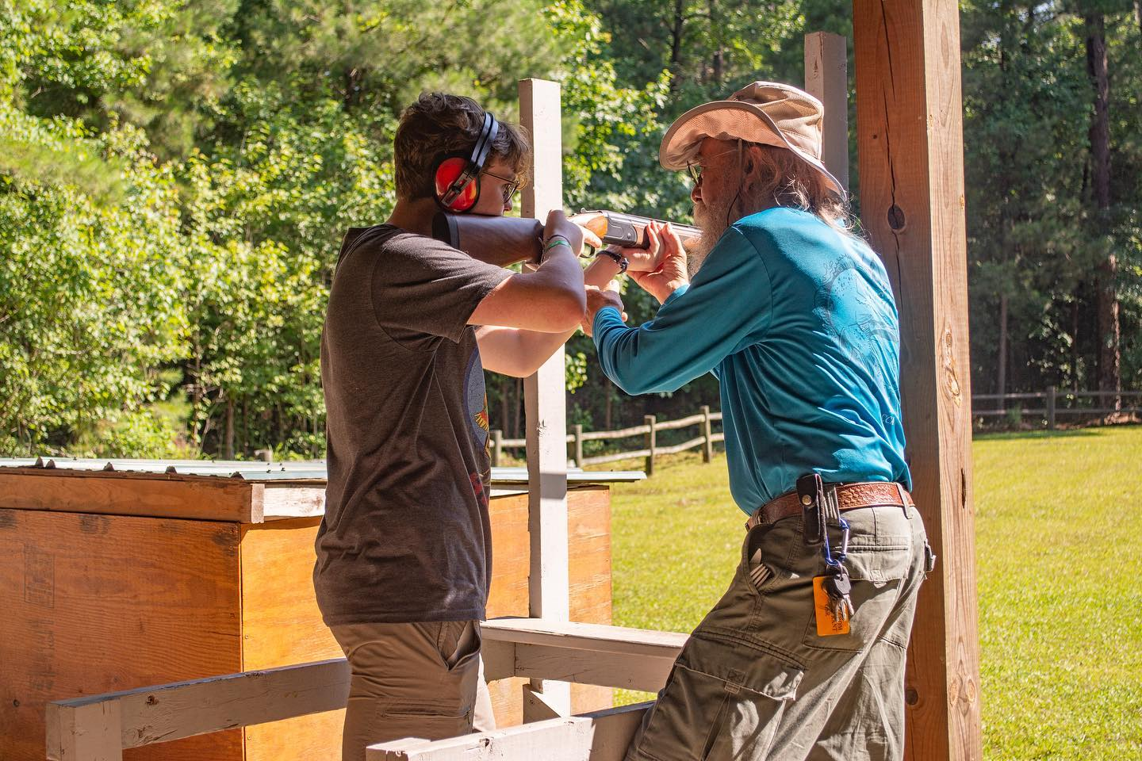
RATA Updates

Slide 17
RATA Updates:
RATA Director: Michael Harrelson
Shotgun Director: Robin Robbins
Rifle Director: Alicia Embrey
Archery Director: JC Fuda

Slide 18
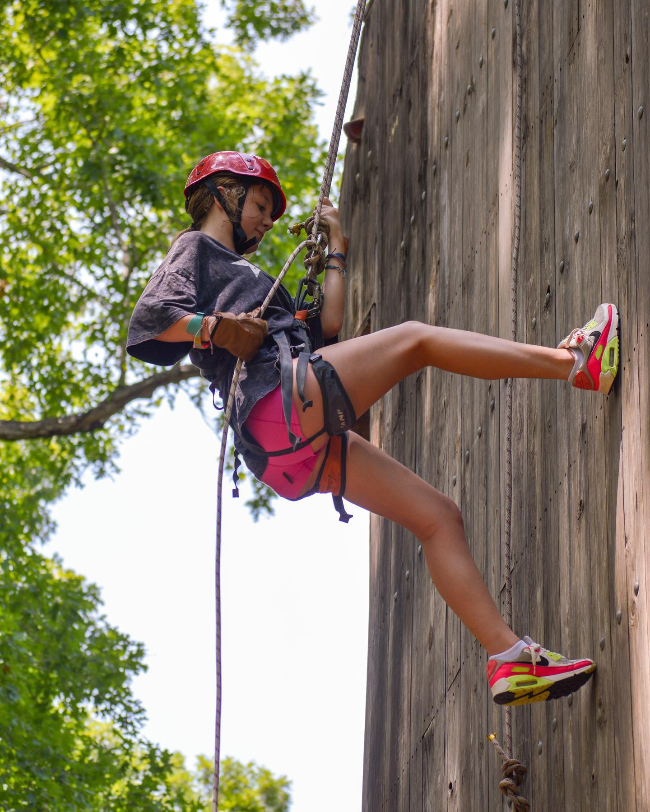
Climbing Updates

Slide 19
Climbing Updates:
  Kevin Shanahan – Climbing Director
Closed toed shoes
Physical fitness encouraged
Rappelling requirements (Camping merit badge):
  Friday during MB make-up
  Open Climb/Open rappel

Slide 20
Needs/Requests From Camp Leadership
Volunteers for Field Trip drivers
Leaders to join Older Youth Programs (esp. During field trips)
Instructors
Support in various areas (Trailblazers, Climbing, Aquatics, etc)
Provisional Leaders – Week 4
Older Youth Programs and new Merit Badges will be live: May 20th, 2026 @ 5PM

Slide 21

Opportunities For Scouts
National Jamboree
  Receive a $450 credit toward your National Jambo Regsitration (available for Occoneechee Council Scouts only)
Provisional Camping
  Available Weeks 2 - 4
2nd Week Discount
  Receive a $75 discount if you come back to Durant for a second week
Venturing Week – Week 3
Venturing/Exploring Leadership Seminar
  Venturers and Explorers earning knowledge in Project Management, Time Management, Goal Setting, and Mentoring
  Week 3
Summer Cuboree
  July 19 – 22nd, 2026

Slide 22
Future Resources for Leaders:
Next Leader's Meeting:
June 11th, 2026 @ 7PM
During Camp:
Scoutmaster meeting (Sun – Thurs)
9:30AM
Questions/Comments/Needs:
Registration issues/Payment Issues/Campership: michael.morrell@scouting.org
Everything Else: erin.shiflett@scouting.org
Black Pug Registration page (daily updates)
Black Pug Updates/Communications

Slide 23
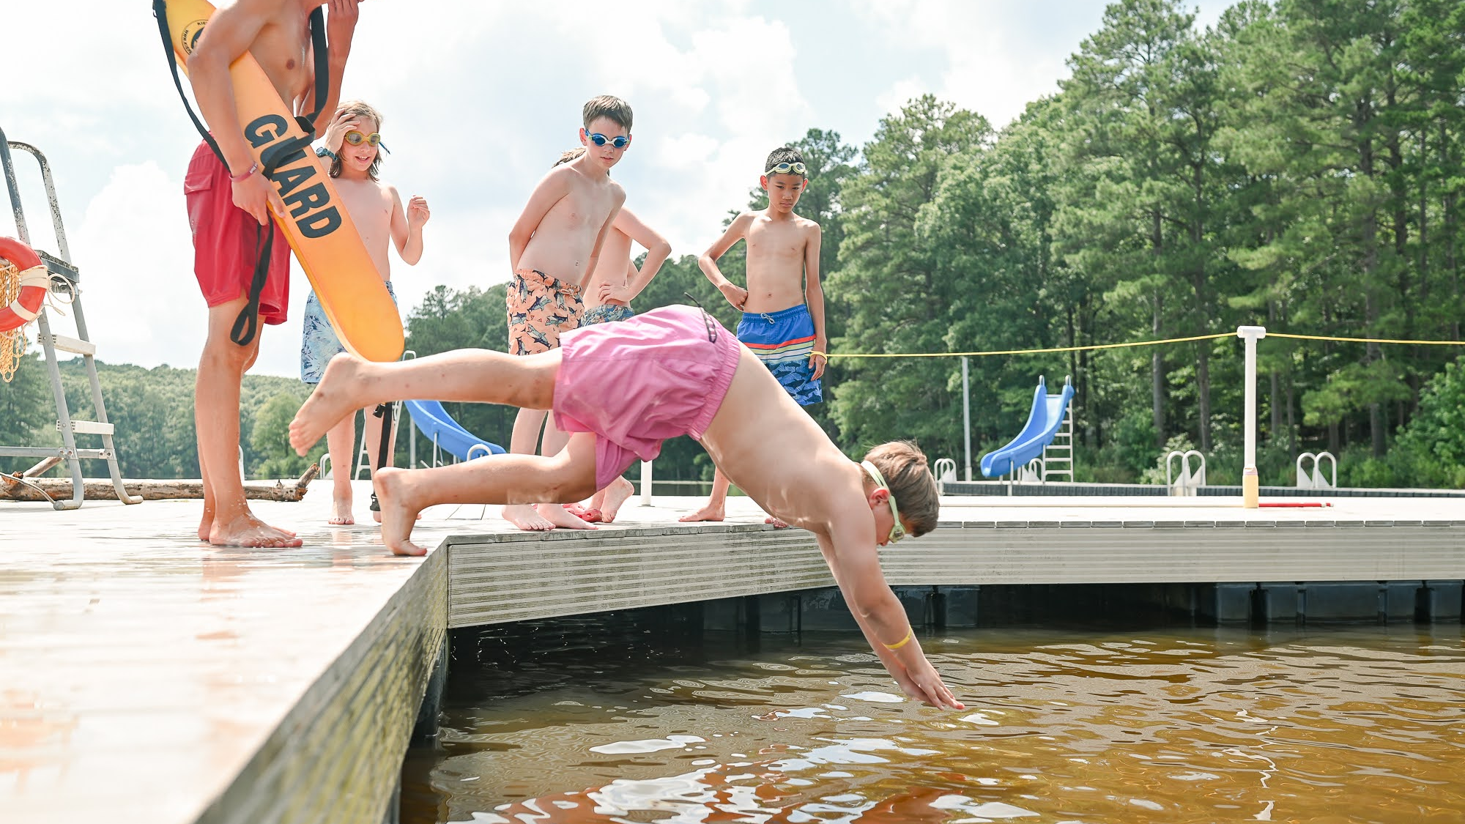
Questions

