Slide 1
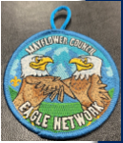
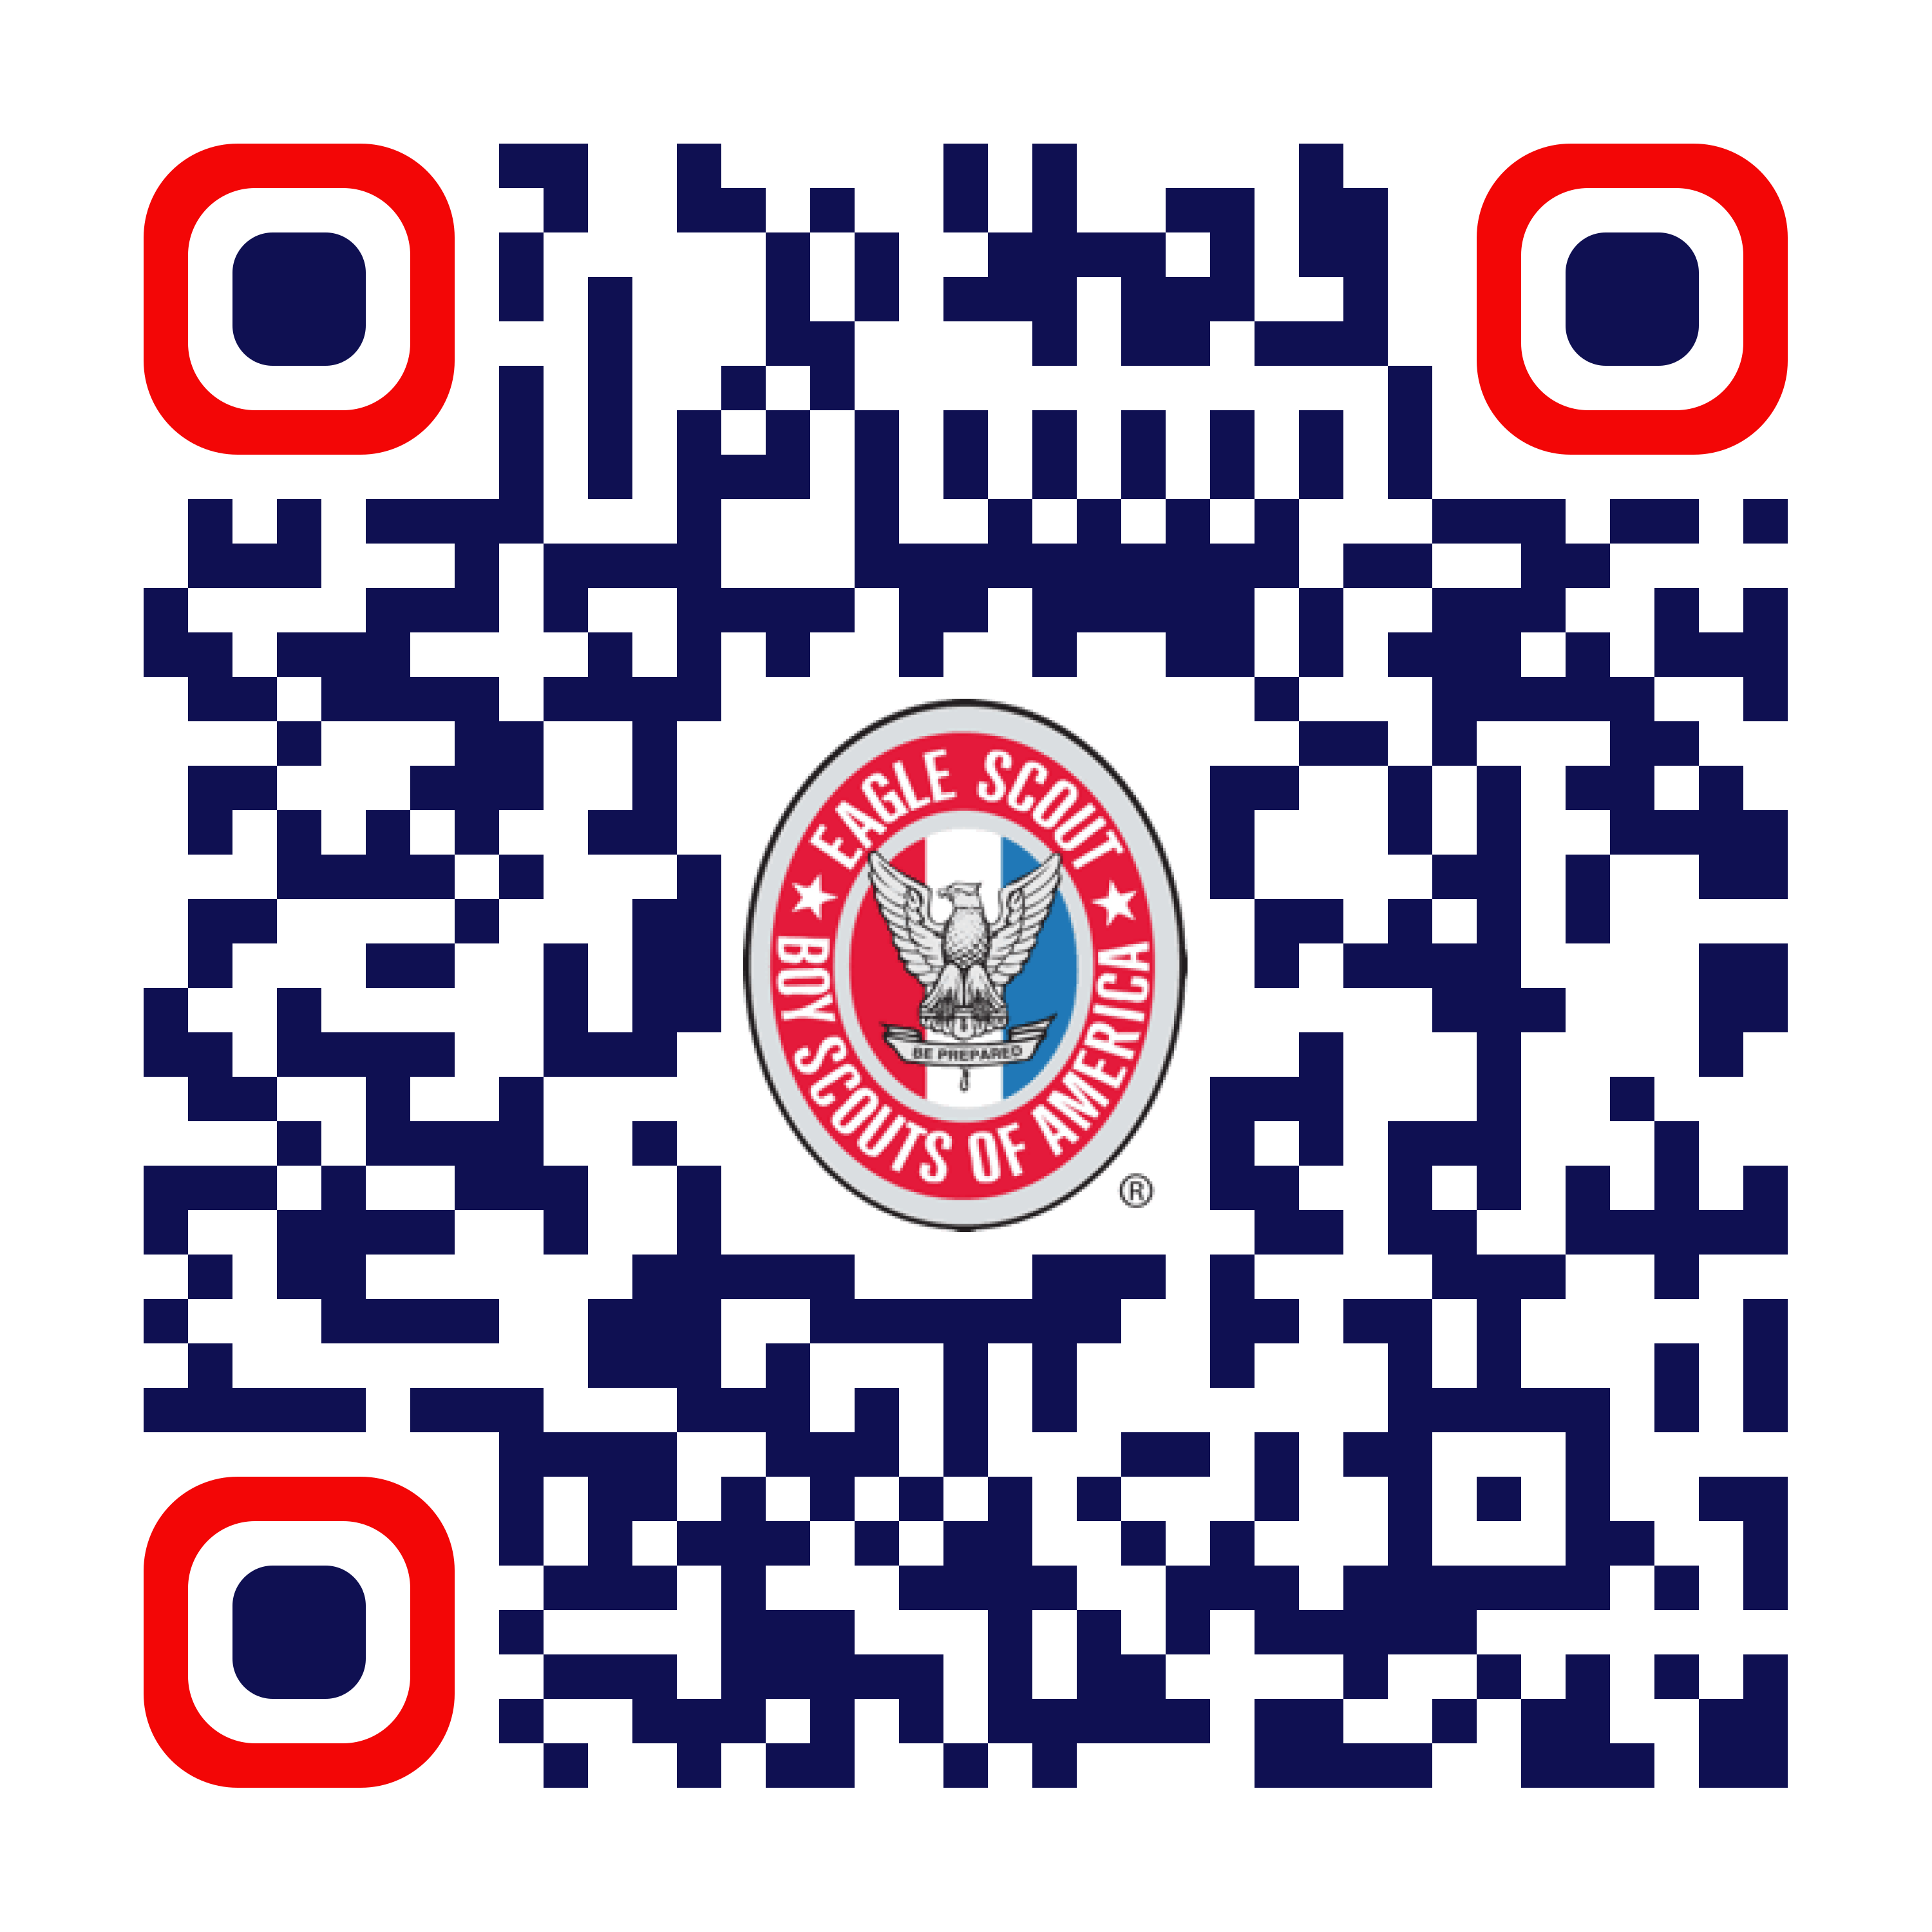
Mayflower Council NESA Chapter
Eagle Recognition Dinner
Join us at the Annual Eagle Recognition Dinner celebrating the Eagle Scout Class of 2024
June 16, 2025 - Lake Pearl, Wrentham, MA
Together we will celebrate:
• 4 New NOESA recipients.
• 2024 Eagle Project of the Year winner.
• The Eagle Scout Class of 2024.
Friends, Family, and most importantly Sponsors are all encouraged
to attend this popular event. Last Year we sold out, so sign up early
At https://251sa.org/2025eagle
2023 Eagles are free to attend!

