Slide 1
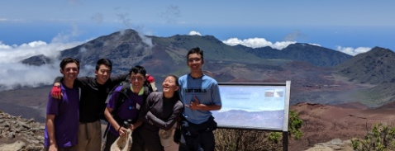
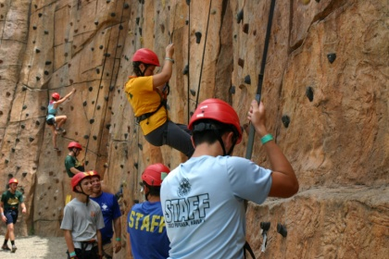
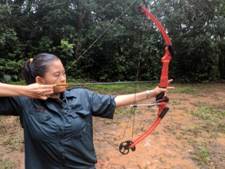
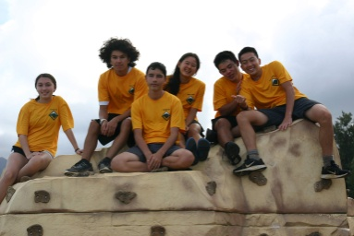
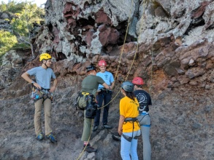
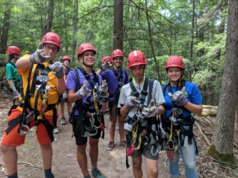
Scouting America Venturing Program
Looking to take on your next high adventure trip?
Want to build your leadership skills?
14 – 20 year old youth and parents are welcome to find out more about the Scouting America’s Venturing Program.
Hosts: Venturing Crew 808
Event: Venturing Orientation Night
Location: Mililani Recreation Center #2
94-300 Anania Dr, Mililani, HI 96789
Date: June 22, 2025, Sunday
Time: 5:00 – 7:00 pm
Want to take part in National and International youth events?
Interested in opportunities to expand your personal growth?
Seeking to give service to your community?

