Slide 1


Slide 2
BSA Check In Procedures and Camp Policies to Keep Youth Safe!
Check begins at 4:30 pm on Friday, April 24. The gates will be locked until then.
No early arrivals will be checked in until 4:30 pm.
No one will be allowed to enter Camp on Friday night after 9:00 PM.
All participants must check in at the Administration Building.
Please remain in your vehicle.
One Pack trailer will be allowed to be parked near the campsite, not in it.
You will be allowed to drive to your assigned campsite. Unload your gear as quickly as possible (10-15 minutes). Then move your car to the parking area. DO NOT setup your tent plan. You will be holding up other families from getting their gear into the campsite.
Please do not block the roads while you ae unloading your gear.
There will be no program on Friday night.
Registration fees must be paid in full! Camp staff will not be taking Registration money at check in.
Check-in will begin again on Saturday the 25th at 7:30 AM and end at 10:00 AM.
No one will be allowed in camp before 7:30 AM Saturday morning.
No exceptions due to safety reasons.
All vehicles MUST be parked in the designated parking areas all weekend.
Driving in camp during check in and out is limited to 10 mph and should be slower if you are near people.
Driving is not permitted during program, plan ahead if you need to leave early.
Absolutely no riding in the back of trucks.
Leave No Trace: If you pack it in, pack it out. Please secure trash as you pack it out so it doesn’t blow out.
Use fire rings. Fires are not allowed outside of a fire ring.
No open-toed shoes allowed.
No use of alcohol, illegal/recreational drugs or misuse of prescription drugs.
No firearms or fireworks allowed.
No smoking in view of Scouts.
No pets are allowed in camp.
Please have your medical forms (put them in a folder), a first aid kit and water in a designed place in your campsite. This is for emergencies. If someone is hurt the staff or an Adult will be able to get the information and supplies needed quickly.

Slide 3
Awards will be given for the following at
Sunday Morning Assembly
Bring your entry forms to the Saturday morning Assembly!
Spirit Stick Contest
The Spirit Stick needs a new home until the next Cub Scout Event of 2026!
The Pack showing the most Cub Scout Spirit will be awarded the Spirit Stick to decorate and bring back to the next Council Event.
Just because your pack may be small doesn’t mean you can’t win the Spirit Stick!
What staff looks for is:
Participation in the Campsite decoration by the youth
Participation in the Dutch Oven contest
Participation in the activities
Being present at all Assemblies
Having a Pack/Den Cheer/Song
Participation in campfire program (when there is a campfire)
Practicing Leave No Trace
Practicing Points of the Scout Law with out being told
All-around Cub Scout Spirit!
Campsite Decoration Contest
This years Camp theme is a Prisoner of Azkaban.
There will be 1st, 2nd and 3rd place awards.
Turn in Entry Forms Saturday morning after assembly.
You will have until lunch time Saturday to finish decorating your campsite.
Be sure to have your Pack number displayed.

Slide 4
Dutch Oven Cook Off
Turn in Entry Forms Saturday morning after assembly
on the table in the Dining Hall.
Be sure to pick up a sample cup with lid.
Fill out the form completely.
Bring the Entry Form and your entry to the Dining Hall
at 6:30pm Saturday Night.
There are 2 groups:
Adult and Scout
Please prepare a Wizards favorite.
The entries must be prepared and cooked in camp by the person entering the cook off.
Good luck!!!!
The Camp theme for this weekend is “Prisoner of Askaban”. We encourage everyone to dress up and have fun with the theme.
Trading Post will be open. Mrs. Grace would love to see you!
Hours for Trading Post: Friday Night 6 PM – 10:30 PM.
Saturday 8:30 AM – 7:00 PM

Slide 5
Camp Schedule
This camp schedule is not, set in stone. It could change and may change. Please be at the Assemblies so that Camp Staff can pass along any updates.
Friday – Program Schedule
4:30 – 9:00 PM | Camp opens. Check-in at the Administration Building for campsite assignment
9:30 PM | Staff meeting in Dining Hall.
10:30 PM | Quiet hours begin – Lights Out
Saturday -- Program Schedule
7:00 AM | Rise and Shine / Breakfast in campsites
7:30 AM | Staff Breakfast in Dining Hall & Staff Meeting Check-in opens at Administration Building.
8:45 AM | Opening Ceremonies at the flagpole in front of Dining Hall
9:15 – 12:00 AM | Day Time Activities Begin. Please move as a pack or den.
12:15 – 1:30 PM | Lunch in campsites
12:30 PM | Staff Lunch in Dining Hall and Staff Meeting
1:45 PM – 5:00 PM | Day Time Activities Continue
5:15 PM | Flags retired, return to Campsites for Dinner. Practice your skit/songs for Big Campfire
5:30 PM | Staff Supper in Dining Hall & Staff Meeting
6:30 PM | Dutch Oven Cook Off Judging Starts in Dining Hall
7:45 PM | BIG Campfire Great Hall (Pavilion).
10:30 PM | Quiet hours begin – Lights Out
Sunday -- Program
8:00 AM | Rise and Shine / Breakfast in campsites
8:00 AM | Staff Breakfast in Dining Hall & Staff Meeting
9:00 AM | Flag Raising / Morning Tid-Bits
9:30 AM | Chapel Service at the Flagpole / Awards
10:15 AM | Break camp and depart

Slide 6
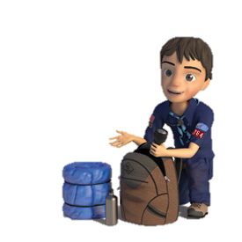
Suggested Packing List for Youth and Unit
This is for both Camps in the Council
Medical Forms (A, B1, B2)
Tent & tent pegs/stakes
Tarp for under Tent
Sleeping Bags
Air mattress, Cot or Sleeping pad
Extra Blankets
Pillows
Bug Repellant
Sunscreen
Lantern
Flashlight & Batteries
Camp Chairs
Stove and fuel or metal grate to put over campfire
Matches/Lighter
Canteen or water bottle
Mess Kit (Plate, Fork, Spoon, Knife)
Cord, rope, clothes pins
First Aid Kit
Fishing gear
Fan, battery operated/extra batteries
Pack and Den Flags
Food, Snacks, Beverages, Coffee
Ice Chest / Cooler w/ice
Cookware & cooking utensils
Hot Pads or gloves, Plastic / Paper cups, plates, utensils, bowls
Full Uniform
Sturdy walking shoes or boots
Extra change of clothes
Dry sleep clothes-you will stay warmer
Extra socks, shoes, underwear
Rain gear – poncho recommended
Sweatshirt and/or Jacket
Hat
Towels and washcloth
Personal items & toiletries(Baby wipes come in handy!)
Personal medication
Place clothing in Ziploc bags to keep dry
Cub Scout Handbooks
Good Attitude :)
Pocketknife – Only Cub scouts who have earned their Whittling Chip and
are supervised by a
parent are allowed to
have knives. Whittling
Chip must be on you
NOTE: Leave Your Pets At Home!

Slide 7
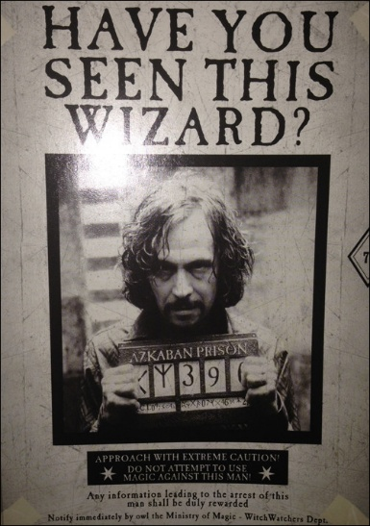
Campsite Decoration Contest Entry Form
This year’s camp theme is
Prisoner of Azkaban
Make sure your Pack Number is displayed on or near the campsite decorations.
Judging will begin after lunch on Saturday.
Pack Number: _________________
Name: ______________________
This Photo by Unknown Author is licensed under CC BY-SA

Slide 8
Dutch Oven Cook Off Rules and Entry Forms
Theme for entry is Wizard’s Favorite.
If you do not have an entry form, you may pick up a form after the Saturday morning assembly
in the Dining Hall.
Be sure to pick up a sample cup with lid.
The entries must be prepared and cooked in camp by the person entering the dish.
Good luck!!!!
There are 2 groups to be judged: Cub Scout and Adult
Judging will begin at 6:30 PM on Saturday in the Dining Hall.
Bring your sample dish in a one of the containers that is provided.
Write your name, pack number, and Entry Group on the bottom of the container.
Fill out the Entry form completely and bring with your entry.
Dutch Oven Cook Off Entry Form
Adult Entry Name: _____________________________________________
Pack Number: ____________ Campsite Name: ________________
Name of Dish: _________________________________________________
Dutch Oven Cook Off Entry Form
Cub Scout Entry Name: __________________________________________
Pack Number: ____________ Campsite Name: ________________
Name of Dish: _________________________________________________

Slide 9
