Slide 1
SUMMER CAMP
Thank you for joining us we will begin shortly!
Please place in chat:
Your Name, City, Week Attending

Slide 2
SC 2024: Information Session
Registration Website
Check-in
Merit Badge Programs
Adult Programs
Troop Times
Red vs. Blue Activities
Question & Answer

Slide 3
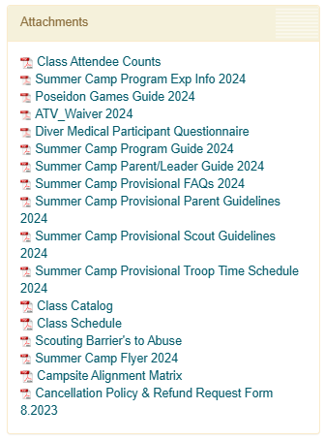
Resource Before Arrival
scoutingevent.com/083-summercamp

Slide 4
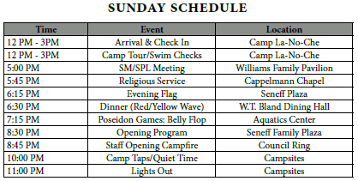
Check-in Basics
Units Check-in between 12-3:00pm
Camp tour on arrival:
Unit Photo opportunity- to take home to parents
Program Areas- to learn of the location of merit badges
W.T. Bland Dining Hall- to learn of our dining hall procedures
Brown and Brown Aquatics Center- to take your swim checks
Adult Leader/SPL Orientation Meeting at 5:00pm (Williams Family Pavilion)
Campsite Administrative Box located at campsite on arrival
IMPORTANT DOCUMENTS
BSA MEDICAL PART A, B, C
ATV CERT & WAIVER
SCUBA MEDICAL QUESTIONNAIRE
REQUIRED CLOTHING
ATV
AQUATICS
CLIMBING

Slide 5
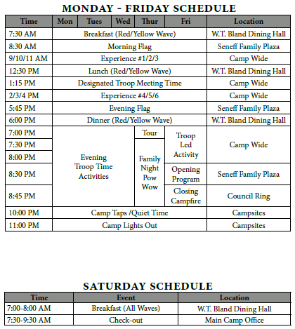
Weekly Schedule

Slide 6
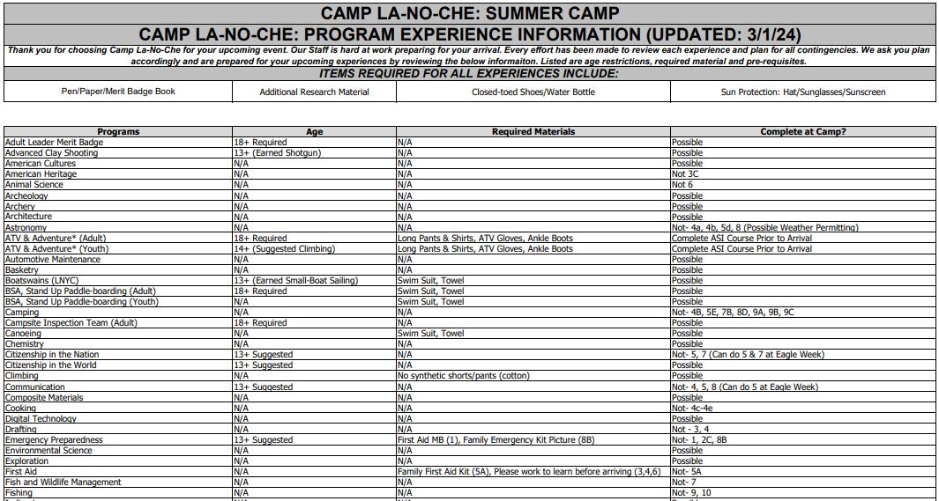
Merit Badge Programs

Slide 7
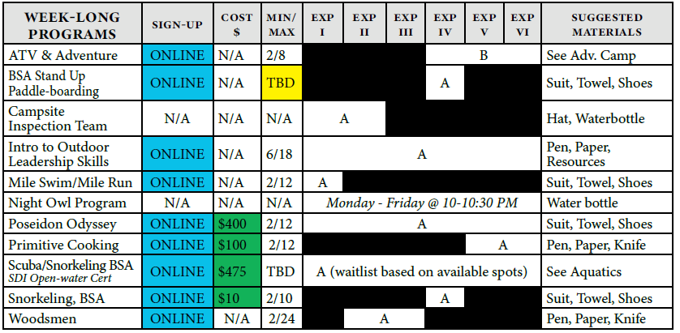
Adult Leader “Week-long” Programs

Slide 8
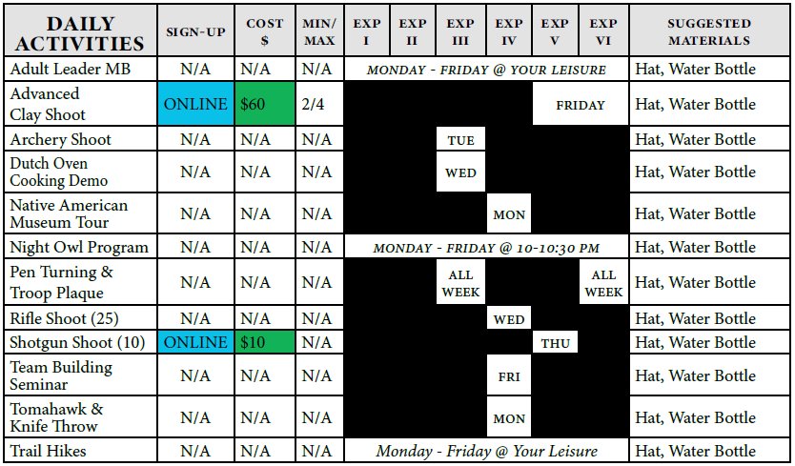
Adult Leader “Daily” Programs

Slide 9
Troop Times
ADVENTURE CAMP
TRAILBLAZERS
SHOOTING SPORTS

Slide 10
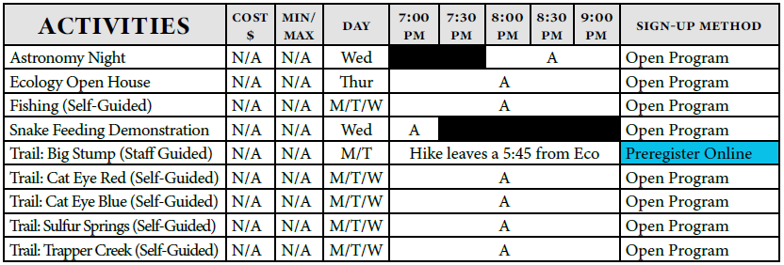
Troop Times
ECOLOGY
HOBBIES/SKILLS/STEM

Slide 11
Troop Times
CAMP-WIDE
NATIVE AMERICAN
AQUATICS

Slide 12
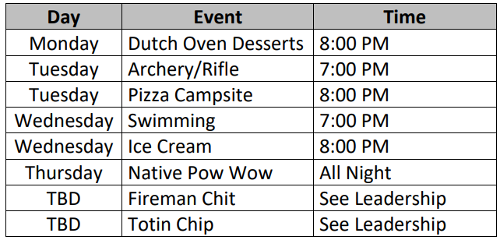
Special Provo Troop Times

Slide 13
THE POSEISON GAMES

Slide 14
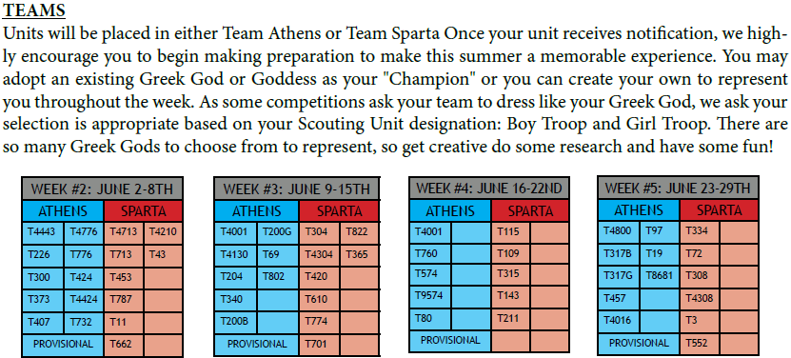
ATHENS & SPARTA

Slide 15
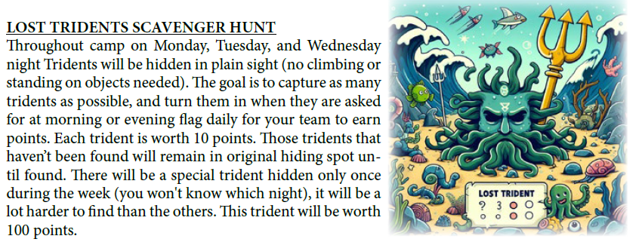
Week-long Games

Slide 16
Sunday Games

Slide 17
Daily Games
Mon- Human Foosball
Tues- Olympic Ring Medley
Wed- Chariot Races
Thu- Sink-A-Thon (After Lunch)
Fri- La-No-Che-A-Thon
Patrol Competitions
Patrol Flag- Turn in Thursday by 2PM to QM
Gateway- Judged Thursday AM in campsite
Scout Spirit/Service- Throughout Week
Campsite Inspections Weekly

Slide 18
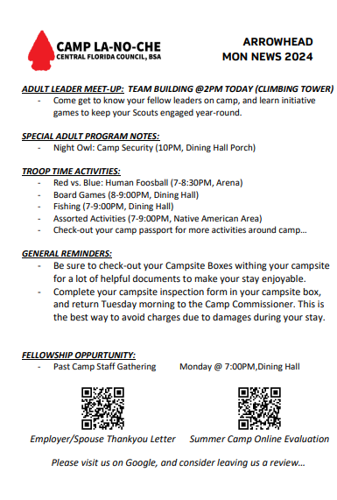
Resources On Arrival

Slide 19
PROVISIONAL
SESSION

Slide 20
Check-in Basics
Provo Check-in between 12-3:00pm (Provo Check-out between 8-10:30am on Sat)
Important Forms/Items Needed:
BSA Medical/All Medications
ATV Certs & Waivers
SCUBA Questionnaire
Provo Scout/Parent Guidelines
Meet with “Admin” Leader in Activity Shelter (Scout/Parent/Leader)
Meet with “Campsite” Leader outside for tent assignment/unpack
Camp tour as a unit (between 3-4:00pm)
Unit Photo opportunity- to take home to parents
Program Areas- to learn of the location of merit badges
W.T. Bland Dining Hall- to learn of our dining hall procedures
Brown and Brown Aquatics Center- to take your swim checks

Slide 21
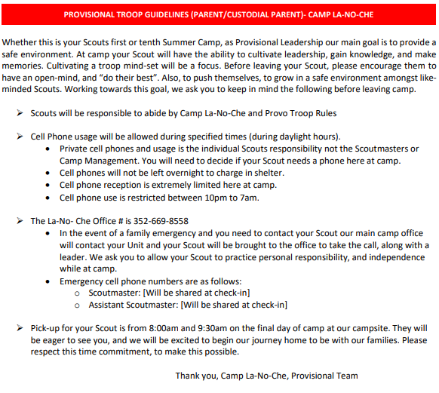
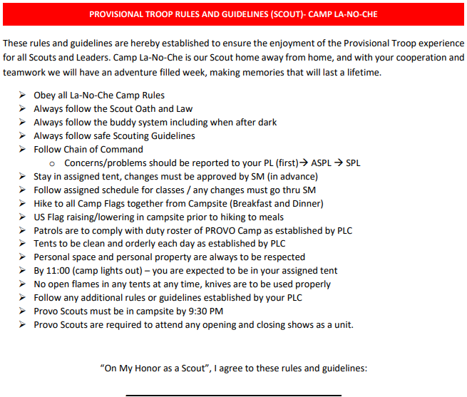
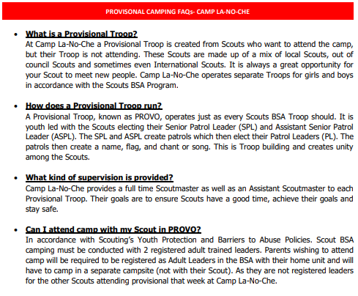
PROVISIONAL RESOURCES
PROVO
PARENT GUIDELINES
PROVO
SCOUT GUIDELINES
PROVO
FAQ

Slide 22
Provo Attendance by Week
Unit Type | Week #2 | Week #3 | Week #4 | Week #5
Male | 27 Scouts | 8 Scouts | 11 Scouts | 4 Scouts
Female | 5 Scouts | 6 Scouts | 8 Scouts | 9 Scouts
(Boys Campsite #16 & Girls Campsite #10)

Slide 23
Questions & Answers
Contact Information:
Mac Griffith – Program Director – mac.griffith@cflscouting.org

