Slide 1
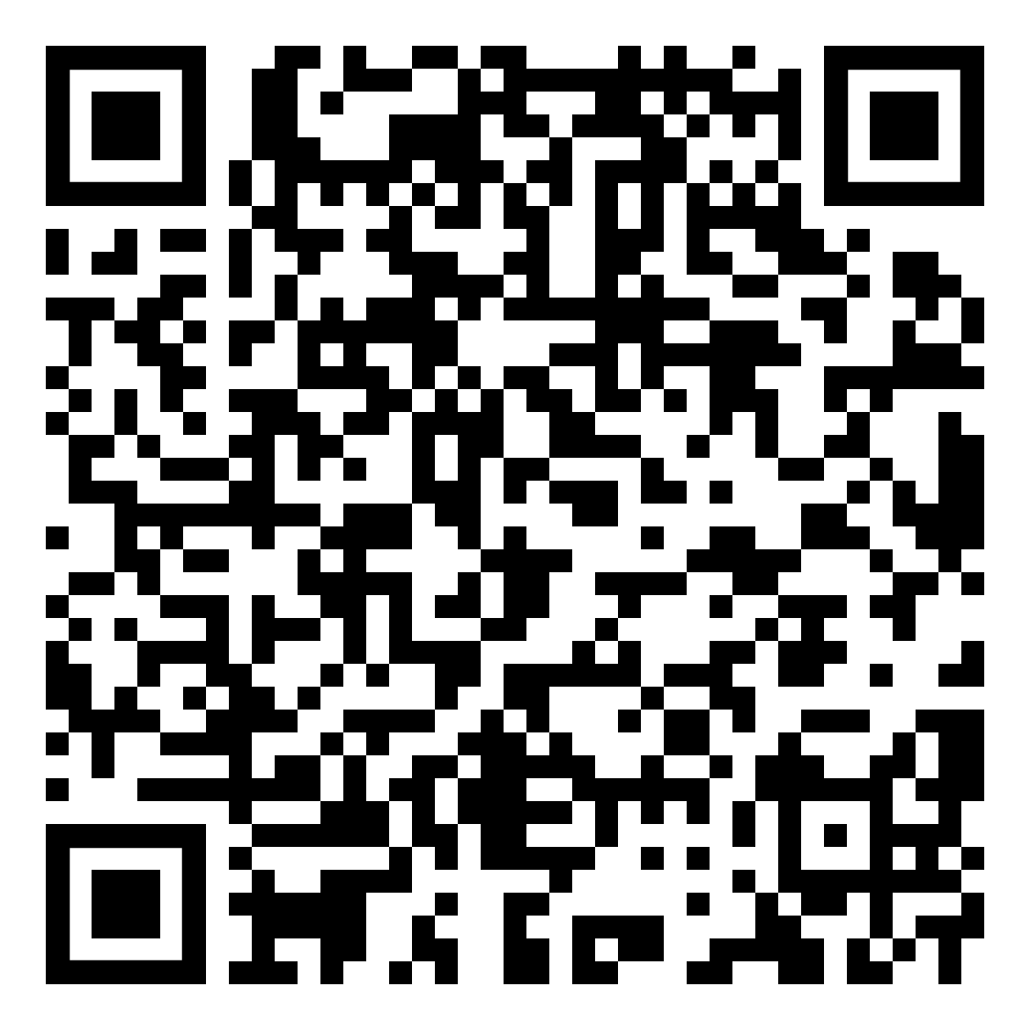
TONIGHTS PPT SHOW
WE WILL BEGIN SHORTLY…
THANKS FOR JOINING US!

Slide 2
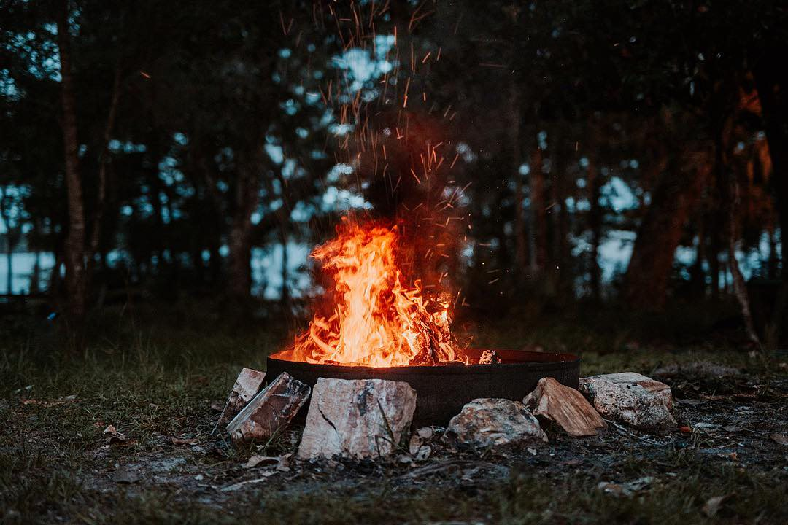
AGENDA
Spring Break Mini Camp 2024
Summer Camp 2024
Eagle Week 2024
Winter Camp 2024
Council Camping Weekends 2024
Unit Camping Opportunities in 2024
Seasonal Camp Staff

Slide 3
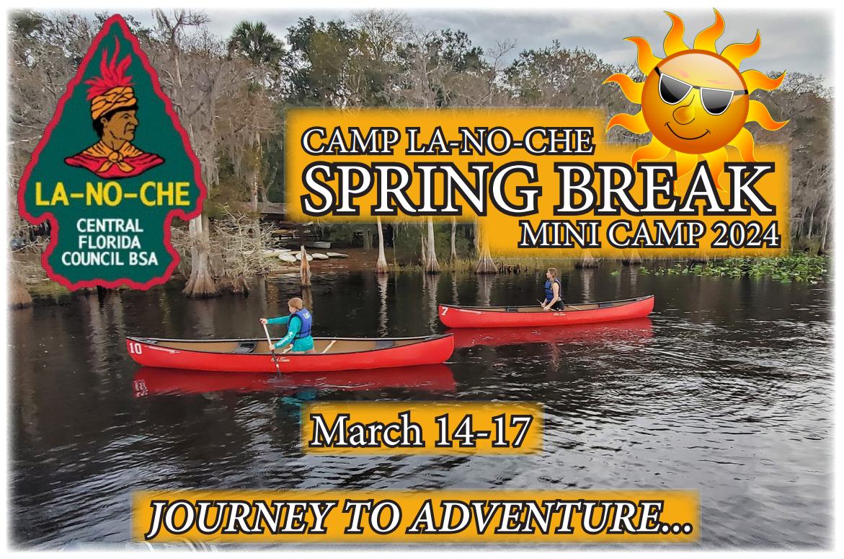
scoutingevent.com/083-SPRINGBREAKMINI

Slide 4
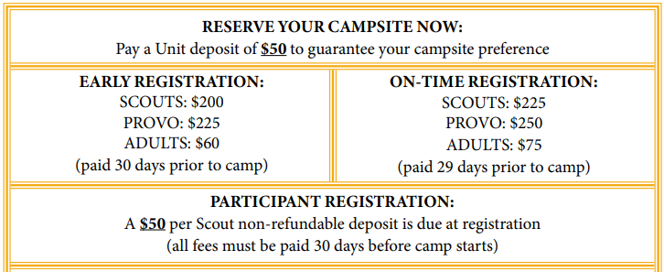
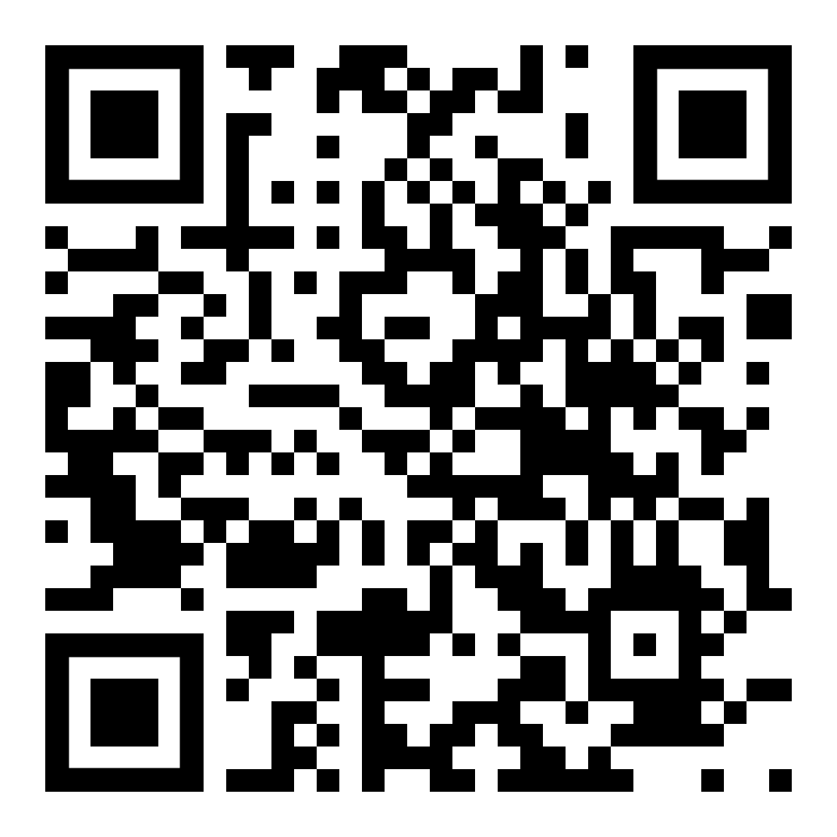
REGISTER NOW
scoutingevent.com/083-SPRINGBREAKMINI

Slide 5
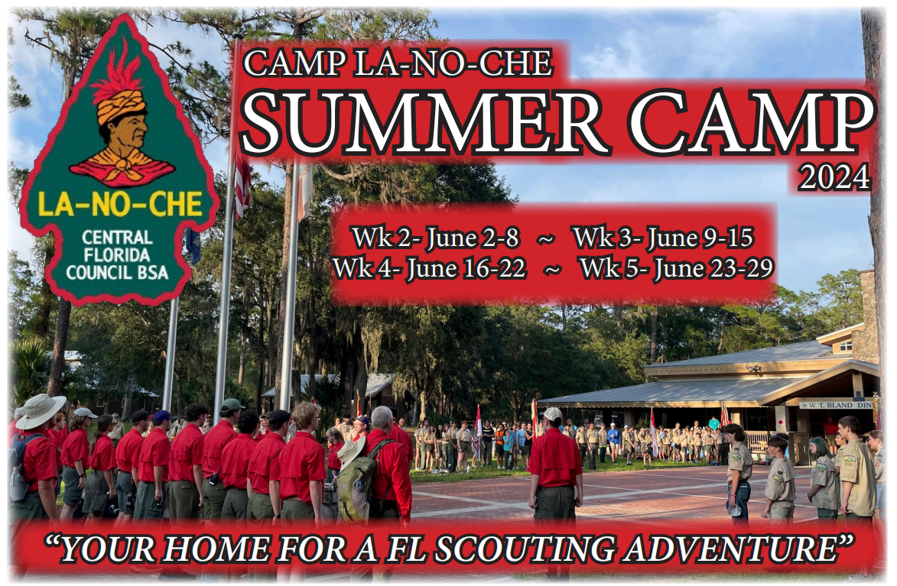
scoutingevent.com/083-SUMMERCAMP

Slide 6
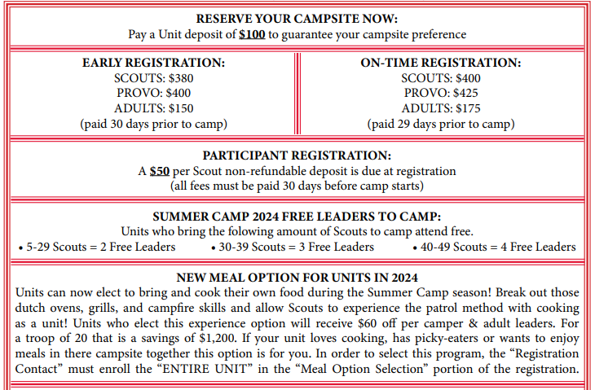
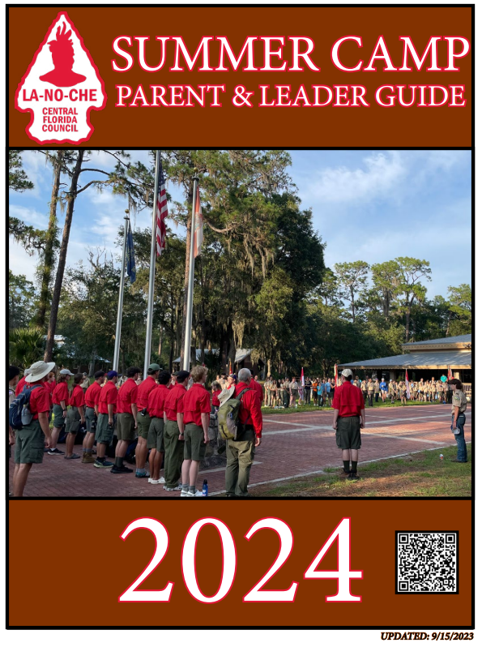
scoutingevent.com/083-SUMMERCAMP

Slide 7
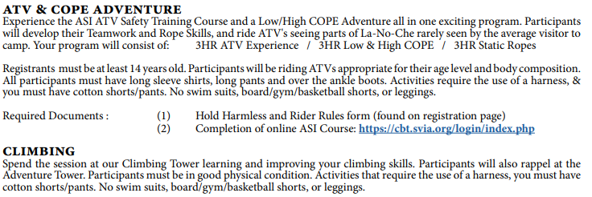
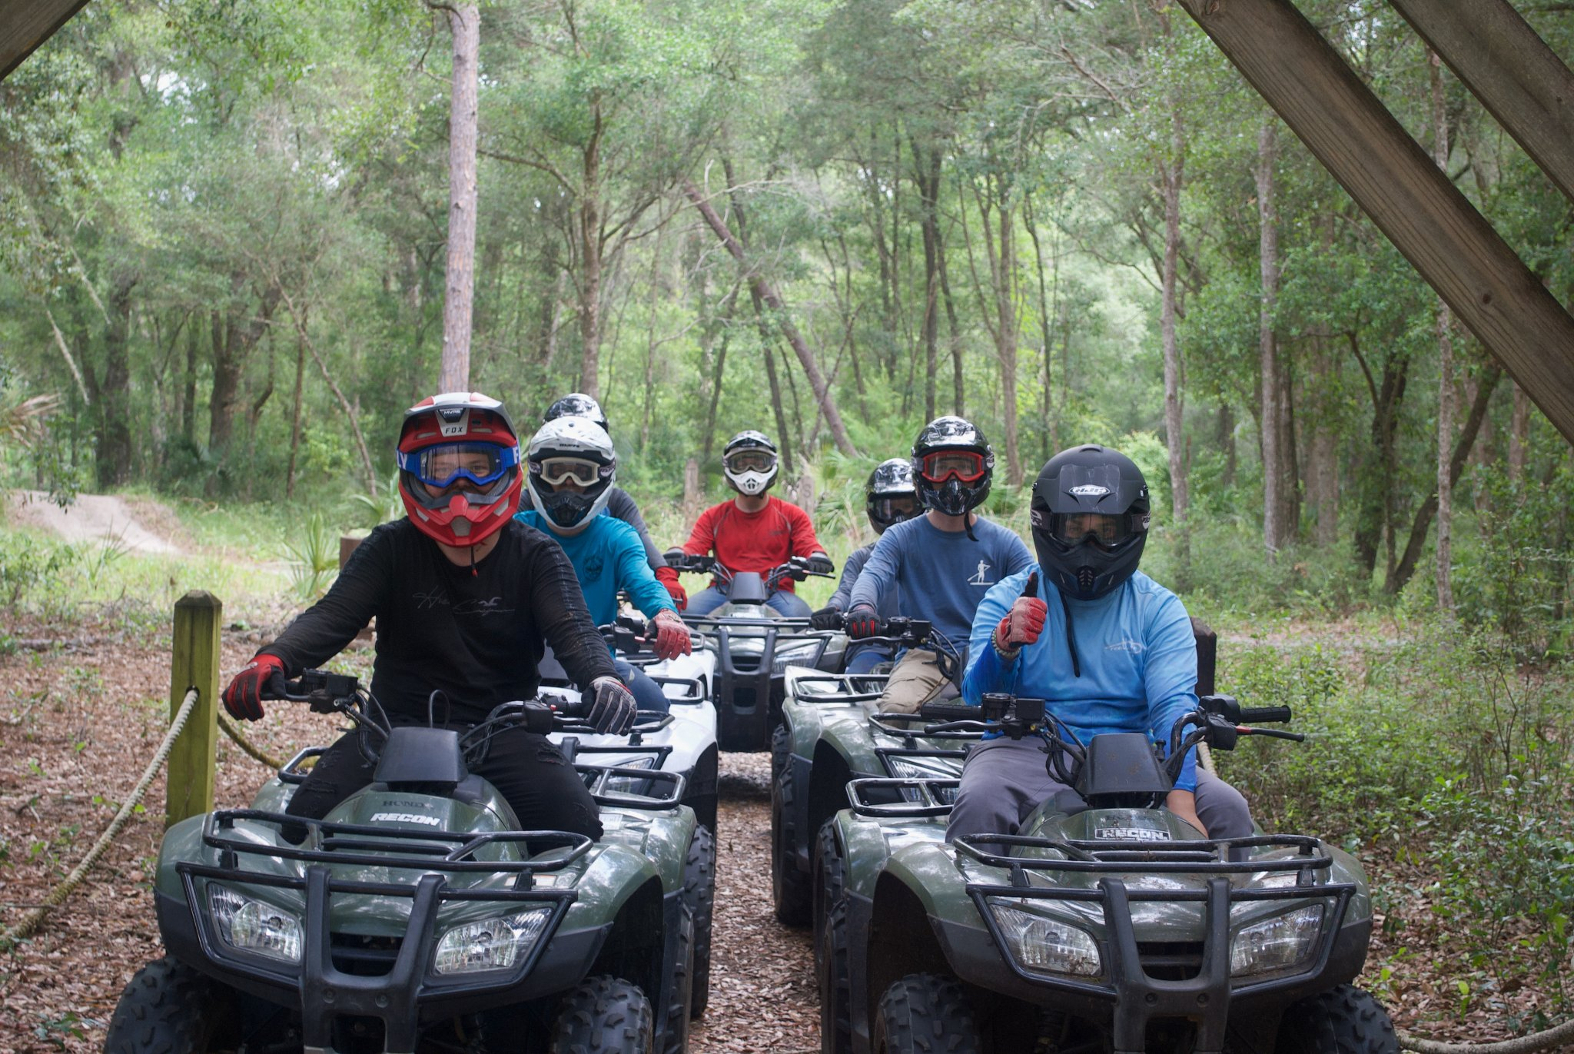
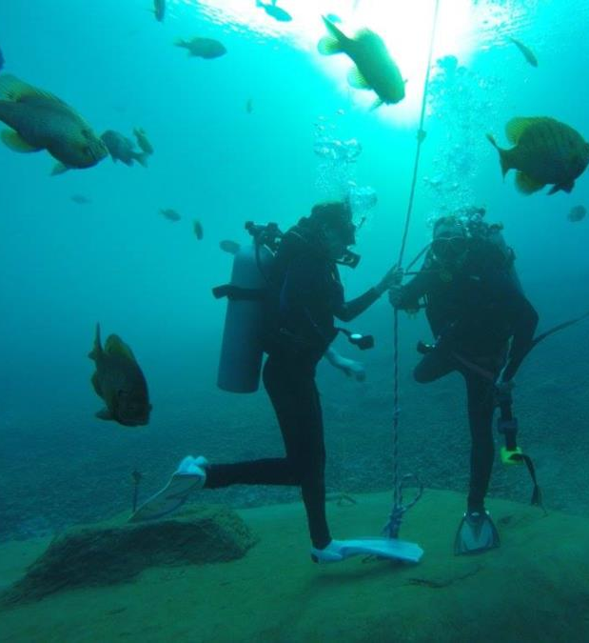
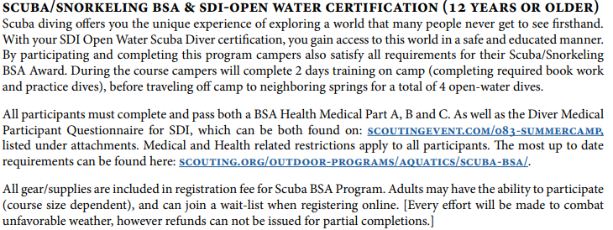
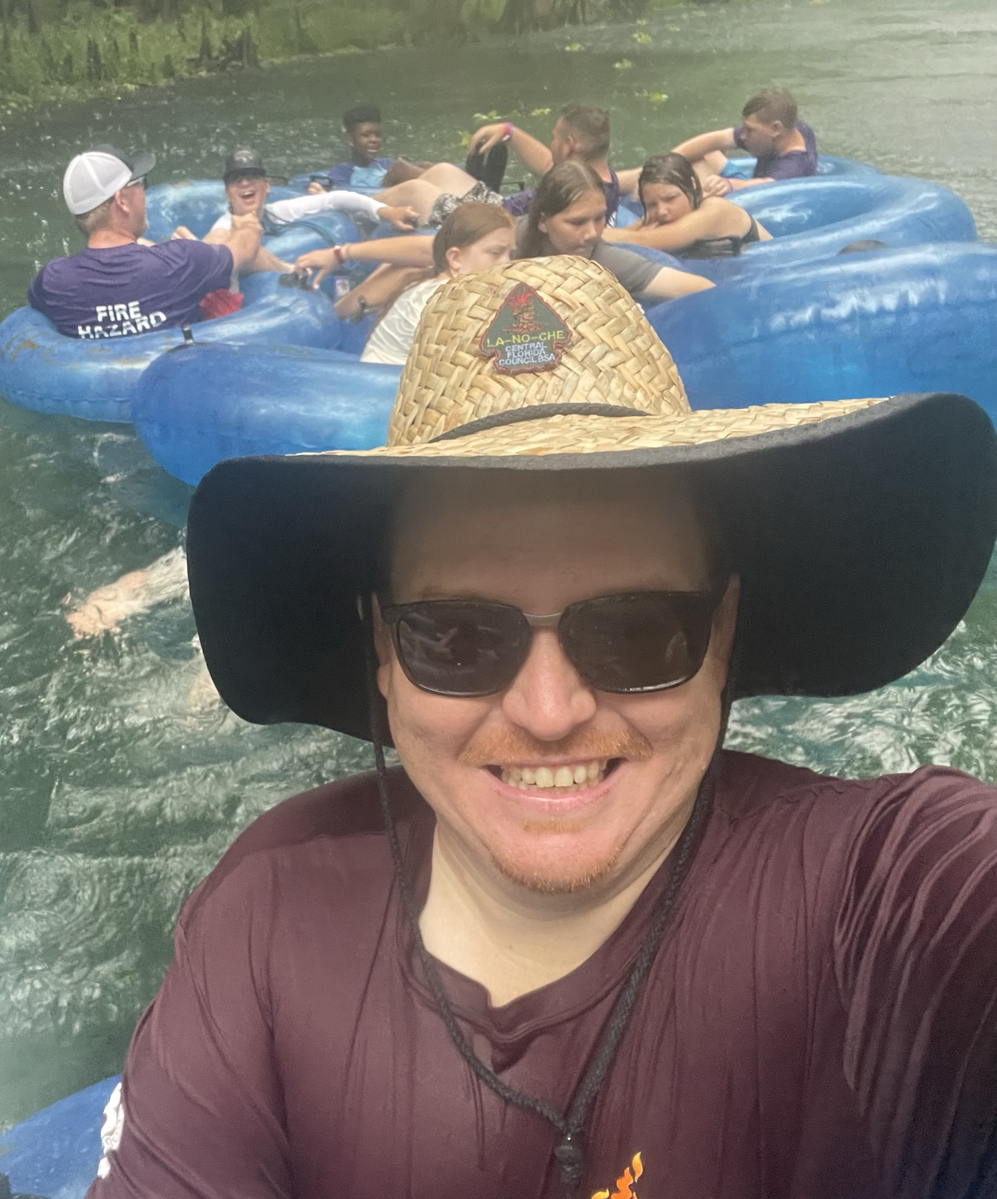

Slide 8
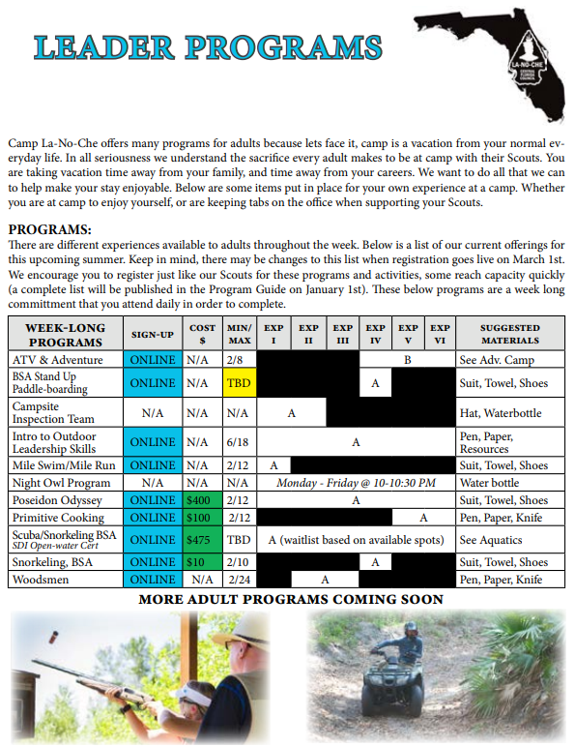
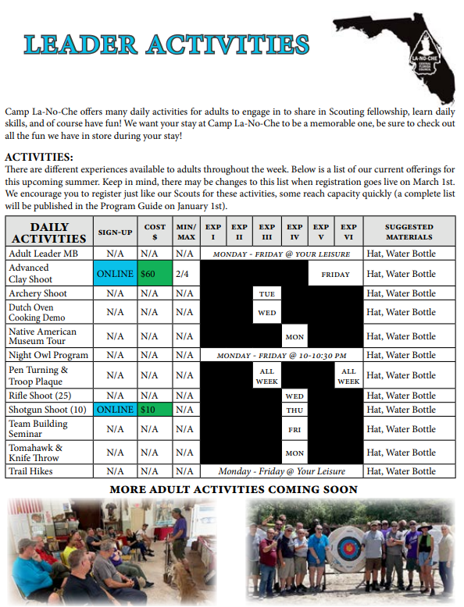

Slide 9
T-SHIRT CONCEPT: SUMMER CAMP 2024
?

Slide 11
scoutingevent.com\083-EAGLEWEEK

Slide 12
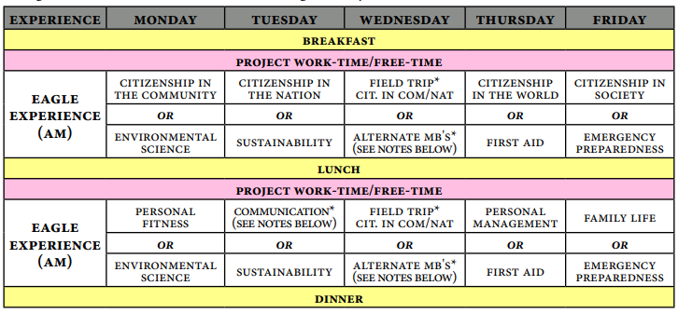
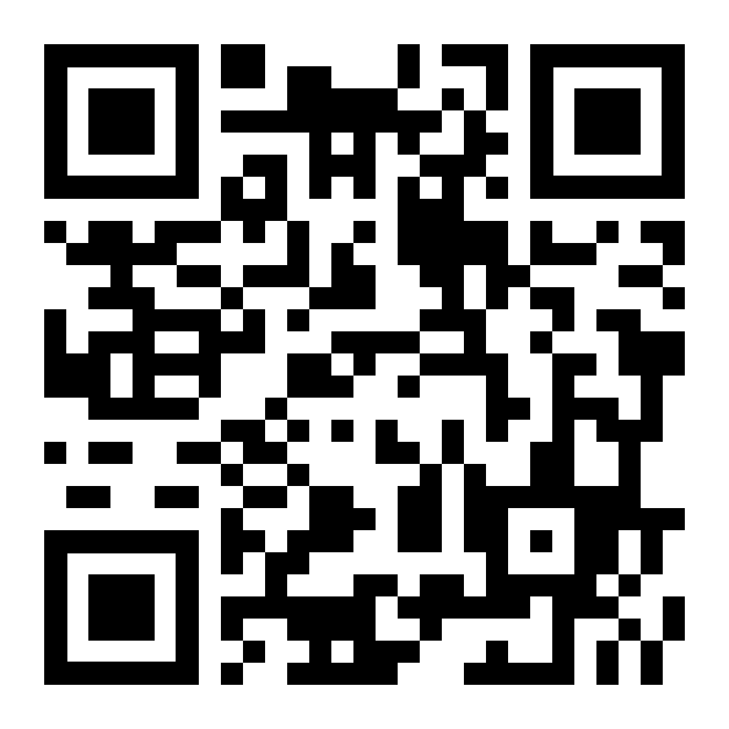
The Eagle Week Program is an intensive learning program conducted one week during the summer. Community Experts who are accomplished in the Merit Badges offered are brought to camp to conduct rigorous, but valuable instruction for Scouts working towards the rank of Eagle. Participants are housed in air-conditioned housing throughout their stay, and all courses are conducted in airconditioned environments at Camp La-No-Che.
Eagle Week is held at Camp La-No-Che during Summer Camp and is its own stand-alone program. Scouts attend as individuals and Troops are formed from all participants. Adult Staff members fill the roles of Scoutmaster and Assistant Scoutmaster during the week and provide supervision. Participants take Eagle Merit Badge programs of their choosing in the morning and afternoon, and in the evening are invited to engage in special Troop Time Activities arranged through various camp program areas including Adventure Camp, Aquatics, & Shooting Sports.
scoutingevent.com/083-EAGLEWEEK
EVENT INFORMATION
$350 Early Registration
(per youth) Provisional Only
[Limited Capacity]

Slide 13
scoutingevent.com/083-wintercamp

Slide 14
COURSES FOR 2024
scoutingevent.com/083-NYLTSUMMER
scoutingevent.com/083-nyltwinter

Slide 15
QUESTIONS RESIDENT CAMP?
camplanoche.com/scout-bsa-resident-camp/

Slide 16
COUNCIL CAMPING WEEKENDS
camplanoche.com/scouts-bsa-venturing-and-sea-scouts/

Slide 17
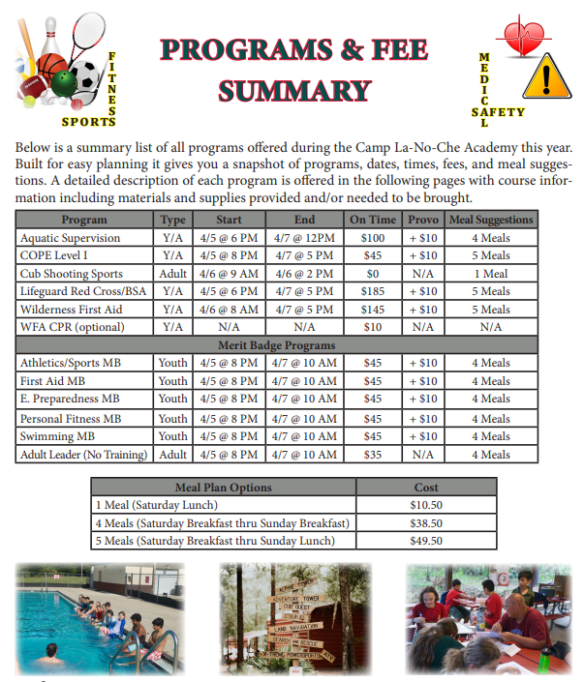
REGISTRATION OPEN
scoutingevent.com/083-Academy

Slide 18
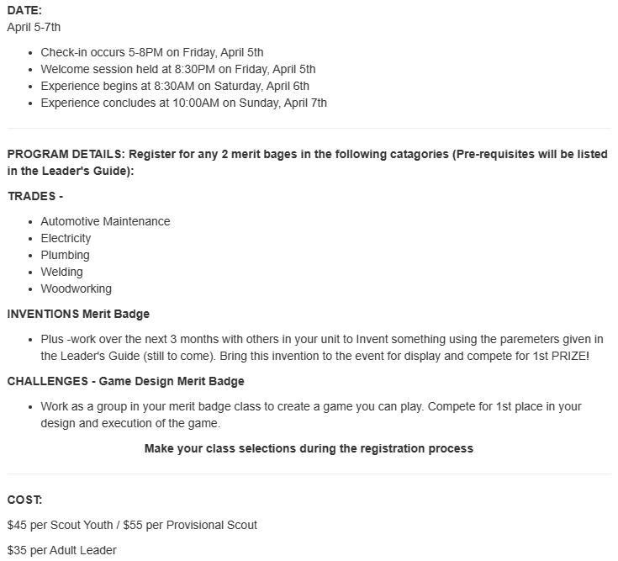
REGISTRATION OPEN
A Scouts BSA Weekend of Trades, Inventions & Challenges Looking for something different for your Troop, Ship or Crew to enjoy at Camp La-No-Che this Spring? Come and check out our Trades, Inventions and Challenges!
scoutingevent.com/083-Academy

Slide 19
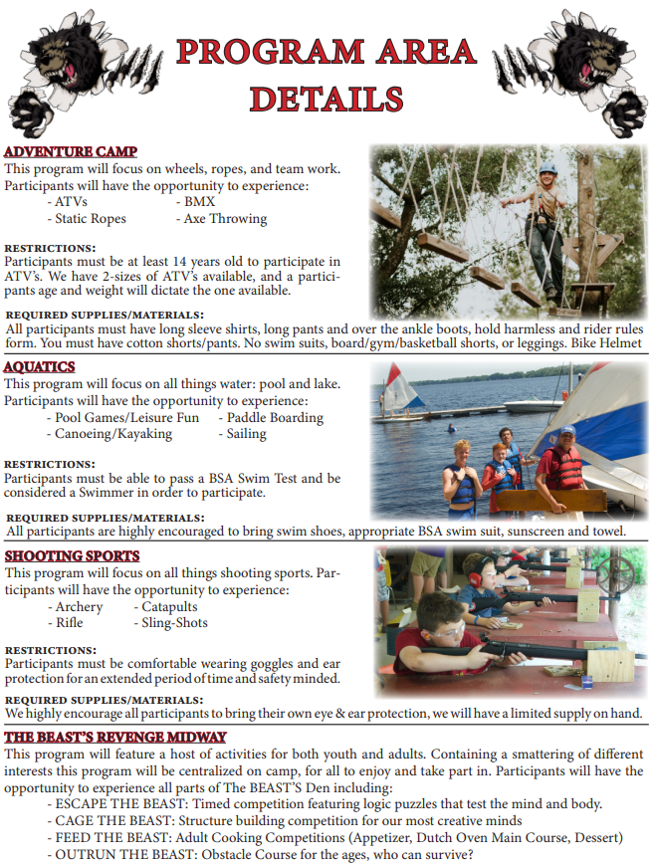
REGISTRATION OPEN
scoutingevent.com\083-Thebeast

Slide 20
REGISTRATION OPEN
scoutingevent.com\083-LNTSPRING
scoutingevent.com/083-LNTFALL

Slide 21
REGISTRATION OPEN
scoutingevent.com\083-LNTMASTER

Slide 22
SAVE THE DATE
camplanoche.com/scouts-bsa-venturing-and-sea-scouts/

Slide 23
QUESTIONS COUNCIL CAMPING WEEKENDS?
camplanoche.com/scouts-bsa-venturing-and-sea-scouts/

Slide 24
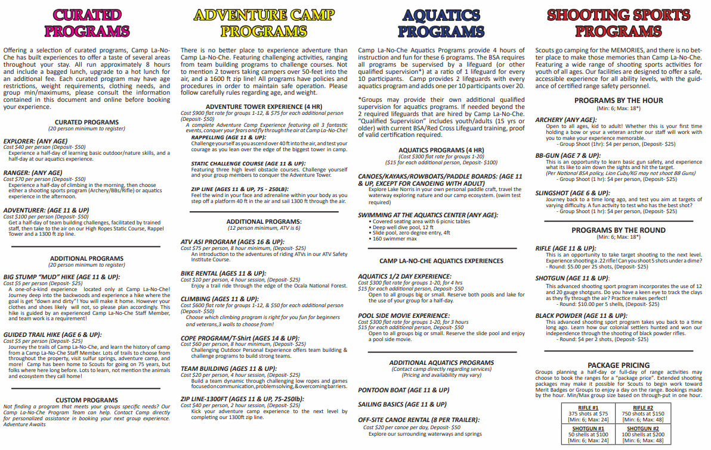
UNIT CAMPING
camplanoche.com/camp-resources/

Slide 25
SCOUT BSA/VENTURING BROCHURE
camplanoche.com/camp-resources/

Slide 26
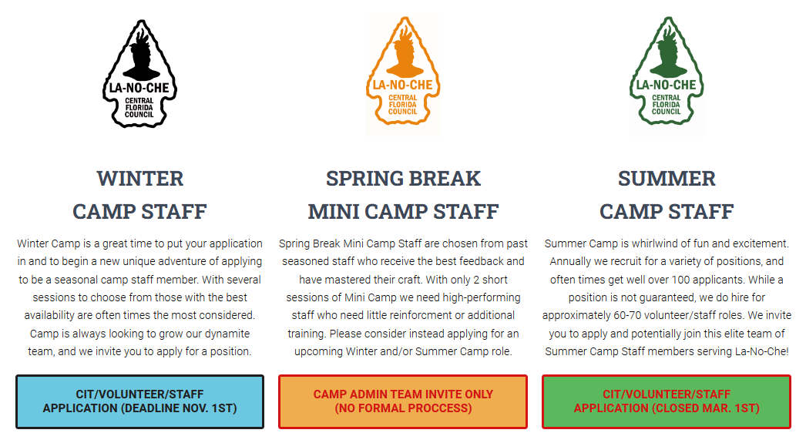
camplanoche.com/seasonal-camp-staff/

Slide 27
camplanoche.com/seasonal-camp-staff/

Slide 28
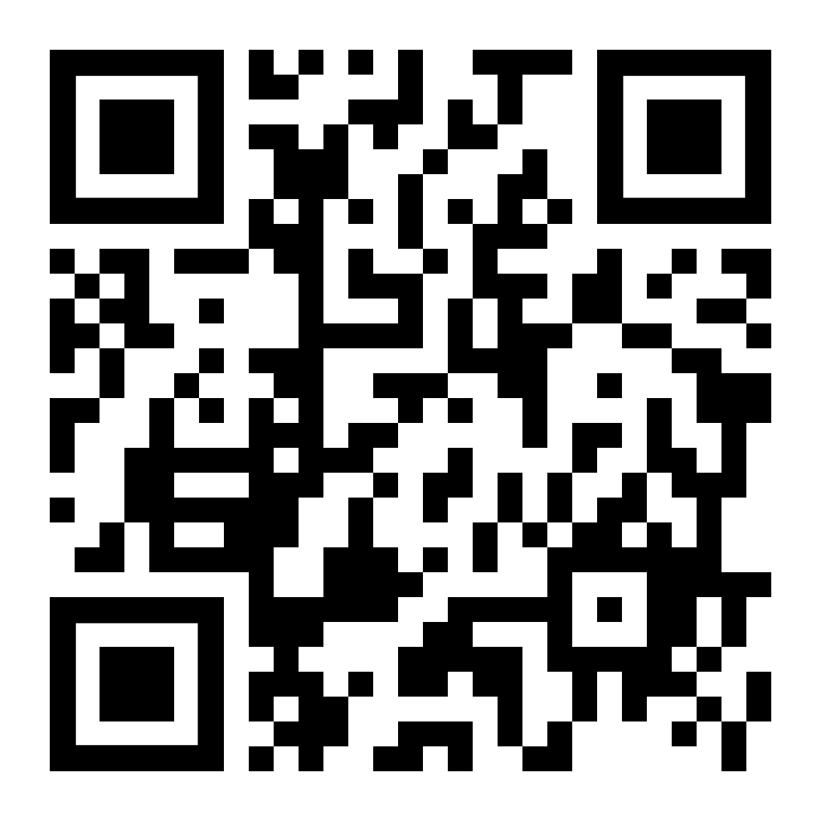
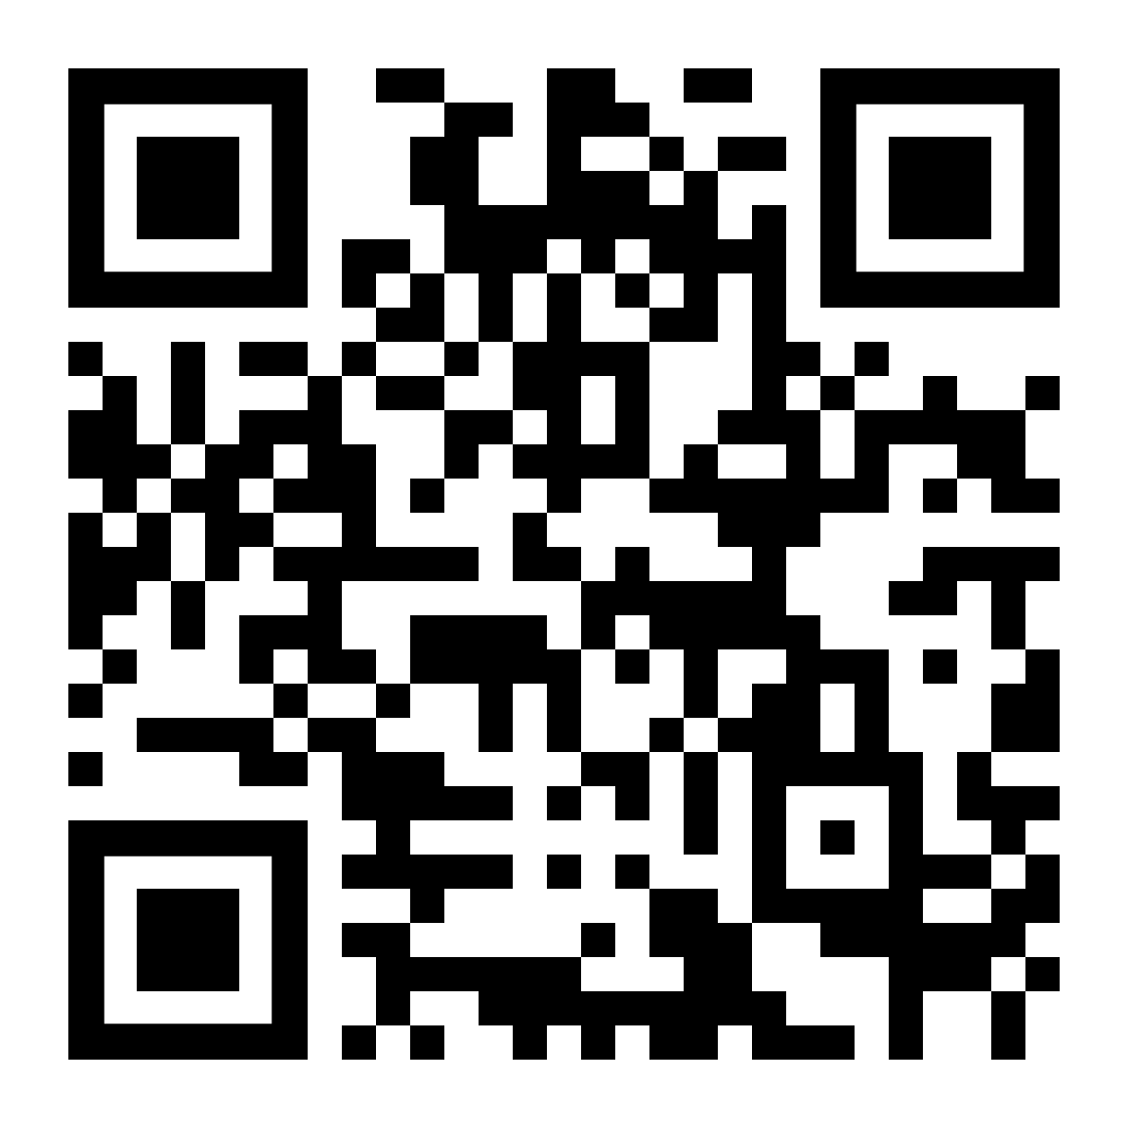

Slide 29
THANK YOU FOR JOINING US
TONIGHTS PPT SHOW
Mac Griffith
Council Program Director
MAC.GRIFFITH@CFLSCOUTING.ORG - 386-506-1853

