Slide 1
White Oak District WW 2016 Activity and Camping Plan

Slide 2
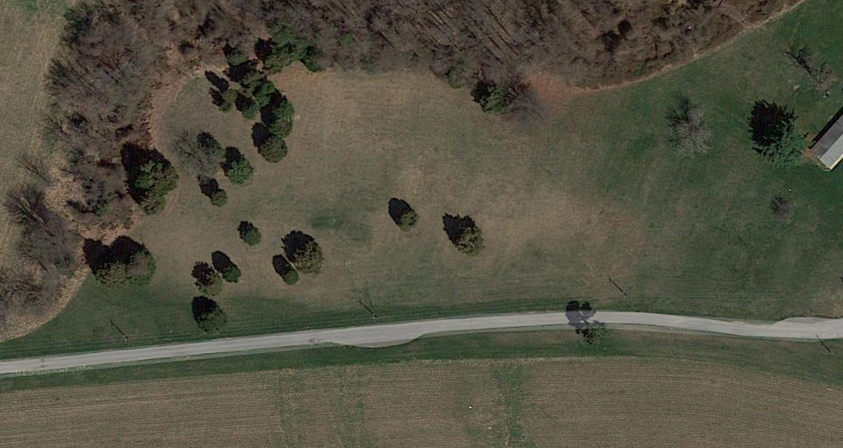
Webelos Weekend 2016 - Camp Bennett
Archery
20501 Georgia Ave.
Brookville, MD 20833
W II Activity Areas
W I Activity Areas
Water Spigot
Camping Area 4a
Camping Area 2a
Camping Area 3a
Camping Area 4b
Opening Ceremony
Lion Roar / Tiger Hunt
Bon Fire
Camping Area 2b
Camping Area 1
Camping Area 3b
HQ
Walkways
Please park perpendicular to road and leave north side clear until we get the Troop trailers into the site.

Slide 3
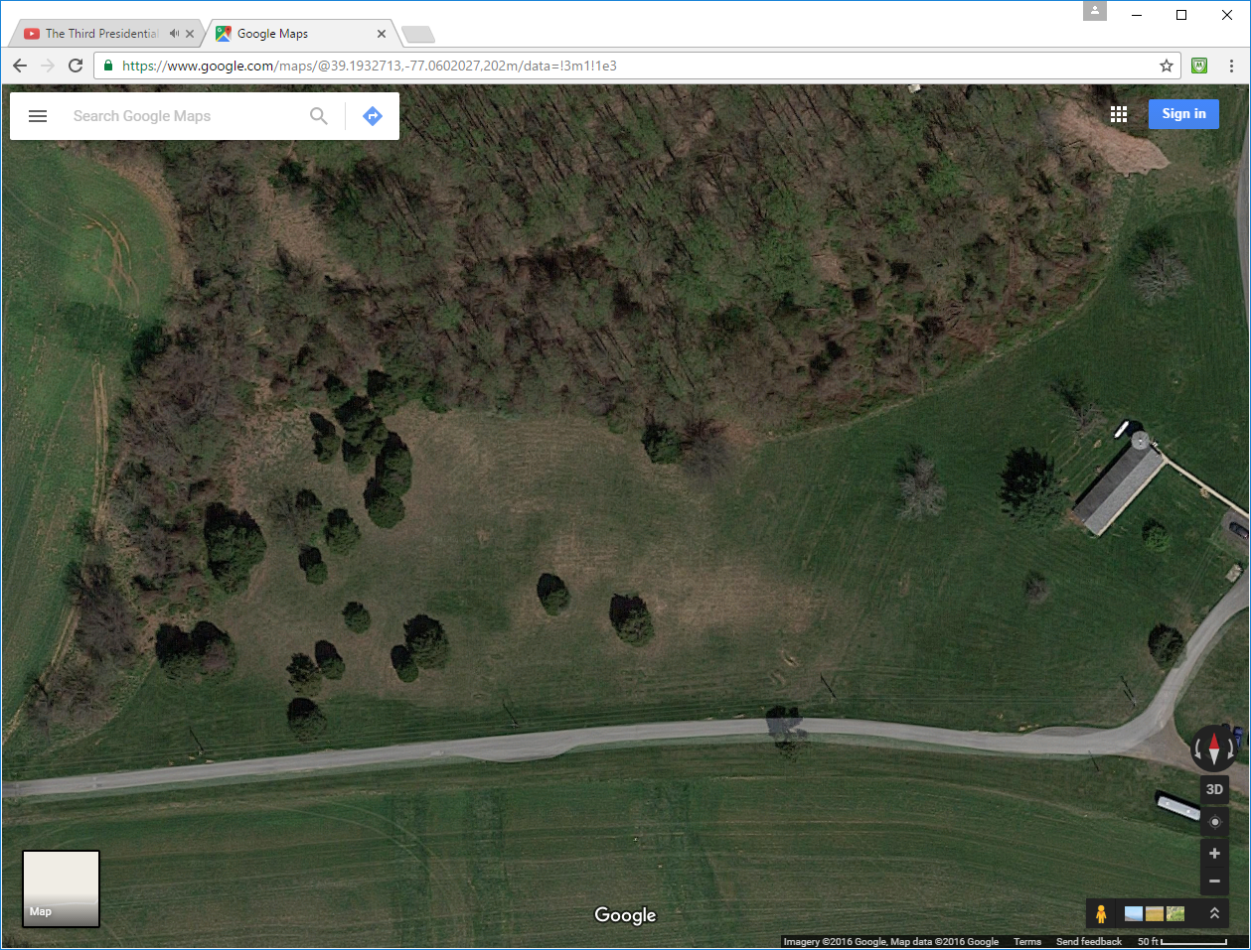
Webelos Weekend 2016 – Camping Plan
Archery
Hole & High Grass Area
Troop and
Pack 249 12 + 0
1
2
Water Spigot
Troop 96 7
Pack 96 27
Total 34
3
4
Pack 248 12
5
Troop 772 13
Pack 1072 13
Total 26
Troop 220 7
Troop & Pack 480
23
7
8
Troop 4316 9
9
Troop 1441 20
Pack 499 23
Total 43
Troop and Pack 763 8
Camp
Assembly
Area
Tiger Hunt
Lion Roar
Troop & Pack 264 41
Pack 1074 7 Pack 434 9
Total 57
Troop 1444 41
Pack 442 8 Pack 209 2
Total 51
Open spot if needed
Troop 433 40
Pack 64 6
Pack 178 0
Pack 250 9
Pack 774 16
Total 71
Troop AND Pack 440 18
Pack 275 14
Total 32
Troop and Pack 759 31
Troop and Pack 457 47
Troop and Pack 33 35
Troop 1071
11
HQ
Walkways

Slide 4
Webelos Weekend 2016 – Activity Areas
W I Activity Areas
W II Activity Areas
Archery
**
First Aid
Obst. Course
**
Fire Building
**
Knots
**
Fire Building
**
Cooking
First Aid
(trees)
Cooking
Knots
**
Totin’ Chip
Monkey Bridge
Model Campsite
** Competitions will be in both Webelos I and II Activity Areas

Slide 5
White Oak District WW 2015 Activity and Camping Plan
(for reference)

Slide 6
Webelos Weekend 2015 - Camp Bennett
Model Campsite (W Is & W IIs)
20501 Georgia Ave.
Brookville, MD 20833
Activity Area
HQ
Archery W IIs

Slide 7
Webelos Weekend 2015 – Camping Details
Troop 249 12
Troop 33 Pack 33
Pack 23 27
Troop & Pack 264 58
Pack 1074 6
Pack 434 18
Total 82
Troop 4316 8
Pack 1072 8
Total 16
Troop 1444 25
Pack 442 7
Total 32
TBD
Troop 763 10
Activity Area
Troop 433 25
Pack 64 6
Pack 178 12
Pack 250 22
774 14
Total 79
HQ
Troop 440 20
Pack 275 35
Total 55
Troop and Pack 96
31
Troop and Pack 457 60
Troop and Pack 759
31
Troop & Pack 480 21
Troop 1441 22
Pack 499 21
Total 43

Slide 8
Webelos Weekend 2015 – Activity Areas
Model Campsite
W1 & W2
Knots
W2 | W1
First Aid
W1 | W2
Totin’ Chip
W2
Fire Building
W1 | W2
Obstacle Course
W1
Monkey Bridge
W1
Cooking
W2 | W1
Archery
W2

